Slide 1
Ensuring an effective engineering HE provision for STEM engaged applicants from UTC Education
Dave Knapton
BSc(Hons), MIET, PGCHE, FHEA
Principal Lecturer - University of Sunderland

Slide 2
Context
Traditional A-level Education
BSc Product Design with Management
Industrial Automotive Design Experience
Consultancy Role – Digital Tools
HE Academic Delivery & Leadership
Me, introduction

Slide 3
Industrial Landscape
22k
Annual shortfall of graduate level engineering skills until 2024[1].
46%
Percentage of companies in latest IET survey reporting recruitment difficulties due to skill shortage[2].
[1] The State of Engineering, Engineering UK (2018)
[2] Skills and Demand in Industry Survey, IET (2017)

Slide 4
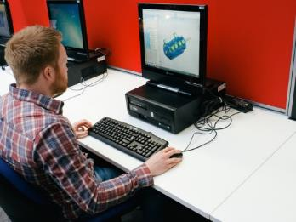
Motivation
Perkins Review of Engineering Skills (2013)
Observation of ‘Freshers’ and changing mind-set.

Slide 5
Educational Routes [3]
2013
Many routes to professional registration
High attrition rate
Great importance placed on professional registration
[3] Perkins Review of Engineering Skills, 2013

Slide 6
Educational Routes [3]
2018
Routes remain relevant
Degree Level Apprenticeships
University Technical Colleges
STEM Enrichment
2013
Many routes to professional registration
High Attrition Rate
Great importance placed on professional registration
[3] Perkins Review of Engineering Skills, 2013

Slide 7
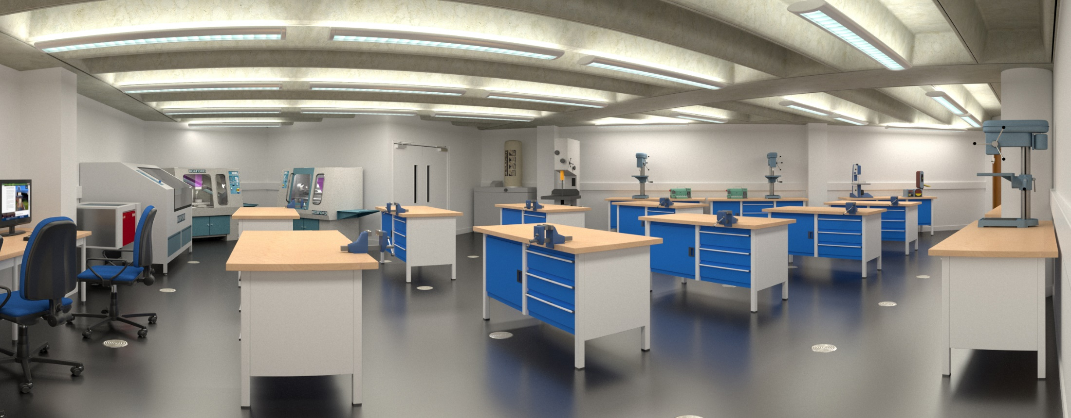
Millennial Expectations

Slide 8
STEM Enrichment

Slide 9
STEM Enrichment
51%
Percentage of 11-19 year olds who would consider a career in engineering [4]. Increased from 40% since 2013.
[4] The State of Engineering, Engineering UK (2017)

Slide 10
Pipeline Approach
GCSE
[Levels 1-2]
A-levels B-Tech Further Education
[Level 3]
Higher Education
[levels 4-6(7)]
Early Career Graduates
Professional Registration
Earlier Schooling

Slide 11
Pipeline Approach
GCSE
[Levels 1-2]
A-levels B-Tech Further Education
[Level 3]
Higher Education
[levels 4-6(7)]
Early Career Graduates
Professional Registration
Earlier Schooling
Focus of Research

Slide 12
University Technical Colleges
Immersed in technical specialism
Culture of applied learning
Almost half of 2017 leavers progressed to University [5]
UTCs have a varying focus
Changing numbers
[5] UTC Students – 2017 Destinations, UTC (2017)

Slide 13
Research
Understand differences in:
Culture
Experience
Expectations
Aspirations
20 Question Survey
Participants from UTC and other schools

Slide 14
Combined between all schools surveyed
Very little difference between UTC and NON-UTC schools

Slide 18
Findings
Passion for the subject is the most stated reason for 14-19 year old participants pursuing an engineering career.
This is common between UTC and Non-UTC students.
Confidence Varies between UTC and Non-UTC students.
Confidence appears to increase after a year of study within a UTC.

Slide 19
Further Work
Data shown is only a cross section of a single academic year. Data from subsequent years will be added to validate longitudinal observations by a comparison of the assessment of confidence from the same cohorts.
Assess the suitability of HE provision by interviews with employers and early career professionals.
Conduct Semi-Structured interviews to understand where passion is ignited; can this be extrapolated into HE pedagogic style?
Data will be gathered from a wider range of participants to understand if these trend can be generalised.

Slide 20
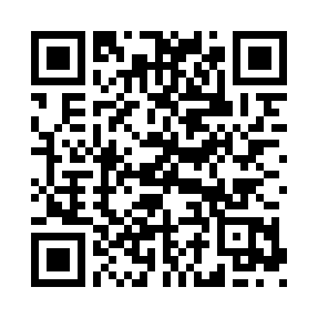
Thank You
Dave Knapton
Principal Lecturer - University of Sunderland
dave.knapton@sunderland.ac.uk

