Slide 1
“With a degree I’ll get a good job”.
A role for employers in UCAS decision making?
Dr Susan McGrath
5th International Conference on Employer Engagement in Education and Training
5-6th July 2018

Slide 2
Two questions…
How can we ensure that young people make informed decisions when choosing just 5 courses for their UCAS application form?
Is there a role for employer engagement in this process?

Slide 3
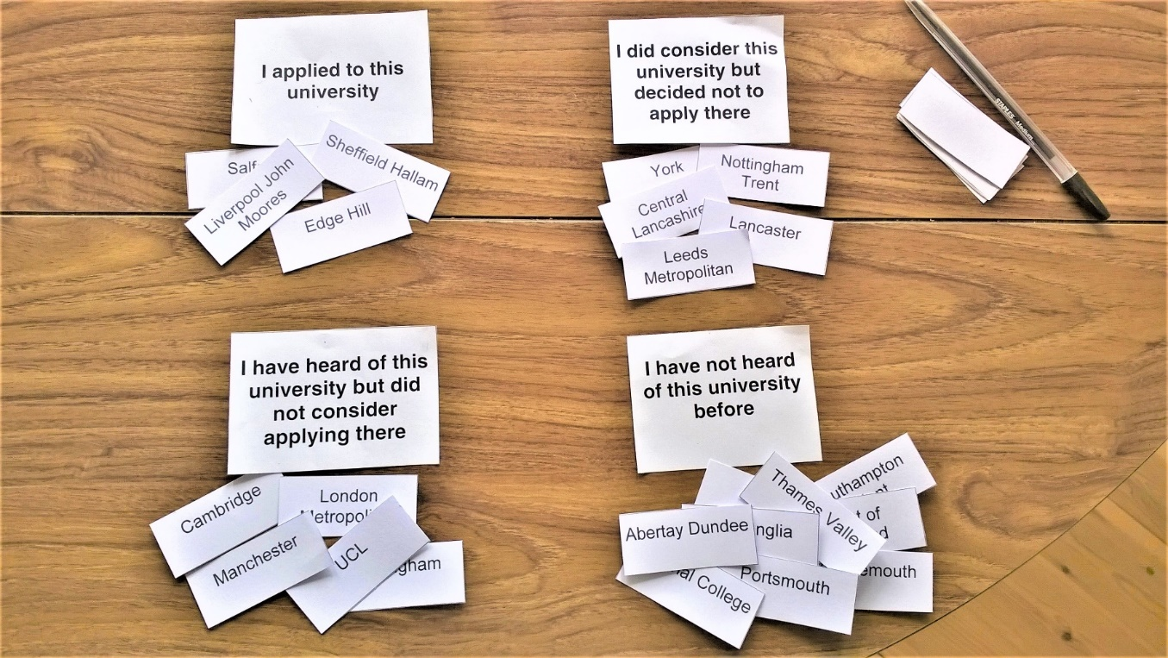
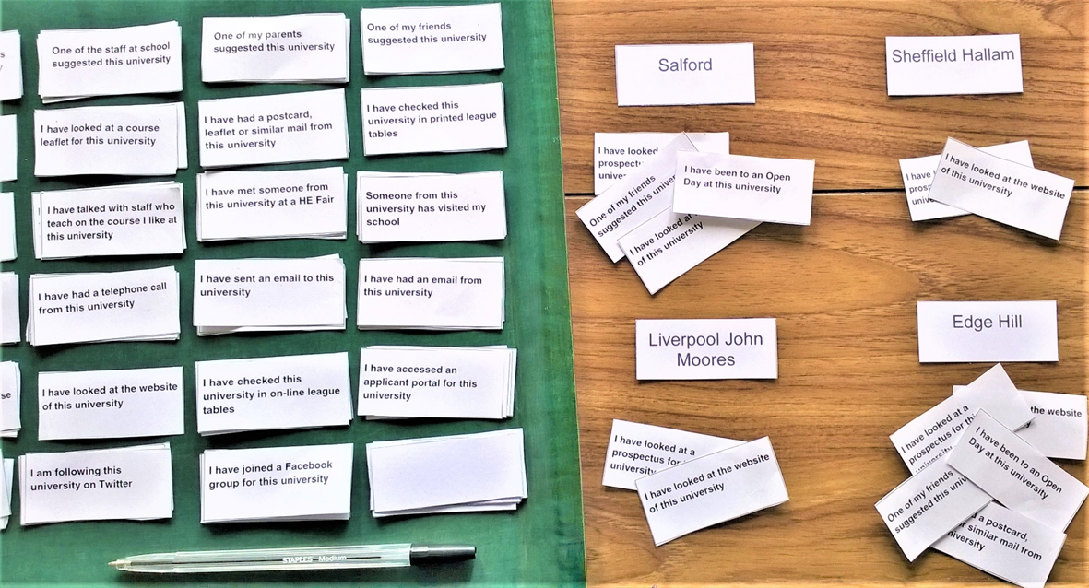
Methodology
Using a series of card-sort tasks within an interview format, six cohorts of Year 13 students (56 in total), described the decision making that underpinned their UCAS choices. The ‘numbers and narrative’ approach illustrated the roles of school or college, teachers and tutors, parents and friends, universities and UCAS.
Task 1: Knowledge of UK universities
Task 2: Sources of information used

Slide 4
The fieldwork centres and cohorts

Slide 5
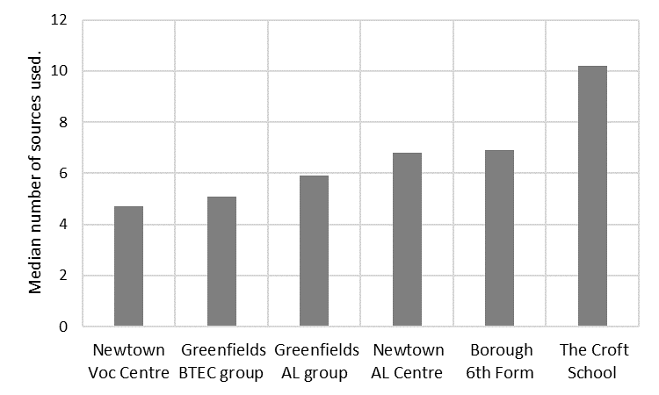
Fig 1: Number of sources used to research a university.
As the educational environment became more traditionally HE-oriented, a greater number of sources of information were used.
This was accompanied by an increased ability to use and evaluate sources, and to understand the difference between established facts and marketing materials.
Some students were unaware of the UCAS website, and many did not fully understand how it could be used to inform their decision making.

Slide 6
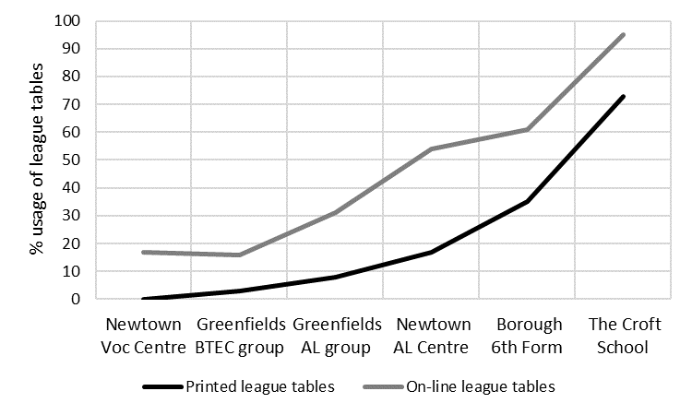
Fig 2: Percentage usage of league tables (printed and online).
There was a significant trend towards greater use of league tables in more traditionally HE-oriented environments.
Every student spoke of the desire to enter a ‘good’ university, but the concept of ‘good’ was determined by what they knew about the HE-sector.
A weak knowledge structure was linked to ‘hot’ reasoning and a micro-focussed approach reliant on family or friends. A strong knowledge structure was linked to ‘cold’ reasoning and a macro-focussed approach using objective data sources.

Slide 7
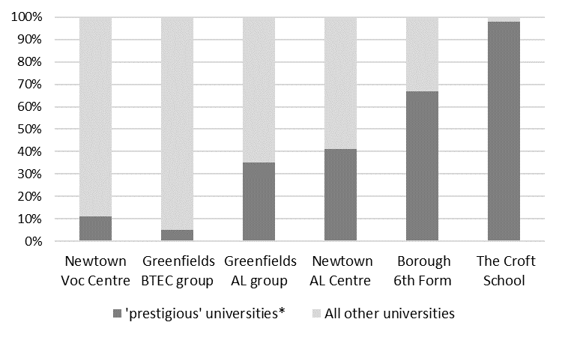
Fig 3: Percentage of applications to ‘prestigious’ universities*.
Patterns of application to ‘prestigious’ universities again showed a trend associated with the HE-orientation of the school or college.
Amongst the college students, some had applied to a Russell Group university because it was close to home, unaware that it differed in any way from their other university choices.
* ’prestigious’ universities defined by membership of the Russell Group or 1994 Group (the latter was dissolved in November 2013).

Slide 8
Employer engagement: part of the narrative…
None of the students included employer engagement in the card-sort tasks, but analysis of the narrative data revealed many references to work experience, and some to other forms of employer engagement.
At its best, this had the potential to provide a degree of insight that resulted in informed, joined-up thinking that located the UCAS process in the student’s overall career planning.
Three examples…

Slide 9
Example 1: Daniel, Greenfields BTEC group
“I set my mind on accounting and finance degrees just this year. I liked the accounting units on the BTEC and I think that teacher influenced me…accountants are always needed by business, even if there’s a slump. I’ve applied for the 4 year accounting and finance sandwich course at all 3 of my universities, so I’ll have experience as well as the qualification.”
Example 2: Danielle, Borough 6th Form
“I’d always liked the idea of accountancy, but my work experience was a very important factor for me…at Barclays I realised that a degree in accounting or finance is not necessary to become an accountant. The staff there encouraged me to think about taking economics as a route to accountancy…you get the professional qualifications as a trainee. At the start of Year 12 I decided on economics at university, and both of my teachers helped me with my choices and with writing the personal statement.”

Slide 10
Example 3: Louisa, The Croft School
“I had thought architecture at one stage but I did work experience for two years and it bombed…I didn’t like it…it was tedious and more about admin than design. I tried a big company and a small company and I didn’t like either. There was not enough ‘attachment’ to the building.
After I decided against architecture I was advised by the school to take part in the Engineering Education Scheme because of my subject interests (maths, further maths, physics and art). It was quite fun…I realised what engineering could do…and it made me research more. I spoke to both of the scheme teachers and my guidance tutor and they all said the same things, such as engineering courses are not keen on gap years. And they found out some things for me, for example, Bristol teaches some of the course with other classes… and it has a 98% chance of employment after the work experience.
I’m applying for general as I don’t know enough yet to specialise, but I think I want electronic…unless it turns out I’m poor at the computer elements.”

Slide 11
An emerging model of CEIAG that supports UCAS decision-making.

Slide 12
Two answers…?
UCAS planning and decision making should be an integral part of CEIAG across the upper secondary stage - it’s not just a hoop for Year 13s to jump through.
Employer engagement is crucial if UCAS decisions are to be fully informed.
Thank you for attending this session. If you have any comments or questions, I can be contacted at susan.mcgrath.14@ucl.ac.uk

