Slide 1
MEANINGFUL ENGLISH AND MATHS: PILOTING A CO-CREATED CURRICULUM
Alice Eardley and Alex Warner
July 2018

Slide 2
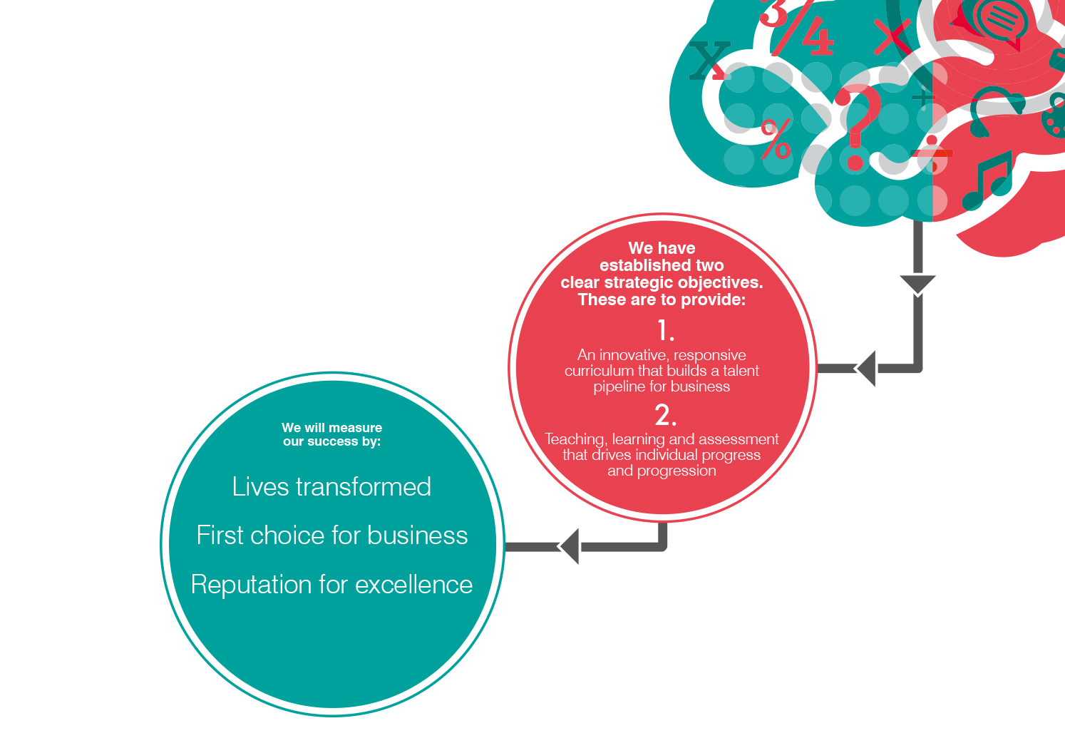

Slide 3
MEANINGFUL ENGLISH AND MATHS
OUR AIMS:
to boost student motivation and attainment in English and maths
to give students valuable contact with employers
OUR METHODS:
members of Activate Learning Technology Faculty worked with employers to design cross-curricular projects
projects last approximately six weeks with employer involvement at every stage of delivery
impact assessed with assistance from the Behavioural Insights Team

Slide 4
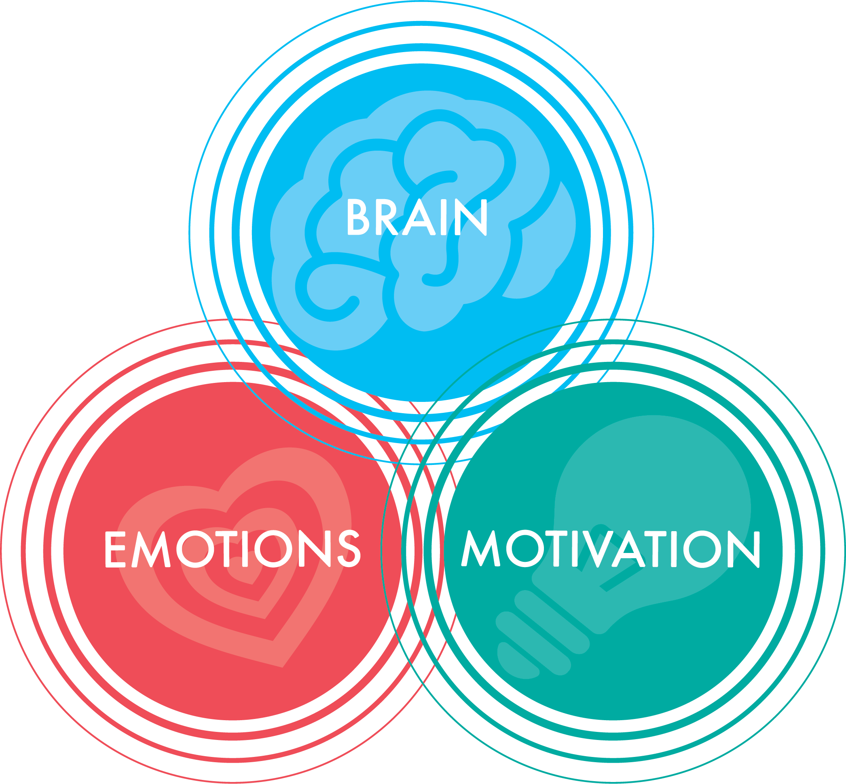
CONTEXT
BRAIN
Employers must play a leading role in the reformed technical education system, working with expert education professionals to define the skills, knowledge and behaviours required for skilled employment. Department for Business, Innovation, and Skills and the Department for Education. (2016). Post-16 Skills Plan.
English and maths are fundamental to young people’s education and employment prospects. Wolf, A. (2011). Review of Vocational Education: The Wolf Report.
MOTIVATION
Motivation and achievement in English and maths can be improved by making the subjects more relevant by using relevant contexts or embedding the subjects in wider learning. Education Endowment Foundation. (2016). Improving Level 2 English and Maths Outcomes for 16 to 18 Year Olds: Literature Review.
Students exposed to pro-social purposes for learning that go beyond their own personal benefits are more likely to persist with even the most boring of tasks. Yeager, D. S., Henderson, M. D., Paunesku, D., Walton, G. M., D’Mello, S., Spitzer, B. J., Duckworth, A. L. (2014). Boring But Important: A Self-Transcendent Purpose for Learning Fosters Academic Self-Regulation. Journal of Personality and Social Psychology, [online] 107 (4), 559-580.
EMOTION
Social mobility in the young is fostered by: access to a range of high-quality education institutions; good careers advice; frequent interactions with universities and employers; and labour market preparation during school, college or university. Social Mobility Commission. (2017). State of the Nation 2017: Social Mobility in Great Britain.
Project work should be focussed on students producing excellent work, through a structured process including redrafting, critique, and public display. Berger, R. (2003). An Ethic of Excellence: Building a Culture of Craftsmanship with Students.

Slide 5
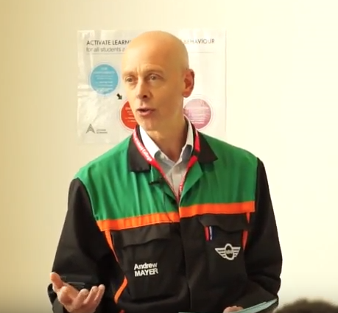
THE PROJECTS
2016/17: “Oxfordshire 2030” with Peter Brett Associates
2017/18: Five projects with Beard Construction, BMW MINI, Lee and Freeman Painting and Decorating, Peter Brett Associates, RES (Renewable Energy Systems)
PROCESS:
meetings with maths, English, and vocational tutors to link GCSE and vocational curricula to needs of employers
resources (specifically course booklets) developed by employers working with tutors
project introduced to students by employer (opening event)
ongoing employer support of students in lessons
grande finale: students presenting to employers who provide feedback, prizes, etc.

Slide 6
RESULTS
2017/2018:
Gap between English/maths and vocational attendance narrowed
58% (English) and 54% (maths) of students made at least one grade worth of progress in mock exams
36% (English) and 34% (maths) of students achieved a grade 4 or above (compared with 31% nationally for English and 25% nationally for maths last year)
2016/2017:
Attendance was up 5% on the previous year
76% of students who undertook the “Oxfordshire 2030” project made at least one grade worth of progress in iGCSE
62% secured a grade ‘C’ (compared with 44% across Activate Learning and 31% nationally)
Notes:
For the treatment group, the gap between maths attendance and vocational attendance was: 6.5% compared with 6.6 % for all students across Activate Learning
For the treatment group the gap between English attendance and vocational attendance was: 2.4% compared with 4.7% for all students across Activate Learning

Slide 7
RESPONSES TO
STUDENT SURVEY: POSITIVES
Post project, students in the treatment group were more likely than the control group to:
Report studying English and maths because they want to learn things that will help them have a positive impact on the world
Report feeling confident that they can identify employers relevant to their future careers
Report feeling confident that they can work towards their academic or career goal even when they get frustrated
Achieve a higher score on the meaningfulness of college work questions

Slide 8
RESPONSES TO
STUDENT SURVEY: NEGATIVES
Post project, students in the treatment group correspond with the control group in that they:
Report a decline in the amount of attention they pay in English and maths
Report being less likely to say that they are studying English and maths because achieving a grade C/4 will help them get a job
Report being less likely to consider that studying English and maths will give them the skills they need for future employment
Report a lower level of confidence when it comes to choosing a career or path of further study that will suit their interests
Report a lower level of confidence that they can accurately assess what they are good and less good at

Slide 9
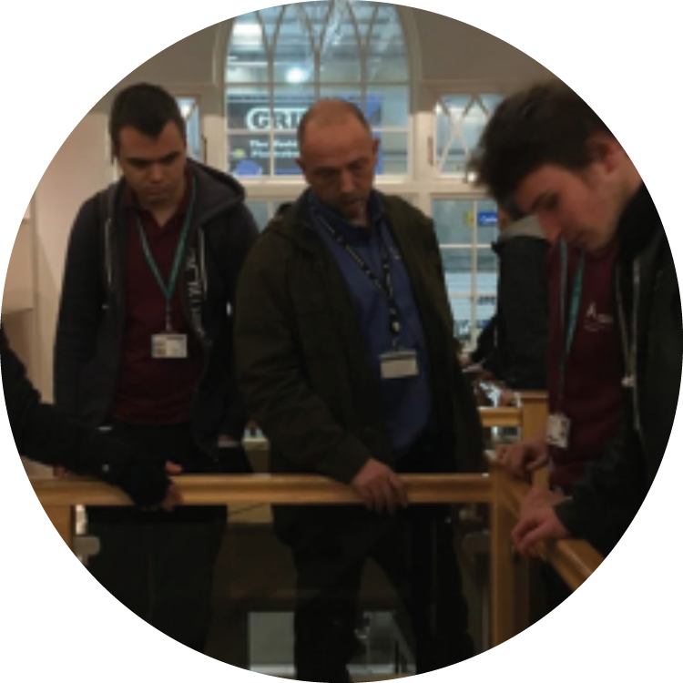
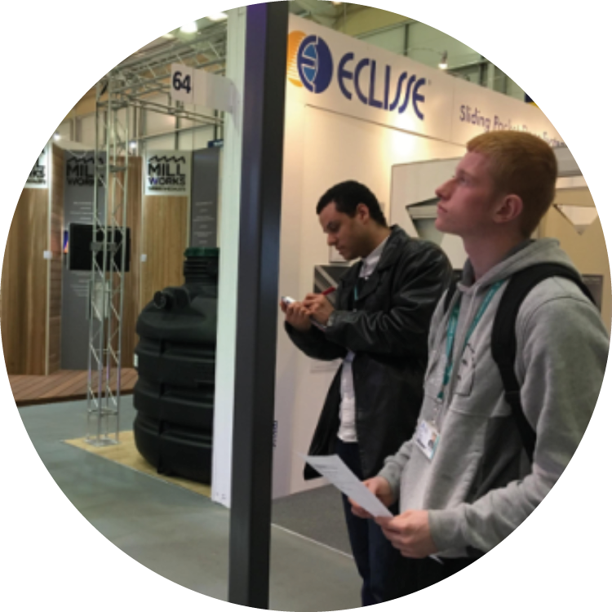
STUDENT VOICE
“I find it somewhat interesting”
“[I liked] working with Beard”
“it will help us in the future”
“it was interesting and more professional”
“knowing that employers were involved in this motivated us to work even harder”
“I found it to be a good challenge”
“[it would be better if] it was longer”
“[it would be better if] we went to the site”
[“[it would be better if] our work actually taught us some English skills”
“[it would be better if it was] more challenging”

Slide 10
SUSTAINABILITY AND DISSEMINATION
THE FUTURE:
Projects ongoing within the Technology Faculty at Activate Learning: model applied to vocational courses
Model being used as the basis for British-Council funded skills development partnership with Northern Cape Urban TVET college in Kimberley, South Africa
Application for Teach Too funding for Local Project involving OxLEP and Organisational project developing teacher training
Development of ‘How-To’ guide for supporting internal and external teachers
Model disseminated through work with other colleges (e.g., Coleg Gwent), through education journals and publications, and through presentations at conferences and teachmeets

Slide 11
REFERENCES
Collins, J. and Barnes, A. (2017). Careers in the Curriculum. What works? [online] London: The Careers & Enterprise Company.
Denoël, E., Dorn, E., Goodman, A., Hiltunen, J., Krawitz, M., and Mourshed, M. (2017). Drivers of Student Performance: Insights from Europe. [online] London: McKinsey and Company.
Education Endowment Foundation. (2016). Improving Level 2 English and Maths Outcomes for 16 to 18 Year Olds: Literature Review.
Gatsby Foundation, Good Career Guidance. (2014). [online] London.
Hanson, J., and Lucas, B. (2016) Learning to be employable: Practical lessons from research into developing character. [online] London: City and Guilds.
Mann, A. (2012). It’s Who You Meet: Why Employer Contacts at School Make a Difference to the Employment Prospects of Young Adults. [online] London: Education and Employers.
Mann, A., Stanley, J. and Archer, L. (Eds.) (2014) Understanding Employer Engagement in Education: Theories and Evidence. London: Routledge.
Mann, A., Kashefpakdel, E.T, Rehill, J. and Huddleston, P. (2017) Contemporary Transitions Young Britons Reflect on Life After Secondary School and College. [online] London: Education and Employers.
Mann, A., Rehill, J., Kashefpakdel E.T. (2018). Employer Engagement in Education: Insights from International Evidence for Effective Practice and Future Research. [online] London: Education and Employers.
McLoughlin, F. (2014). CAVTL: One Year Review. London: CAVTL.
Yeager, D. S., Henderson, M. D., Paunesku, D., Walton, G. M., D’Mello, S., Spitzer, B. J., Duckworth, A. L. (2014). Boring But Important: A Self-Transcendent Purpose for Learning Fosters Academic Self-Regulation. Journal of Personality and Social Psychology, [online] 107 (4), 559-580.

Slide 12
WHY WE WORK WITH EMPLOYERS

Slide 14
