Slide 1



Developing a new model for employability
An action research project
July 2018

Slide 2

The issue
Labour market:
Complex, competitive, changing rapidly
Young people:
Academic success is not enough
  Understand how the labour market works
  Develop skills they know people will pay for
  Sell themselves to potential employers
  Learn from rejection
  Adapt and apply their knowledge and skills

Slide 3
Employability valued but not well understood
Employers
Willing to play their
part …but need help with how to add value
Teachers
Recognise the value
employers bring
…but need help
to understand
employers needs
Young people
Know the importance
of employability
…but struggle
to articulate their experiences / skills
A simple, memorable and coherent framework

Slide 4







We started with the existing evidence
  UK Commission for
  Employment & Skills
  [now defunct]
  Education & Employers
  Taskforce research library
  & seminars
  CBI research and policy papers
  Education Policy Institute
  /Pearson research
  OECD analysis
  EdComs’ client projects
  & research

Slide 5
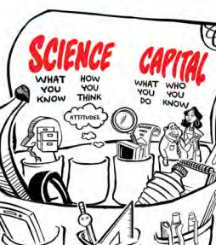
Inspired by research on ‘Science Capital’
  Science capital is a concept to help us understand why some young people participate in post-16 science and others do not.
  The research identified eight dimensions of science capital that together comprise what you know, how you think, who you know, and what you do.
  Ensures a comprehensive and person-centred approach

Slide 6
Our Employability Capital framework
Navigation
Skills
“I know how to find out about work”
“I have the skills employers want”
Reflecting
“I understand why an employer might value me”
Practice
Networking
“I can experience what being at work is like”
“I can get ideas from different people”

Slide 7
Our action research project
Working with School 21
A school that puts employability at the
heart of learning
Project based
learning approach
High levels of
employer involvement
Committed to helping us refine the framework
And develop useful tools
For teachers and young people
Planning
Reflecting
Acting
Observing

Slide 8
Started with an audit of School 21 activity to identify opportunities and gaps
Navigation
Skills
Networking
Practice
Reflection
1:1 interviews
Research sessions
Project based learning
Vivas
‘Big topics’
Experts
Visits
Q&As
Real-World Learning Programme
Coaching
Well-being curriculum
Current
Use experts across more elements
Collaborate with other schools
Make more links to work across subjects
Contextualise the skills they are using
Give more informal feedback on skills
Help students “turn rich experiences into talk”
Opportunities
Articulating the skills and other assets they have
Creating a broader sense of the possible
Understanding the steps required
Imagining the future of work
Overcoming traditional expectations
e.g. cultural / family / school
Gaps

Slide 9
Conducted a teacher workshop
to understand how the framework might help
Framework prompted thinking about:
How to do more to support all elements
e.g. provide informal feedback on their skills
How to exploit existing activities more
e.g. employer-led projects around skills can also be a networking opportunity
How to help the
students ‘own’ their Employability Capital
Develop awareness
Seize opportunities
Build sense of self
Articulate their
experiences and skills
The need for more reflection

Slide 10
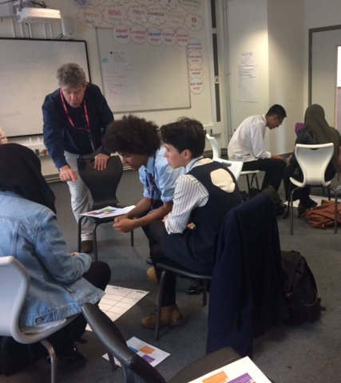
A ‘Reflection’ session
for students
  Aim: To help students reflect more deeply about their experiences, their preferences and their skills
  To help students articulate what they have learnt
  Facilitated workshop for Y9 and Y12
  Covering
  Experiences, self perception, preferences, actions
Notes:
Experiences
What have they done?
Self perception
How do they see others? How do others see them?
Preferences
What do they love doing? What are their strengths? What might that mean for the future?
Actions
What steps might they take now to find out more about future options?

Slide 11
Students found the Reflection session valuable
“I learnt that people observe you in ways that you may not think.”
Year 12
“Lots of time to reflect on ourselves and our future, which is a good and useful thing.”
Year 9
“Loved the self-reflection because it allowed me to submerge into my interests.”
Year 12
“It made me realise and open up to things and find out what others thought of me.”
Year 9
“I really liked the different activities and how on the surface they seemed simple, but had a deeper meaning to help me figure out what I want to do in the future.”
Year 12

Slide 12
It gave students momentum
Year 9
Year 12
Agree
Not sure
Disagree

Slide 13
Teachers saw value in the framework
Good resource to develop a whole school careers strategy
Allows you to assess and audit your offer and identify gaps
Teachers don’t do enough reflecting and articulating around employability
What is the impact of the provision we offer students?
Teachers want more support to take forward into the classroom
More directed questions ‘How does
your subject…’
“It’s a great stimulus for reflection of what we do and how we do it.”
Teacher, School 21

Slide 14
What have we learnt so far?
The framework is proving a useful tool to help us think about employability in the round, to fill gaps and make more of opportunities
Each element gives a different but equally important perspective
It works for teachers, employers and young people
Reflection: particularly the quality of reflection – appears to be the weakest link currently
And have the greatest potential for empowering young people to consider their next steps

Slide 15

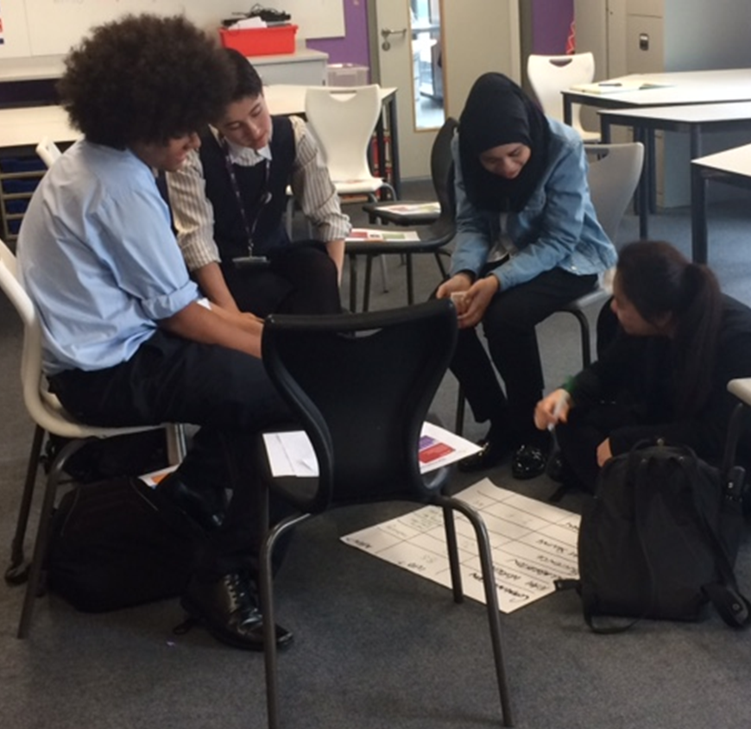
Next steps
Further testing and refinement, working with School 21
Potential to develop
‘Product’ for teachers / schools to use
Audit tool for client programmes
Reflection module to enhance existing activity

