Slide 1
Pupil Engagement: A collaborative employer experience
Bethany Fovargue
Operations Manager, NOVUS

Slide 2
What is NOVUS?
Applied, industry-relevant education
Part of the Chartered Institute of Logistics and Transport (CILT) family
“Not for profit”
Established in 2012
Sponsored by industry parties
Partnered with the Universities of Huddersfield (2012), Aston (2017) and Derby (early 2018) and Hull (mid-2018)

Slide 3
Supply Chain Talent Shortage
25%-33% of the supply chain workforce is at or beyond retirement age (DHL 2015)
Jobs in logistics are estimated to grow by 26% between 2010 and 2020 (US Bureau of Labor Statistics)
Millennials make up 25%-50% of some current workforces (EFT, 2016)
Millennials will make up 75% of the workforce by 2025 (EFT, 2016)
Demand for supply chain professionals exceeds supply by a ration of 6:1 (DHL, 2015)
Shortage at middle-management level (54%) compared to entry level (26%) and executive level (9%) (Supply Chain Insights, 2014)

Slide 4
A Collaborative Approach
Sponsored by 26 companies, at a cost of £5,000, who provide:
Mentoring
Industry seminars and site visits
Optional paid summer work experience
Guaranteed and paid industrial placements in the third year
At least one graduate vacancy per year – the NOVUS guaranteed job

Slide 5
The NOVUS Courses
Business with Supply Chain Management BA (Hons) (Huddersfield)
Logistics and Supply Chain Management BSc (Hons) (Huddersfield)
Business and Supply Chain Management BSc (Hons) (Aston)
Year 1: Business content
Year 2: Industry knowledge – plan, source, (make), deliver
Year 3: Industrial placement
Year 4: Leadership, strategy and modelling, and dissertation
NOVUS Lite (Hull and Derby) provides NOVUS benefits aside from guaranteed employment
Replicable at other quality institutions

Slide 6
Why NOVUS? Student Proposition
Improves your employability
Develops your links with industry and with specific businesses
Demonstrates your commitment to your career and accelerates development
Provides opportunities for real-world learning, making you “work ready”

Slide 7
Encouraging Pupil Engagement
Emotional
Passion for sector
Sense of charity
Personal connection
Locality
Friend or family
Alumni
Commercial
Local recruitment needs
Marketing and PR
Change perceptions
CSR targets
Networking

Slide 8
Objectives
Sharpen our focus
Provide clarity of process
Harness the volunteer effort
Ensure we measure our achievements
Stand together to promote the profession!

Slide 9
What We Heard…
In order to facilitate pupil engagement, we need to share:
Why? Clear objectives
What? Clear agenda
Who? Clear target audience
Where? Defined location
When? Defined time
How? Tracked and traced

Slide 10
Working with partners
Virtual and in person offering
Career insight talks (1 hour)
Tracking and tracing
Profession specific
Half day workshops
Networking opportunity
Regional events (1 day)
Large footfall (1,000+)
Partnering to create logistics-focused areas

Slide 11
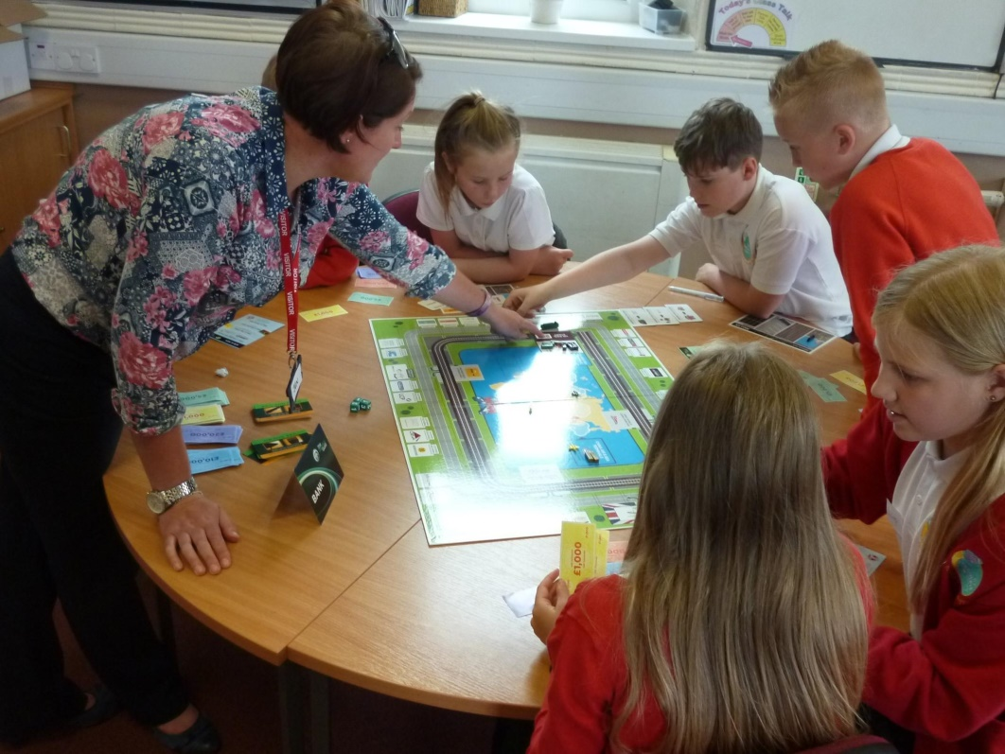
Outcomes
“The Clipper Challenge! A couple of weeks ago myself and some of our graduates and placement students attended a large primary school in West Yorkshire to talk to the students about the world of logistics - we did this with a fantastic game called 'Business on the Move‘, which Clipper proudly sponsors. To say this was a challenging but exceptionally rewarding day is an understatement and we left some very excited children knowing an awful lot more about logistics than when we started. We have now seen over 100 children from several schools using this game and we plan to expand this further, by challenging all of our graduates, placement students and apprentices to reach out to more schools.”
Jennifer Guy, Head of Learning and Development, Clipper Logistics

Slide 12
On-going Challenges
Perception of the profession
Lack of curriculum focus
Demographic of willing volunteers
Changing needs of employers
Centralisation and standardisation

Slide 13
To find out more…
Web: www.novus.uk.com
Twitter: @novustrust
Facebook: The Novus Trust
Email:
bethany.fovargue@ciltuk.org.uk
Bethany Fovargue, Operations Manager

