Slide 1
Some international developments in apprenticeship: Current issues of concern
Professor Erica Smith,
Co-Chair INAP: International Network on Innovative Apprenticeship
5th International Conference on Employer Engagement and Training, London, 2018

Slide 2
What is an apprenticeship?
May include some or all of these features:
A lengthy period of learning e.g. 3 years;
An employment contract;
A combination of on and off the job (i.e. college-based) learning; theoretical and practical learning;
A qualification gained through college, at sub-degree level;
Restricted to designated occupations;
Overseen by governments.
Recent comparative studies show great differences among countries: Chankseliani, Keep & Wilde (2017); Fazio, Fernández-Coto & Ripani (2016); and Smith & Brennan Kemmis (2013)

Slide 3
Examples of variability (Smith, Brennan Kemmis et al)

Slide 4
What do apprenticeships mean to people? (and young people’s parents)?
Learning from an experienced worker;
Enculturation into an occupation;
A passage into adulthood;
A ‘ticket’ for earning a living throughout life.

Slide 5
WHY do governments encourage apprenticeship?
Aid ‘school to full-time-work’ transition;
Assist with labour force participation for disadvantaged groups;
Help people climb qualification ladders;
Provide a supply of skilled workers;
Gain engagement of industry/employers and trade unions in the education system.

Slide 6
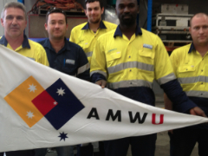
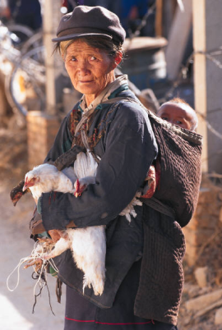
Societal expectations
Apprentices
Countries: Solve youth unemployment
Countries: Address youth disengagement
Help women and workers in the informal economy
Trade unions: Improve working conditions through apprenticeships
Parents: Get children into a secure job.

Slide 7
Economic expectations
Apprentices
Companies: A well trained workforce
Companies: Develop future managers
Countries: International Competitiveness
Companies: Improve productivity and profits

Slide 8
Some (old) questions for the future (1) (2011 – my National Apprenticeship Service presentation)
If apprenticeships are locally-rooted what are the effects of globalisation?
How do, and should, countries decide between investment in apprenticeships and in higher (university) education?
(linked to the above) How can pathways from apprenticeship to higher education be forged with due regard for differences in pedagogy?
How can apprenticeships avoid widening the gap between ‘haves’ and ‘have nots’? (recruitment, completion)
How can apprenticeships survive periods of recession?
How can apprenticeship systems continue to reconcile the interests of different stakeholders?
How can an occupation-based system reconcile with increasingly flexible careers?

Slide 9
Some (new) issues for the future (2) (2018)
Perennial questions
New questions
Youth unemployment;
Socio-economic disadvantage;
Gender inequalities;
The attractiveness of apprenticeships to young people vis a vis higher education.
‘Industry 4.0’;
Structural adjustment to economies including ‘leapfrogging’ in developing countries;
Globalisation of companies;
Global labour movements – voluntary and involuntary;
Gig economy.

Slide 10
My recent research (Colour-coded for old or new issues)
2018, Smith, E. Australian component of ‘Tools for quality apprenticeships’, Skills that Work project, International Labour Organization, Geneva office.
2017-18, Smith, E. Tuck, J. & Chatani, K. ILO survey report of national initiatives to promote quality apprenticeships in G20 countries. International Labour Organization, Geneva office.
2017, Smith, E. Research, Review and Development of a Revised Model of Quality Apprenticeship for Indonesia. International Labour Organization, Jakarta office.
2012-13, Smith, E., Brennan Kemmis, R. and a team of international researchers. Possible futures for the Indian apprenticeship system. International Labour Organisation and World Bank, New Delhi offices.
2009-10, Smith, E. et al, Understanding the psychological contract in apprenticeships/traineeships to improve retention, NCVER, Australia

Slide 11
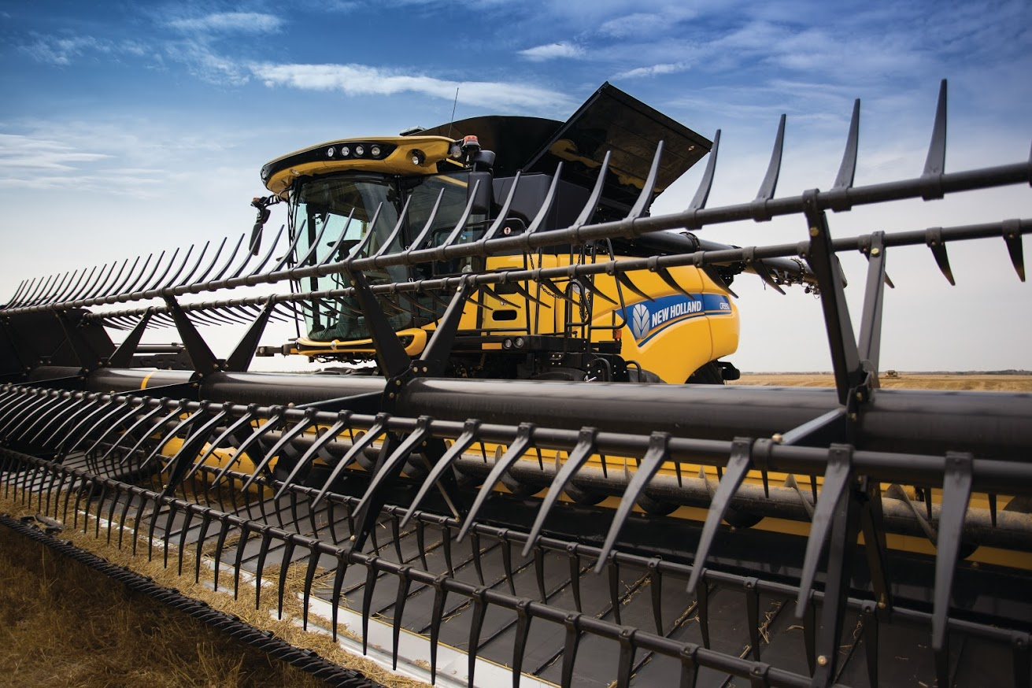
‘Industry 4.0’: Gason engineering, Western Victoria

Slide 12
Structural adjustment to economies
Largest industries
Health and community care
Retail
Construction

Slide 13
Structural adjustment to economies
Priority areas for apprenticeships
Tourism
Manufacturing
Banking
Fisheries (new to apprenticeships)
Retail

Slide 14
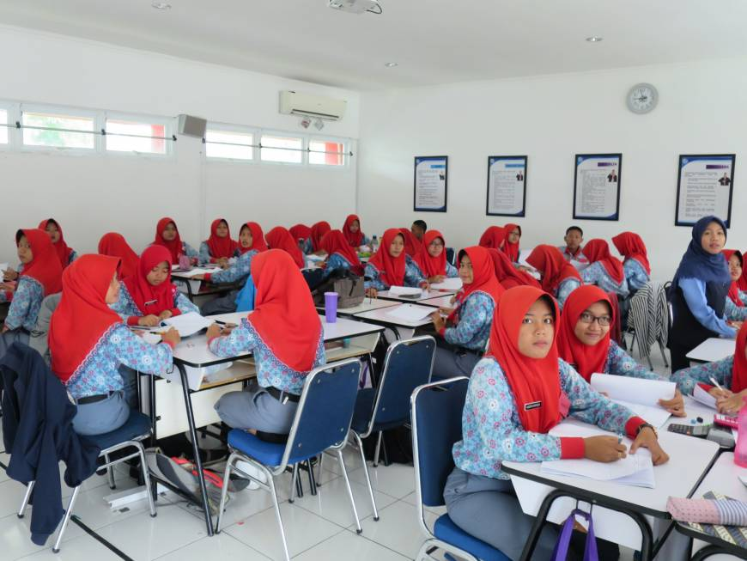
Globalisation of companies: MM2100 Industrial Park High School, near Jakarta

Slide 15
Voluntary and involuntary labour movements
‘Receiving’ countries (Responses to G20 survey)
Germany: “Welcome mentors” programme pursues the economic policy goal of supporting SMEs in securing a supply of skilled workers. At the same time, welcome mentors support the wider social task of integrating refugees into the German employment market.”
‘Integration law’: apprentices on temporary residence permits can’t be deported during, or for two years after, their term.
Three of four businesses surveyed by the DIHK in 2016 said they were willing to offer apprenticeships to recently arrived refugees, provided the refugees had gained adequate German language skills and had appropriate residency permits.
Mexico has a special scheme for ‘Dreamers’ - ex-‘DACA’ young people returning from the USA.

Slide 16
‘Exporting’ and ‘resisting’ countries
Labour ‘exporting’ countries: Both India and Indonesia factor into their apprenticeship systems the preparation of people to work overseas.
Naughty country: Australia will not allow migrants or refugees to undertake apprenticeships. It is funding a re-expansion of the apprenticeship system by ‘fining’ companies who employ workers on temporary visas: the ‘Skilling [White] Australians Fund.

Slide 17
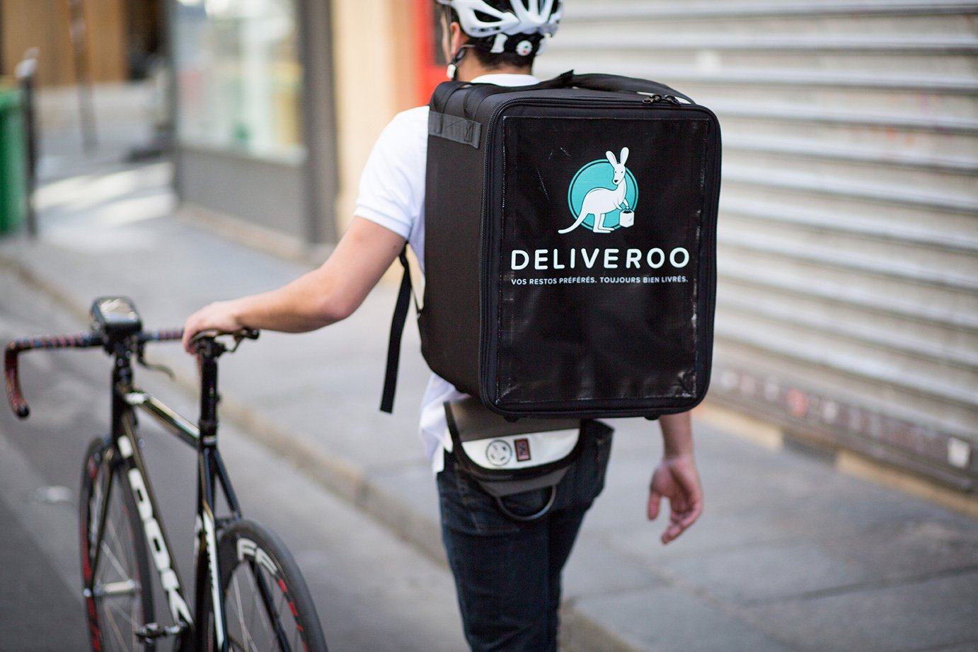
‘Gig economy’: The problem of the missing employer

Slide 18
Challenges
Resistance to change (These features may also be strengths)
Number of stakeholders in apprenticeship systems;
Regulated and legislated nature of apprenticeships;
Deep cultural meaning of apprenticeships within societies;
Conservatism (the external context may change for the worse)
Underlying issues for apprenticeship
Disrespect for ‘working class’ jobs and VET;
Lack of understanding by political leaders;
People making a buck out of government funding.

Slide 19
A delicate balance
How would changing systems affect the balance?
Example of youth employment: If apprenticeship is changed to primarily combat youth unemployment, would the other goals be compromised?

Slide 20
The INAP network: International Network on Innovative Apprenticeship
Established 2006 to examine best practice in apprenticeships internationally;
Aimed at use of research evidence in apprenticeship policy;
Our 8th conference is in Konstanz in March 21st-22nd 2019 (TBC).
http://www.inap.uni-bremen.de/
Erica Smith: e.smith@federation.edu.au

