Slide 1
Social Mobility, industrial and skills strategies, post-Brexit: What role can employer engagement and technical education play?
Engaging teachers in evidence-based practice: Challenges and opportunities
Ewan MacRae
Thursday 5th July 2018 BEIS Conference Centre, London Westminster
Notes:
I am a postgraduate research student, funded by the Department for the Economy (Northern Ireland) in the Centre for Evidence and Social Innovation at Queen’s University Belfast. I am researching how teachers are engaged in evidence as they conduct lessons based on neuroscience and cognitive psychology research into memory and retention. This includes over 100 schools in the North of England and 300 GCSE science teachers. My previous research was how teachers in Scotland are supported by organisations for teaching on human rights education. Today I am discussing how evidence is important for social mobility and of great importance to the reforms to technical education and how and why employers can support teachers in evidence.

Slide 2
social
Should teachers worry?
Notes:
Firstly, Iam going to discuss on of the key themes in this conference: social mobility. There is debate about whether social mobility is a political, economic and societal issue and nothing to do with schools and teachers. I will look at this debate briefly to underline why I believe it is very much within the realm of the school.

Slide 3
“Social Mobility is not the point of education”
“Let me be clear: my job is to teach my students and teach them well. To inspire them. To instill in them a sense of wonder and curiosity about the world. To convey the seriousness of the subject and in doing so to help turn them into free-thinking autonomous young citizens of the world who value the pursuit of knowledge for its own sake. That is my responsibility and I take it seriously. What happens after young people leave school is a political, social, economic and personal question, not an educational one. Let teachers teach and let politicians fix the job market”
(Rooney, 2017: 26-27)
“Social Mobility is not the point of education” tes no. 5263 (2017) 26-27
Notes:
I won’t read this in full but give you some time to digest this opinion that was published by a leading teachers’ periodical. (Kevin Rooney is the head of social science at Queens' School, Bushey. This article appeared in printed matter, publicly-available, at cost, education magazine TES).

Slide 4
Social Mobility Index
(chance of social mobility)
Lowest
Highest
School Ranking
(Ofsted 2016)
Inadequate Requires Good Outstanding
Improvement
Hot Spot
Cold Spot
0 -65
66-259
260-324
Notes:
When we think of schools we can get all sorts of data on them on a variety of different measures. Online you can find what percentage of pupils are eligible for FSM – I was on FSM during my high school years. Schools in rural, coastal regions and in certain areas such as the North and South East and West face challenges. In the next slide I will contextualise the previous quotation by highlighting the school that the teacher works in.

Slide 5
Social Mobility Index
(chance of social mobility)
Lowest
Highest
School Ranking
(Ofsted 2016)
Inadequate Requires Good Outstanding
Improvement
Hot Spot
Cold Spot
0 -65
66-259
260-324
Notes:
As you can see, it is important to think critically about voices within education. It is important to look for the more invisible, less heard voices when we act. The context of the quotation earlier comes from one of the most advantaged schools in England. (61 out of 324 – just inside the ‘hot spot’).

Slide 6
908 members of an education union responded to a survey on child poverty
These respondents were working in early years, primary and secondary schools and settings across England, Wales and Northern Ireland
87% believed that poverty or living on a low income affects the learning of their pupils/students significantly
Notes:
While efforts made at a political, economic level must continue education is an inherently social domain. Schools can and do affect the opportunities of their pupils and teacher attitude and approach is also important.
A joint National Education Union (NEU) and Child Poverty Action Group (CPAG) survey received responses from 908 NEU members working in early years, primary and secondary schools and settings across England, Wales and Northern Ireland. https://www.teachers.org.uk/sites/default/files2014/Child%20poverty%20and%20education%20-%20A%20survey%20of%20the%20experiences%20of%20NEU%20members.pdf

Slide 7
Schools and colleges can deepen inequality
“Schools and colleges can and do contribute to class-based inequalities of educational resources through a host of mechanisms and procedures...”
(Lynch & Baker, 2005: 6-7)
Lynch, Kathleen & Baker, John (2005) Equality in Education: An Equality of Condition Perspective, Theory and Research in Education (2005) Vol. 3, No.2: 131-164
Notes:
Current research finds poor practices in grouping students, especially in maths but also in English nd these subjects are vital to the new T-levels. Misallocation and low expectations and less demanding curricula are all teacher-driven factors as well as the more institutional policy of fixed positioning in low groups. I was misallocated in French and it I am sure many here today have had similar experiences. It has been highlighted in the research by UCL, KCL, and QUB as practices that affect a higher proportion of pupils from a disadvantaged background. Thus, the idea that schools should ignore social mobility is especially problematic.

Slide 8
social
Teachers should worry.
Notes:
This part of my presentation has I hope highlighted that the notion schools should ignore social mobility is problematic and should be examined critically.

Slide 9
Evidence
Notes:
One of my favourite programmes on TV at the moment is “24 hours in police custody” which follows Bedfordshire police in Luton. In a recent episode, a lead detective defined evidence in quite a straightforward way: “forensics and witnesses”. More academic and generic definitions include “support for a belief” however I will use the first definition.

Slide 10
Teachers
Pupils
Parents
School leaders
Society
University researchers
Scientists
Organisations, Charities
Education Endowment Fund (EEF)
Wellcome Trust, Sutton Trust
Randomised Controlled Trials (RCT)
Notes:
If we think of forensics what we have is quite a collection of bodies and professions who are interested in compulsory education but not in the day-to-day operations. In many ways, this is the forensics element of the detective’s definition. Witnesses on the other hand include people who are seeing or feeling the impact of schooling at the time. An education intervention brings the two together in order to look more closely at a phenomenon or to problem solve something.

Slide 11
Inadmissible
Neuromyths
Unsubstantiated beliefs
Ideological opposition
Fads & Trends
Neuroscience
Cognitive psychology
Behavioural genetics
Notes:
Psychology has been demanding more of a role in education for about a hundred years. Neuroscience is much more recent and is built on the developments on the fMRI scans of the brain and so on. Behavioural genetics and education is more controversial and is linked to the work of Professor Robert Plomin at Kings College London and educational attainment; he believes that within months education will be focused on his work.. A key discussion currently is removing anything that is inadmissable. This is a very contentious topic in man ways and beyond the scope of my time limit. Neuromyths (left brain/right brain) Unsubstantiated beleiefs (Superhero stances - BBC), Ideological opposition (phonics) , Fads & Trends (Triple marking) are all things inadmissable.

Slide 12
Notes:
This the Education Endowmnent Fund (EEF) Teaching and Learning Toolkit. It provides open-access to scientifically-robust evidence on best practice in educational attainment and focuses on helping disadvantaged pupils. It is the educational element of the What Works centres. The T-levels can draw inspiration from this although the application will be for 16 and under pupils. However, there is a vast resource available to colleges on maths and english and science.

Slide 13
T-Levels and Evidence
Students will have to achieve a minimum of level 2 maths and English in order to achieve a T Level
A work placement with an external employer lasting between 45 and 60 days
Notes:
There is already a great deal of evidence on English and maths being published by the Education Endowment Fund (EEF) freely available and robustly evaluated. T-levels must draw on this.
There is less evidence available on work placements. There is more work to be done here on evidence of effective practice and teaching in the workplace. In the same way that social mobility can be affected in the summer holidays when inequality of experiences exist so can work placements be seen as potentially adding to inequality of opportunity.

Slide 14
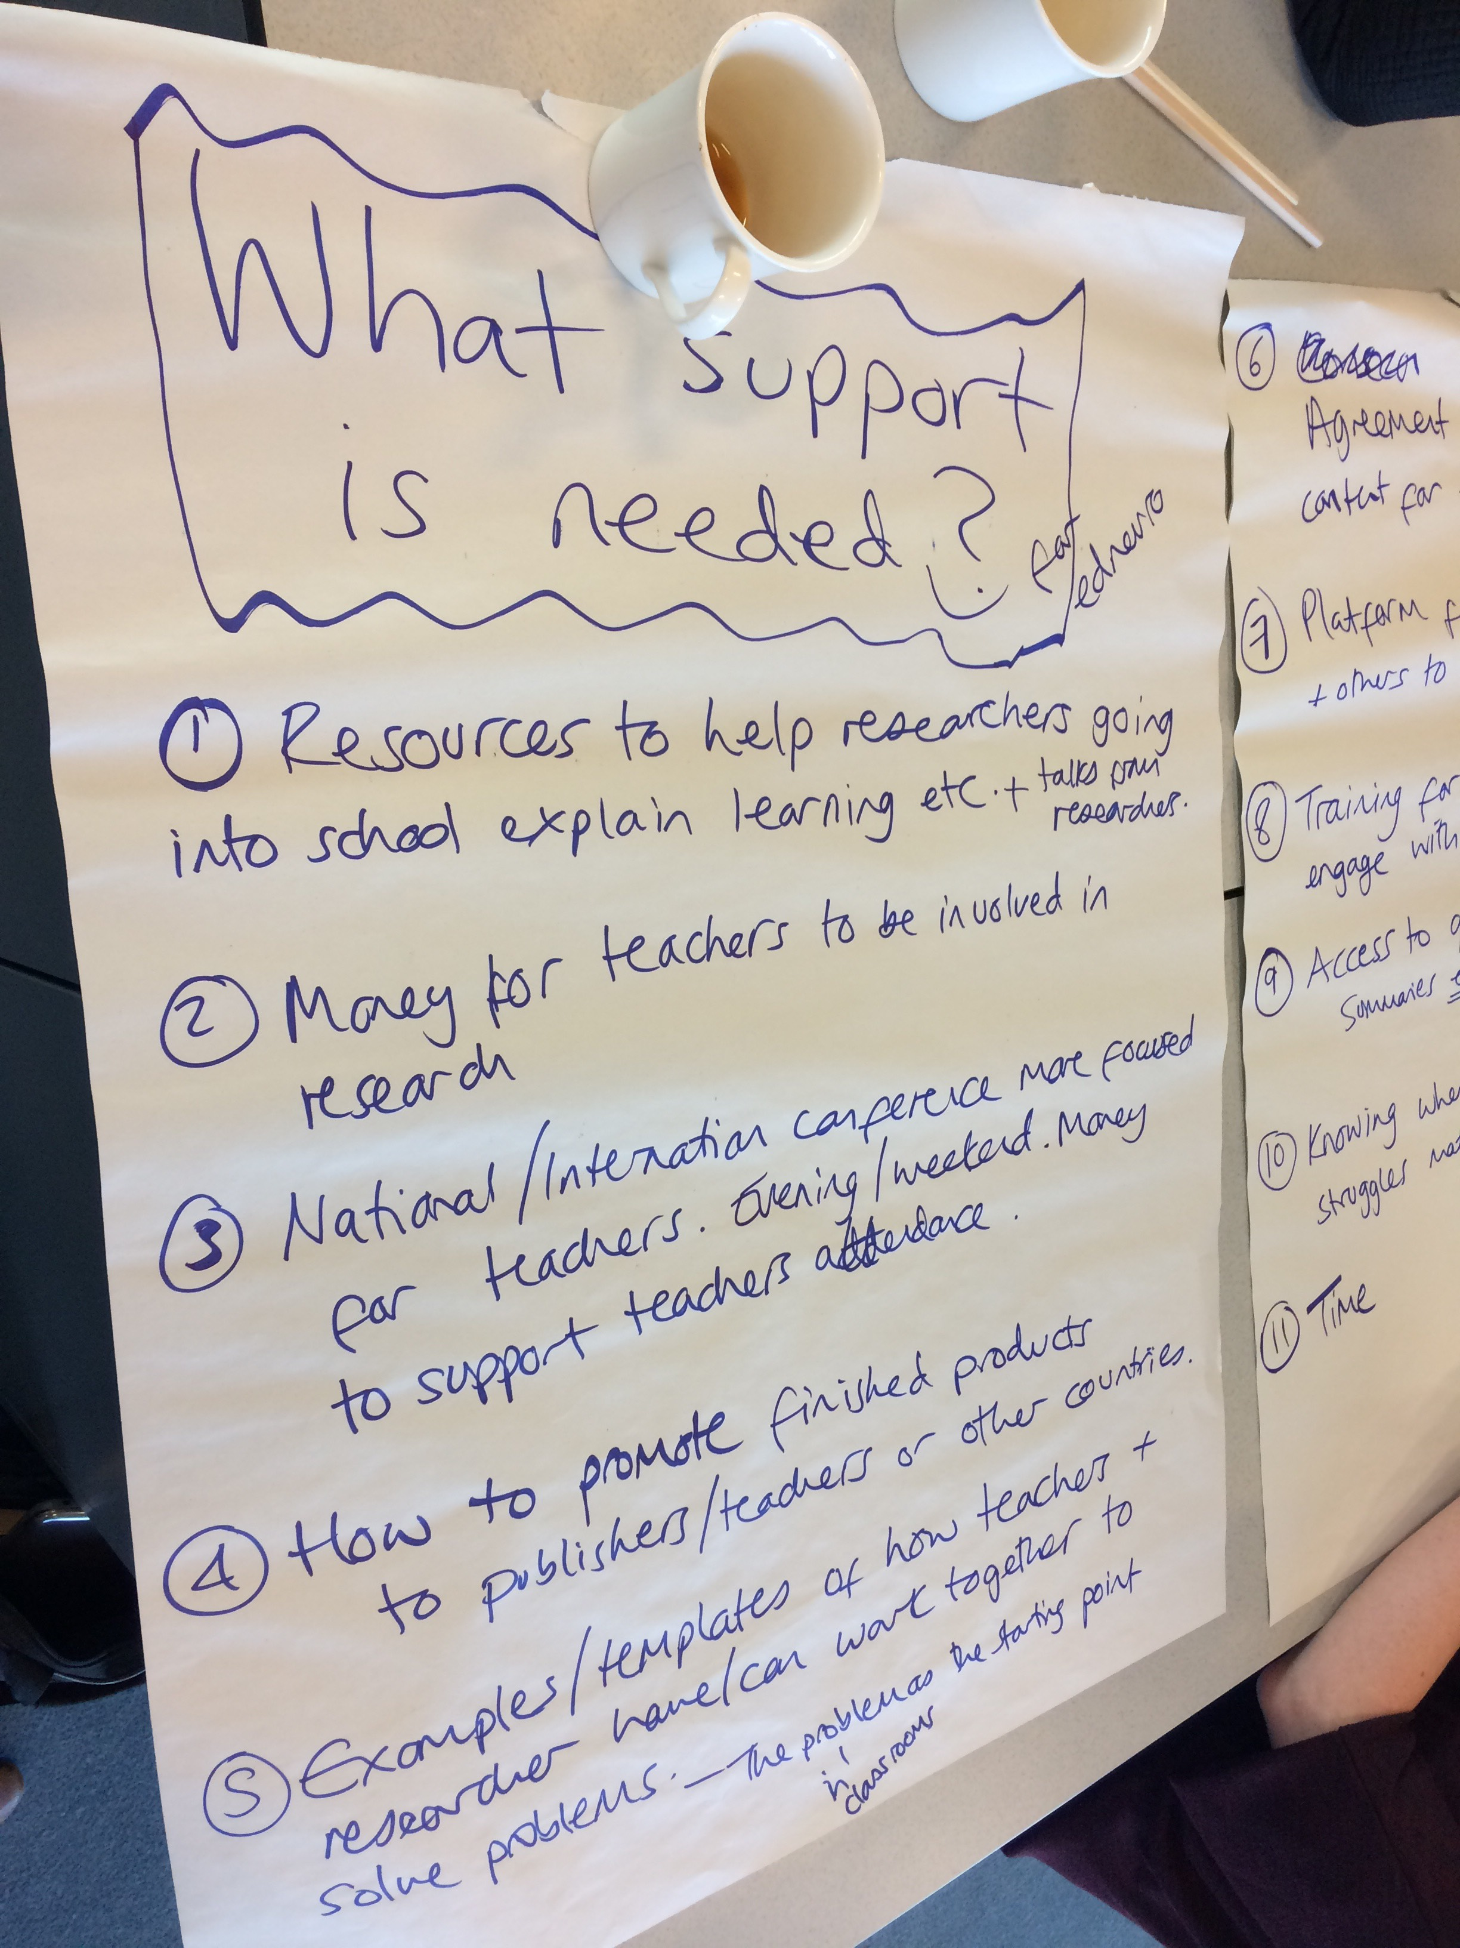
What support is needed?
Notes:
Evidence in schools appears to be here to stay and will define the field for generations to come. This photo was taken at a brainstorming session from the European Association for Research on Learning and Instruction (EARLI) SIG 22: Neuroscience and Education conference hosted by the Wellcome Trust 4-6 June 2018. I believe it is of great relevance to you today and the next slide has a more user-friendly transcription.

Slide 15
Resources to help researchers going into schools explain learning and talks from researchers
Money for teachers to be involved in research
National/International conference more focused for teachers. Evening/Weekend. Money to support teachers’ attendance.
How to promote finished products to publishers/teachers or other countries
Examples/templates of how teachers and researchers have/can work together to solve problems
Agreement on ‘science of learning’ content for teacher training
Platforms for teachers/researchers and others to discuss ideas
Training for teachers to help them engage with research
Access to quality/robust evidence summaries, etc.
Knowing where to go if students have struggles maths/reading/attention etc.
Time
Notes:
I think this demonstrates a reasonably comprehensive overview of what is needed to promote evidence use. As you can see, it is a mix of resources, knowledge, time and collaboration. I can see a lot of things here that applies to the reforms taking place in technical education and the establishing of Institutes of Technology
[Slide reflects the brainstorming session from the European Association for Research on Learning and Instruction (EARLI) SIG 22: Neuroscience and Education conference hosted by the Wellcome Trust 4-6 June 2018]

Slide 16
How to Engage Teachers in Evidence
Rural/coastal schools
Teaching School Alliances/Multi-Academy Trusts
Self-improving School system
Go where help is needed most
Don’t make it easy for you: put the teacher first
Blend tacit knowledge and evidence
Expect mutuality
Notes:
The social mobility index shows that rural/coastal schools need help the most. Also, research from NFER has shown teachers in struggling schools are already trying to access evidence more than schools deemed to be on track. Teaching School Alliances/Multi-Academy Trusts usually have one or two highly-ranked schools and a collection of other less-highly ranked schools: go where the need is greatest within the alliance or trust. Self improving-school system - Schools have become responsible for their own professional development with local authorities and government now removed from the picture. Thus, there are fewer barriers to engagement. Don’t make it easy for you – think of teachers’ lives. When will be the best time to set up meetings, community of practices, conferences, visits? At the start of the school year or the end? Before exams or after? During school or at weekends/evenings? Blend tacit knowledge and evidence – give teachers context and stories to conceptualise their teaching. Expect mutuality – what can teachers do for you? Can they work in a more effective way

Slide 17
Thank you!

