Slide 1
Measuring the Wider Impacts of Apprenticeships
Friday
6 July 2018
Education and Employer’s Conference
Dr Patrick Watt
Gillian Wylie
Aligned to the Impact workstream at

Slide 2
Modern Apprenticeships in Scotland
Notes:
Background to MAs in Scotland
Over 27,000 people start an apprenticeship each year
Available in over 80 frameworks
Individuals, work, learn and earn
SDS contributes towards training costs
Employers pay the apprentice a wage

Slide 3
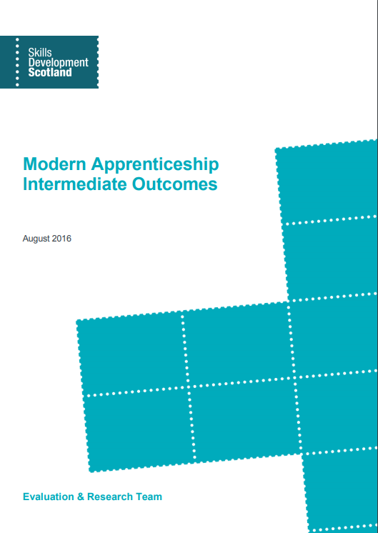
MA Outcomes to MA Long Term Outcomes (MALTO)
MALTO to ALTO
Notes:
Always measured the outcomes associated with the MA programme and have typically done this 6-9 months post training
In 2014, Audit Scotland reviewed the programme and recommended that we also measure outcomes in the long term
In 2016, we worked with the OECD to produce a framework for measure the long term outcomes of the programme

Slide 4
Monitoring Outputs
Short Term Outcomes
Long Term Outcomes and Impacts
Monitoring Inputs
Use and Views
Benefits
Costs
Time in training
MA volumes
Split by framework, level and MA characteristics
Motivation
Route
Satisfaction
Recommendation
Career Progression
Personal Development
Skills utilisation
Benefits
Cost-benefit Analysis
ROI
Destinations after 6 months
Wider Impacts
Individuals
Wage returns
ROI
Cost benefit analysis
Wages
MA Employer volumes
Penetration
Size and Sector
Involvement
Recruitment
Satisfaction
Recommendation
Improved productivity
Staff retention
Productivity at the end of the training
Productivity
Employers
Costs
Payments to providers
Materials
ROI
Cost-benefit Analysis
Robust Cost Modelling for MAs delivery
System Wide Impacts – Economic and wider
System Wide Impacts – Economic and wider
Exchequer/ Economy/ Society
Cost-benefit analysis
Key:
Knowledge Gaps
Exploratory
Indicative
Strong
Notes:
This is the framework for measuring the outcomes of the MA programme to individuals, employers and the exchequer.
There is a key down the bottom that indicates where there are knowledge gaps and the strength of evidence that is available.
This is where we were in the summer of last year.

Slide 5
Monitoring Outputs
Short Term Outcomes
Long Term Outcomes and Impacts
Monitoring Inputs
Use and Views
Benefits
Costs
Time in training
MA volumes
Split by framework, level and MA characteristics
Motivation
Route
Satisfaction
Recommendation
Career Progression
Personal Development
Skills utilisation
Benefits
Cost-benefit Analysis
ROI
Destinations after 6 months
Wider Impacts
Individuals
Wage returns
ROI
Cost benefit analysis
Wages
MA Employer volumes
Penetration
Size and Sector
Involvement
Recruitment
Satisfaction
Recommendation
Improved productivity
Staff retention
Productivity at the end of the training
Productivity
Employers
Costs
Payments to providers
Materials
ROI
Cost-benefit Analysis
Robust Cost Modelling for MAs delivery
System Wide Impacts – Economic and wider
System Wide Impacts – Economic and wider
Exchequer/ Economy/ Society
Cost-benefit analysis
Key:
Knowledge Gaps
Exploratory
Indicative
Strong
Notes:
This is where we are now
We have started to fill the research gaps on measuring the economic impact of the MA programme through conducting a CBA, ROI and system wide impact. Further work is needed in this area in order to strengthen the evidence.
We have also measured the wider, non-economic impact of the MA programme to individuals. We consider the evidence gathered in this area is strong, and it’s what we’re going to talk about today.

Slide 6
Apprenticeship Wellbeing Survey (AWS)
Estimating the wider impacts of the MA Programme:
Personal Development
Career Progression
Subjective Wellbeing
Telephone survey completed in-house at SDS Contact Centre
Over 2000 interviews achieved
1-3 years since left training
Currently using non-completers as the control group
Representative of the MA population and data weighted

Slide 7
Interpreting Subjective Wellbeing
Satisfaction
Assessing one’s life
Overall, how satisfied are you with your life nowadays?
Worthwhile
Meaning and purpose
Overall, to what extent do you feel the things you do in your life are worthwhile?
Experiences and emotions
Positive and negative experiences and emotions
Overall, how happy did you feel yesterday?
Overall, how anxious did you feel yesterday?
Mean Point Score (0-10 scale)
Notes:
Questions developed by the Office of National Statistics for measuring personal wellbeing. They’re used in many surveys, including the Annual Population Survey which allows comparisons to the general population.

Slide 8
MAs report high levels of wellbeing – higher than the general population and other learners
– higher than the general population….
Red boxes indicate a statistically significant difference between AWS and APS
Source: AWS, APS

Slide 9
MA Completers are significantly more satisfied with their life
and less anxious than non-completers
Red boxes indicate a statistically significant difference between completers and non-completers
Source: AWS

Slide 10
Those in Social Services and Healthcare report significantly higher levels of feeling that their life is worthwhile compared to those in; Business and Administration, IT and Telecommunications and Retail
Red boxes indicate a statistically significant difference from PAWS
Framework | n | In training (Sep 17) |  | Satisfied | Worthwhile | Happy | Anxious
Active Leisure and Sport | 30 | 461
Land Based | 55 | 719
Domestic Plumbing and Heating | 49 | 1131
Construction: Building | 94 | 4735
Other Manufacturing, Process and Engineering | 70 | 1234
SS, Health and Technical | 107 | 1223 |  |  | 8.9
Freight Logistics | 97 | 1018
Customer Service | 45 | 522
Engineering | 118 | 3422
Management | 80 | 548
Other | 69 | 701
Hairdressing and Barbering | 63 | 1289
Social Services CYP and Technical | 95 | 1875
Other Construction and Related | 73 | 4639
Construction: Technical and Professional Apprenticeship | 70 | 588
Construction: Technical | 73 | 973
IT and Telecommunications | 107 | 1180 |  |  | 8.0
Hospitality and Technical | 189 | 2485
Business & Administration | 196 | 1735 |  |  | 8.1
Automotive | 74 | 3005
Retail | 140 | 1227 |  |  | 8.0
Food and Drink Operations | 60 | 853
Other Finance and Business | 47 | 1020
Comparison group (AWS)
Sorted by sum of mean scores across all wellbeing variables
Footnote: N doesn’t add up to the total sample because not all participants answered the questions.
Source: AWS

Slide 11
Female MAs more anxious than male MAs
- in line with the general population
Red boxes indicate a statistically significant difference between males and females
Source: APS, AWS

Slide 12
Work improves wellbeing
Red boxes indicate a statistically significant difference between employed and unemployed
Source: AWS

Slide 13
Do you think that participating in the MA programme has had an influence on any aspect of your wellbeing? Why?
The vast majority of responses showed high levels of attribution and positive effects on wellbeing.
Gained Confidence
“Definitely, beforehand I suffered really bad depression and anxiety and never really left the house. Since starting the apprenticeship it helped my confidence and boosted my career.”
Female, Business and Administration, 16-19, Level 3
Increased Opportunities
“Yes, if I didn’t have this SVQ then I wouldn’t have had my trade and now the world is my oyster and I can do anything.”
Male, Roofing Occupations (Construction), 20-24, Level 3
Gained Knowledge
“It has been a good experience and has put me in a good position in life. The skills I have gained from the MA and afterwards has given me a better idea of what I want to do with my life in future.”
Male, Creative and Digital Media, 20-24, Level 3

Slide 14
Do you think that participating in the MA programme has had an influence on any aspect of your wellbeing? Why?
However, a minority of the responses were slightly more negative…
Required Qualification
“If someone is new to the industry and younger then it is great to gain an MA, but I’m older and have been in the industry for years and already have the skills required. I just required the qualification to show this”
Male, Hospitality, 25+, Level 3

Slide 15
High levels of personal and career development have been reported – which increase the longer individuals have left the programme
Red boxes indicate a statistically significant difference between two surveys
Source: AWS, MA Outcomes

Slide 16
What’s next?
Further insight and analysis into the results
Investigate sub-groups in the data
Drivers of wellbeing
Series of Focus Groups to find out the ‘why’
Completed in-house
Focus on speaking to under-represented groups

Slide 17
Measuring the Wider Impacts of Apprenticeships
Friday
6 July 2018
Education and Employer’s Conference
Dr Patrick Watt
Gillian Wylie
Aligned to the Impact workstream at

