Slide 1
Employer engagement: too little too late?
Maria Turkenburg-van Diepen
Pam Hanley
International Conference on Employer Engagement in Education and Training, BEIS, London 5 July 2018

Slide 2
Why outreach with primary schools?
Classroom activities and local industry visit put science learning in context
Crucial age group, transition into secondary school

Slide 3
CCI aims
increase pupils’ enjoyment of learning science
increase teachers’ knowledge and confidence in teaching science
improve teacher and pupil perceptions of science and industry

Slide 4
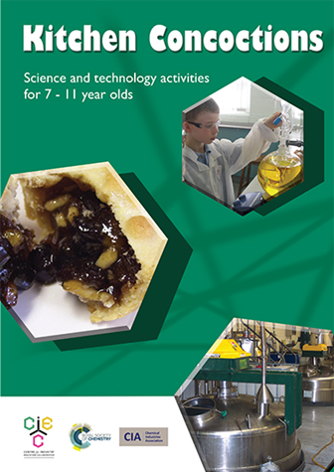
Main features - in school
Notes:
Advisory teacher, classroom sessions, whole school CPD, written and web-based resources

Slide 5
Main features - industry
Notes:
Site visit, ambassador visit, training for industrial partners, written and web-based resources

Slide 6
Aims of research
What can be said about the effectiveness of school/industry partnerships through CCI or similar programmes?
level of engagement in partnerships between industry and education?
nature of industry outreach programmes?
decision-making process
perceived benefits and challenges

Slide 7
Methodology
Bespoke survey of industry employees of variety of companies:
Current CCI participants
Former CCI participants
Potential CCI participants
‘Non-participants’
Interviews with industry employees

Slide 8
Interviewees
35 offered to be interviewed
13 interviews with 15 respondents:
7 senior managers,
3 middle managers,
5 others (subject matter expert, community liaison team, communications team, HR and admin support)

Slide 9
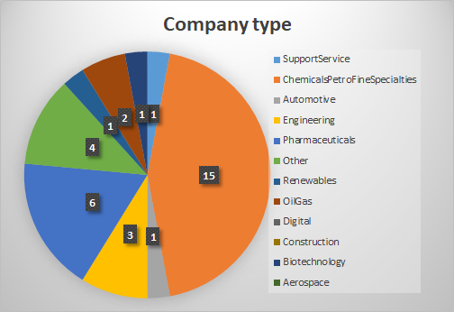
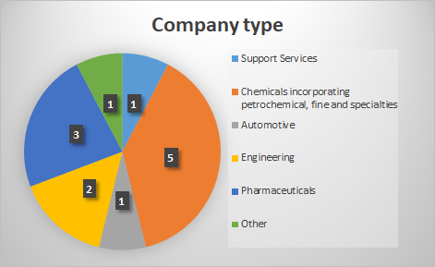
Respondent profiles
Questionnaire respondents
Interviewees

Slide 10
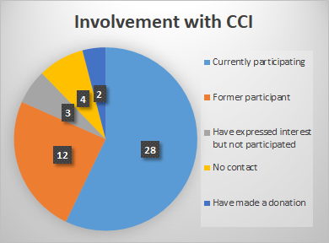
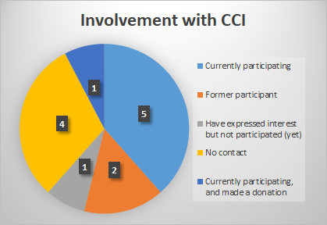
Relationship with CCI
 | >6y | 3-6y | <6y
current | 13 | 2 | 10
former | 5 | 4
Questionnaire respondents
Interviewees
Notes:
No contact: 2 heard of CCI, 2 had not heard of CCI
21 don’t know if there has been contact with CIEC - 7 of those had heard of it (eg in previous employment)

Slide 11
Reasons for involvement
schools-related
community-based
corporate social responsibility (CSR)
company policies
inspire future workforce
(employee benefits)

Slide 12
Best things about CCI
wonder
enjoyment
Children
learning
changing perceptions
Fun/buzz

Slide 13
Challenges of CCI
time
staff
Resources
high numbers
Management
keeping to time
design programme
Visit
difficulty level

Slide 14
Suggested improvements to CCI
explain how industry visit fits within programme
get more companies involved
increase advertising and marketing
more funding

Slide 15
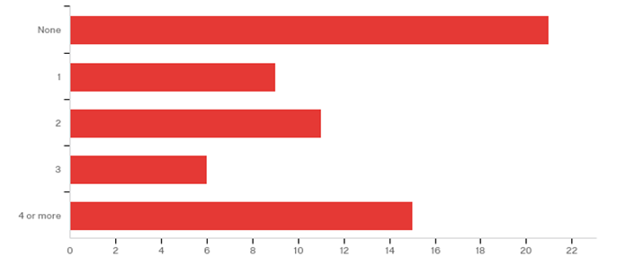
Involvement in other schools-related programmes

Slide 16
Other programmes: types
External programmes eg STEM/SIP ambassadors
Internal programmes eg BASF Kids’ Lab, Pfizer Lab in a Box
Less formal links eg work experience, school visits/events

Slide 17
Other programmes:
benefits
industry awareness
interest in chemistry/science
Visitors
careers: information and promotion
community relations
Hosts
staff engagement
supply of apprentices

Slide 18
Other programmes:
challenges
Time
company priorities
Changes
making it inspirational
staff
Work experience
making it appropriate

Slide 19
I agree strongly that...
links with schools are valuable for my company: 36
industry links with schools are valuable for secondary school children: 42
industry links with schools are valuable for primary school children: 27
industry links help get children interested in science: 42
industry links help get children interested in jobs in industry: 37
(56 respondents)

Slide 20
Anything else?
Respondent P: “What does CCI offer that other outreach programmes don't?”
Respondent T: “We have done plenty of ad-hoc events where we visit schools on a one-off basis. What is different about CCI and the reasons we want to get involved are: 1) it is aimed at primary students BEFORE they have decided that a STEM career is not for them, 2) they come in to see us, which creates a great atmosphere and sense of excitement for our team, 3) we think having the support from the advisory teacher to tailor the classes around the visit has far more impact than us doing one-off events.”

Slide 21
Thank you

Slide 22
Report June 2017
Turkenburg-van Diepen, M., & Hanley, P. (2017). Evaluation of the impact of the Children Challenging Industry programme 2012 to 2016. York: University of York
Notes:
The staff CPD session involves the teachers in trying out some of the activities themselves.
© Centre for Industry Education Collaboration
22

