Slide 1
Increased educational aspirations and consequences for the vocational education system in German
Prof. Dr. Franz Kaiser & Dr. Philipp Struck
The 5th International Conference on Employer Engagement and Training London - 05.07.2018
Apprenticeships and VET pathways International comparisons

Slide 2
Content
Introduction
German school system
German vocational education system
German vocational orientation system
Project context and Methodology
Analysis
Results
Conclusion
Discussion

Slide 3
Introduction: German school system
Three divisions:
lower secondary school -> vocational education
middle school -> vocational education
high school -> academic education (& vocational education)

Slide 4
Introduction: German vocational education system
Two main types: school-based VET (200.000), Dual System (500.000)
learning places in DS: enterprise and vocational school
Duration: 2 – 3.5 years
About 330 different kinds of vocational occupations
No school leaving certificate as a formal requirement
New contracts for a vocational education in 2016:
High school degree - 28,7%
Middle school degree - 42,8%
Lower secondary school degree - 25,3%
Without a degree - 3,1% (BIBB, 2018, S. 132)

Slide 5
Trends in the last decades in German VET system
Decline in the number of in-company training places
high number of unplaced applicants
at the same time many vacancies for apprentices (branch specific)
increasing number of apprentices with university entrance qualification
Broadening the qualification profiles of the training occupations / Reduction in the number of training occupations
Trend towards broader and more demanding VET courses, with continued "simpler" two-year training occupations

Slide 6
Introduction: German vocational orientation system
Company visits
Practice days in an enterprise / practical training
Career consultation
Profession and Career exploration
Potential analysis
Offers are:
Begins in the seventh class and continues until the school leaving

Slide 7
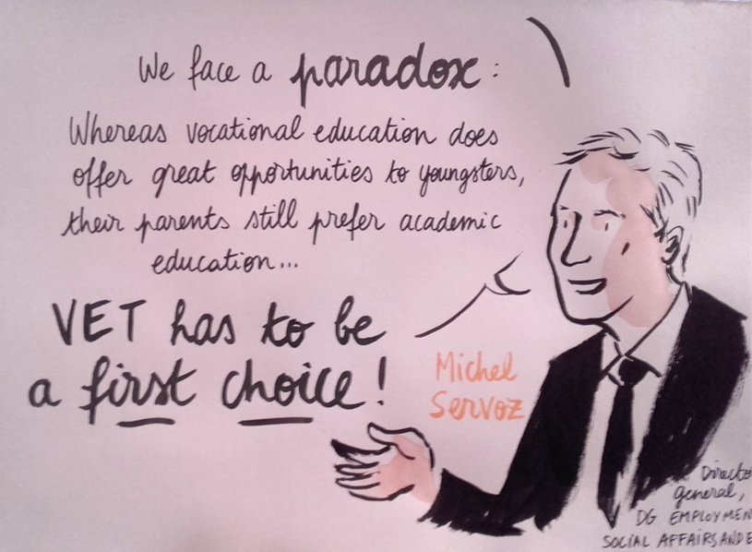
The Situation: Declining attractiveness of dual vocational training or increasing educational aspiration?
Current studies (e.g. Shell 2015 and Schnitzler & Granato 2016) clarify increased educational aspirations
Many kinds of schools to achieve the high school degree after the middle school; the schools are successful in promoting their further education options (school to school cooperation is allowed in Germany)
“To make VET the first choice” as a political goal of the VET skills week in Brussels 2017 by the EU Commission
© EU Commission

Slide 8
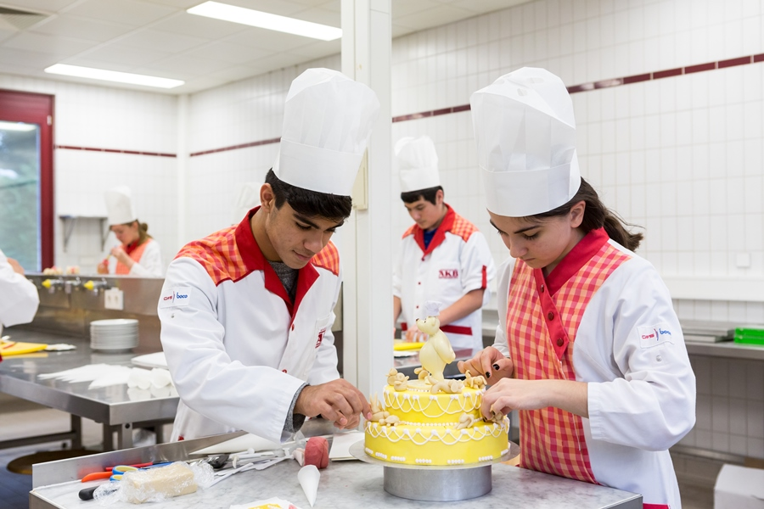
Project: Evaluation of vocational orientation initiatives
Evaluation of the federal governments program to promote vocational orientation in inter-company and comparable vocational training centers
„Berufsorientierungsprogramm“ in grade 7 and 8: Potential analysis & Profession and Career exploration
2013 – 2017
Research consortium of INTERVAL GmbH, Leibniz Universität Hannover and qualiNETZ
Observations during the program, quantitative and qualitative surveys of young participants and surveys at different levels of the groups of people involved (e.g. parents, teachers and educators)
© BMBF
© BMBF

Slide 9
Methodology of the sub-project (Struck 2017)
Methods:
Qualitative study with interview guide
Data Set:
174 pupils from ten different locations in Germany from secondary school (except high school) beginning in grade 7
Longitudinal section with 4 measurements

Slide 10
Results (Struck 2017)
93 pupils achieved the middle school degree
33 chose a vocational training
53 try to pass the high school degree; 31 female and 22 male
The pupils from the middle school made two years before school leaving the decision to prefer a high school attendance instead of a vocational education (in grade 8: 25 of 53; in grade 9: 41 of 53)
No applications send; although passing different kinds of vocational orientations

Slide 11
Results – Arguments of the youth (Struck 2017)
“It was like, that I did not feel myself ready for the world of work yet.” (male, 16; Original-Speech: „Es war so, dass ich mich für die Arbeitswelt noch nicht bereit gefühlt habe.“)
“My mother did not think it was okay for me to work at 16. She thought it was too early, I should rather try an apprenticeship at 18.” (female, 16; Original-Speech: „Meine Mutter fand es noch nicht so okay, dass ich mit 16 arbeiten gehe. Sie fand es zu früh, ich soll lieber mit 18 eine Ausbildung versuchen.“)
“Because I did not know what else to do. You can say it was a stopgap. My certificate was good enough to continue, and now I have three more years to think about it.” (female, 17; Original-Speech: „Weil ich nicht wusste, was ich sonst machen sollte. Man kann sagen, es war eine Notlösung. Mein Zeugnis war gut genug, um weiter zu machen, und jetzt habe ich noch drei Jahre länger Zeit zu überlegen.“)

Slide 12
Results
They feel themselves as “too young” or “not ready” to start a vocational education
For others the secondary school is also a stopgap; some chose the scholar pathway postponement of the decision, they try to extend their career choice process, because of beginning uncertain -> Moratorium is needed
Also some parents prefer a secondary school instead of a vocational education

Slide 13
Conclusion
A vocational education seems to be less attractive
It cannot exclude that people believe: The entrance into a vocational training completes or even stops the educational advancement. Maybe the German term of “Ausbildung” and “ausgebildet sein” transports between the lines, to be finished with learning and so with personal development, perhaps at a dead-end.
Certain vocational training places remain vacant, especially in hotel and tourism and the handcraft sector
The apprentices become older when they start their vocational training (at the end of their high school education, which they could have already started with their middle school certificate)

Slide 14
Conclusion
Talks for the career guidance:
Raising awareness of the advantages and disadvantages of high schools (e.g. dropout rates, increased academic achievement level)
In addition, a vocational training isn’t a dead-end qualification it enables additional promotion and further education options, so that a high school diploma can still be achieved
To make the advantages and possibilities of a vocational education more clear to the young adults and to focus more individually on their motives and interests. -> To prevent confusion and ignorance of vocational education pathways
Talks for the employers:
Promoting the advantages of vocational education: “You can get money during the apprenticeship and also a lot of further education options!”
“You learn earlier what’s really needed in the world of work and these intensify your successful career.”
To configure vocational education more attractive through new approaches to participation and emancipation, e.g. peer education

Slide 15
Discussion
What are your experiences (in your countries) why young adults are not moving into vocational education?
How could we make vocational education more attractive your young school-leavers?
What can be the task for the employers?
Why parents, society and environment think it is better to continue school instead of starting a vocational career?
Are there not enough role-models? (Like young adults starting a vocational education after middle school degree and explaining their situation as positive)

Slide 16
Thank You
for your attention
Contact
franz.kaiser@uni-rostock.de
philipp.struck@uni-rostock.de

Slide 17
References
BIBB (2018): Datenreport zum Berufsbildungsbericht 2018. Informationen und Analysen zur Entwicklung der beruflichen Bildung (Vorversion). Bonn.
Schnitzler, Annalisa & Granato Mona (2016): Duale Ausbildung oder weiter zur Schule? Bildungspräferenzen von Jugendlichen der 9. Klasse und wie sie sich ändern. In Berufsbildung in Wissenschaft und Praxis, 3/2016, S. 10-14. BIBB.
Shell Deutschland Holding (Hrsg.) (2015): Jugend 2015. Eine pragmatische Generation im Aufbruch. Frankfurt a.M.
Struck, Philipp (2017): Zwischen „Da kam so raus, dass ich handwerklich sehr begabt bin.“ und „Ich wollte noch ein bisschen Schule genießen.“ Evaluation des BMBF-Programms zur „Förderung der Berufsorientierung in überbetrieblichen und vergleichbaren Berufsbildungsstätten“. Sonderbericht Nr. 3. Rostock. Verfügbar unter: www.berufsorientierungsprogramm.de/files/BOP_SonderberichtNr3_Qualitative%20Interviews.pdf (13.10.2017).

