Slide 1
Drawing the future Exploring the career aspirations of primary aged children Jordan Rehill Research Analyst – Education and Employers

Slide 2
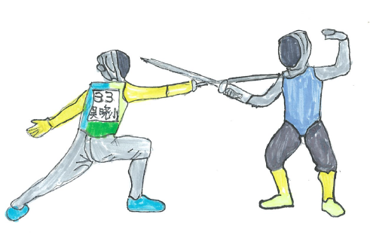
1.
Are children’s aspirations important?
Should we spend time exploring and trying to influence them?
Notes:
A future

Slide 3
Developmental research
Savickas (1991; 2002)
By early childhood children demonstrate
Concern about the future
Control over their lives
Curiosity about occupations and work
Confidence to construct a future
Gottfredson (1981; 2002)
Children grasp the concept of a set of behaviours belonging to gender and social class and begin seeing jobs and future pathways as intrinsically linked to these ideas.
Hartung, Porfeli and Vondracek (2004)
Career development ‘has overemphasised adolescence and early-to-middle adulthood’
Notes:
Early career ideas and aspirations of children can, and should naturally be tentative and imaginative. But worth investigating. As developmental research has shown children begin to understand the world, and their roles within it, from a younger age than once thought.
Gottfredson: occupational aspirations and choices are often compatible with self-images and self-efficacy. Children often eliminate options based on social class, gender, and perception of ability. Accordingly, children restricted career aspirations and choices based on who they perceived themselves to be.

Slide 4
Gender stereotyping
Media portrayals influence children’s expectations about ‘appropriate gender roles and behaviour’
Advertising Standards Authority (2017)
What, and who, influences aspirations?
Socio-economic background
Deprivation and disadvantage influence aspirations
(KidZania. 2017)
With limited role models, children often see certain careers (often STEM related) as for a limited cross section of society
(Archer et al. 2012)

Slide 5
Effort and behaviour in lessons
Children’s aspirations can impact their behavior and the effort they exert in certain lessons.
Flouri and Pangouria (2012) Bandura at al. (2001)
Subjects chosen
The subjects they eventually choose to study.
Archer at al. (2013)
Kelly (1989)
Future career pathways
With limited role models, children often see certain careers (often STEM related) as for a limited cross section of society
Akerlof and Kranton (2000)
Perceptions of careers can impact:
Notes:
The perceptions that children have about certain jobs and careers can go on to shape, and often limit, their academic performance and future life choices.
Flouri – using UK longitudinal data, found that primary school children with higher career aspirations are likely to have behavioural or emotional problems. US and Australian studies have found links between aspirations and later educational outcomes, higher levels of attainment and lower dropout rates
Archer – students who do not express STEM aspirations by age 10 are unlikely to develop STEM aspirations by the age of 14.
Children often rule themselves out of careers that they might otherwise successfully pursue.
This also means that industries do not benefit from all the talent that is potentially available to them.

Slide 6
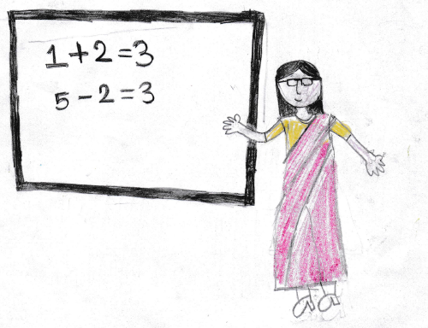
2.
The survey
Methodology and data
Notes:
Drawing the future sought to build on these findings, and given the importance of childrens perceptions of the world of work, wanted to conduct a large scale exploration of what children wanted to do when they were older
With the support of UCL Ioe, OECD, Tes and NAHT

Slide 7
UK Data
Children aged 7-11 were asked to draw what they wanted to when they were older
13,070 primary school children from the UK and channel island took part
Background information
Do you know anyone who does the job? How did you hear about the job.

Slide 8
International Data
7,000 responses from 19 countries outside of the UK:
Albania
Australia
Austria
Bangladesh
Belarus
China
Colombia
Iceland
Indonesia
Mexico
Pakistan
Philippines
Portugal
Romania
Russia
Serbia
Switzerland
Uganda
Zambia

Slide 9
Why drawing?
Remember more about an event or period of time. Allowing them to ‘tell a better story’ (Butler et al. 1995)
Useful for children who are usually shy. Allows them to feel confident expressing their opinions without feeling steered by agenda of researchers (Einarsdottir et al. 2009)
Inclusivity for younger children, does not require strong written or verbal skills
Notes:
Why drawing, why ask children to draw?

Slide 10
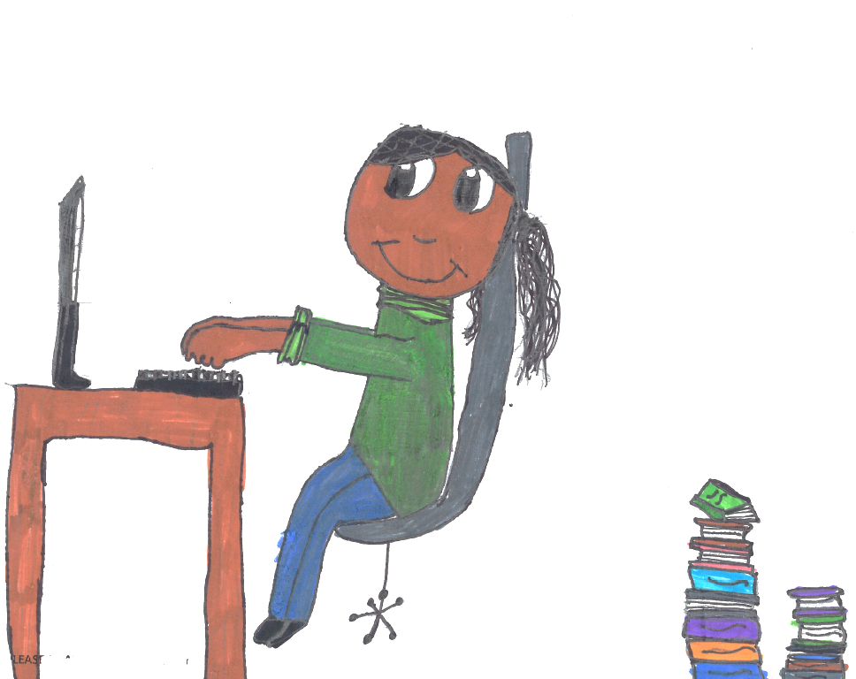
3. Findings

Slide 11
Most popular jobs Top 15 jobs among total sample (excl 9.8% non respondents)
Notes:
By a considerable margin, the most popular job for children in the UK was either a sportsman or sportswoman, followed by teacher, VET
Interestingly social media and gaming ranks highly, growth of online and console based gaming
Positive for STEM related professisons, VET doctor scientist and engineer were 3rd 6th 7th and 11th respectively

Slide 12
How did children hear about their chosen job?
“Do you know someone who does this job? If yes, who are they?”
Notes:
We asked children ‘how did you hear about your chosen job’
When children DID know someone
Parents, extended family and teachers were the most influential
When children did NOT know someone who did the job they drew
Interestingly only 1% of children in our entire sample said they heard about a job from a volunteer from the world of work coming in to school.
That is not to say its not happening, the argument here is one of volume – more is more
Mass media (TV. Film) was the most influential

Slide 13
How did children hear about their chosen job?
“If you don't know anyone personally where did you hear about the job you drew?” (excl. 4.4% non-responses)
Notes:
We asked children ‘how did you hear about your chosen job’
When children DID know someone
Parents, extended family and teachers were the most influential
When children did NOT know someone who did the job they drew
Interestingly only 1% of children in our entire sample said they heard about a job from a volunteer from the world of work coming in to school.
That is not to say its not happening, the argument here is one of volume – more is more
Mass media (TV. Film) was the most influential

Slide 14
Most popular jobs according to gender
Notes:
Childrens aspirations shaped by gender-specific ideas about certain jobs
Boys overwhelmingly aspire to take on roles in traditionally male dominated sectors and professions
5x boys in armed forces
20x boys in manufacturing (mechanic) and construction
20x girls in fashion industry

Slide 15
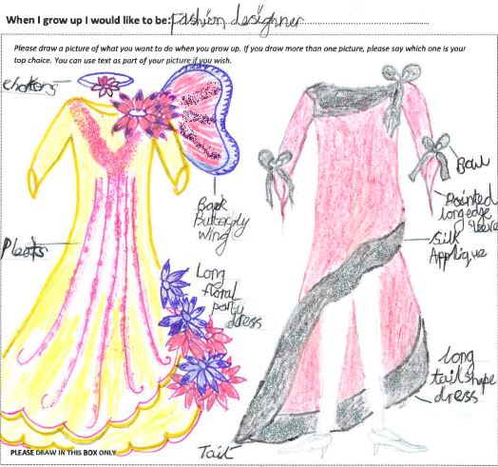
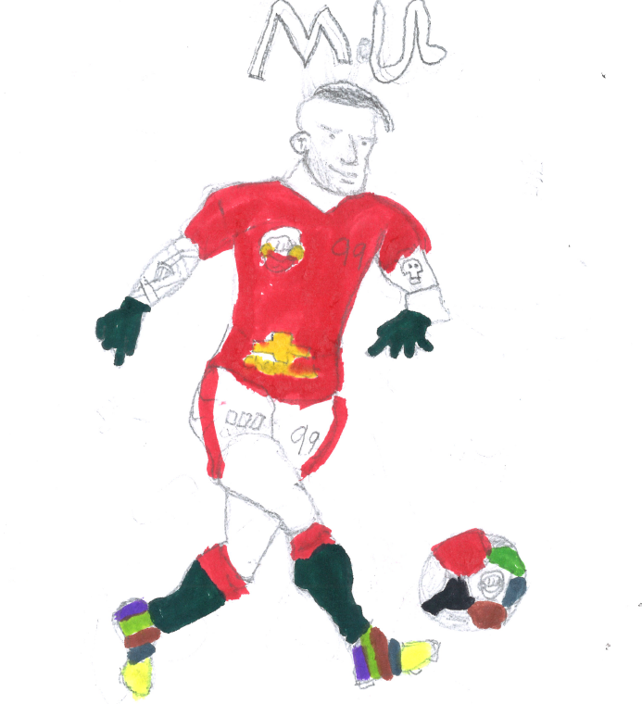
Most popular jobs according to gender
Notes:
Childrens aspirations shaped by gender-specific ideas about certain jobs
Boys overwhelmingly aspire to take on roles in traditionally male dominated sectors and professions
5x boys in armed forces
20x boys in manufacturing (mechanic) and construction
20x girls in fashion industry

Slide 16
Stereotyping in STEM
Notes:
4x boys wanted to become engineers
2x boys want to become scientists
2x girls want to become Doctors and Vets
20x wanted to become doctors compared to nurses and health visitors
Has potential to disrupt talent and skill pipelines in STEM sectors. Especially relevant for NHS, nursing shortfalls. Boys need to be encouraged from a young age to think about a broader range of healthcare professions
These findings fit with wider lit: constructions of masculinity/femininity – caring roles fit in traditional constructions

Slide 17
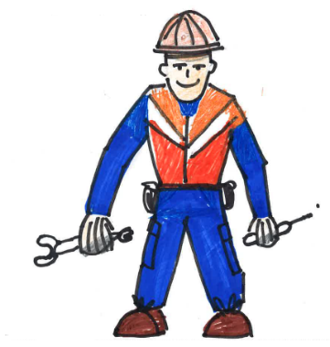
Stereotyping in STEM
Notes:
4x boys wanted to become engineers
2x boys want to become scientists
2x girls want to become Doctors and Vets
20x wanted to become doctors compared to nurses and health visitors
Has potential to disrupt talent and skill pipelines in STEM sectors. Especially relevant for NHS, nursing shortfalls. Boys need to be encouraged from a young age to think about a broader range of healthcare professions
These findings fit with wider lit: constructions of masculinity/femininity – caring roles fit in traditional constructions

Slide 18
Impact of social disadvantage
Aspirations more popular in schools with FSM < 20% | Aspirations more popular in schools FSM > 20%
Among Boys:
Engineer (civil, mechanical, electrical) Vet Singer/Musician Actor/Actress Architect Builder Manager (e.g. in an office, factory, shop, hotel) Farmer Lawyer (barrister/solicitor) Author | Police Teacher/Lecturer Doctor Mechanic Driver/Haulier Retail sales assistant
Among Girls:
Vet Sportsman/woman Actor/Actress Engineer (civil, mechanical, electrical) Architect Airline pilot | Doctor Hairdresser Nurse/Health visitor Beauty therapist Lawyer (barrister/solicitor) Retail sales assistant Dentist Army/Navy/Airforce/Firefighter
Notes:
We asked teachers to outline what % of their children were eligible for FSM, a common signifier of disadvantage
Cannot tell us precisely about a childs socio-economic situation it gives an indication that the school, and therefore its pupils, may live within a disadvantaged area.
Children of less deprived schools being relatively more likely to have aspirations in higher-earning professions
Evidence that creative professions with very high barriers to entry are more popular to boys in less deprived schools – such as being a singer/musician. Actor/actress and author
Among girls, architects, engineers and Vets are more popular in less deprived schools, whereas nurse, retail assistant and beauty therapist are more popular in the deprived schools

Slide 19
Career aspirations as children get older
Notes:
Aspirations vary very little as they move from lower key stage 2 (aged 7 and 8) to upper key stage 2 (aged 9 to 11)
Though the data isn’t longitudinal, still highlights. Challenges the assumption that those in the younger bracket aren’t worth paying attention to as their aspirations are too magical.
One rare trend is decreasing proportion wanting to be a teacher, 14.8% to 7.5%

Slide 20
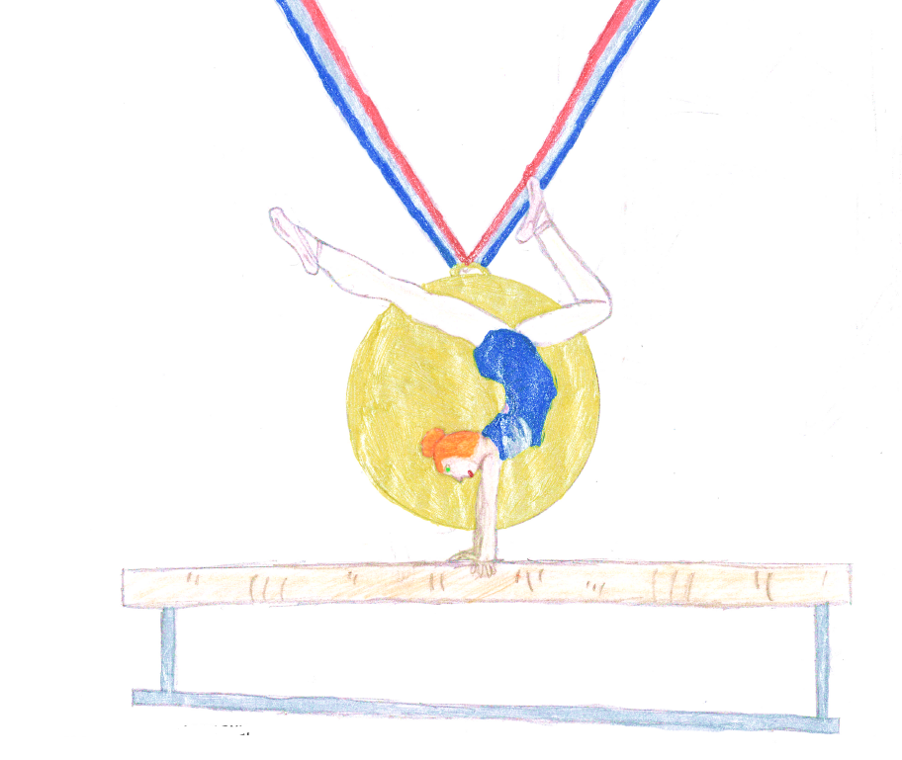
4. Discussion
How to best address these issues?
Notes:
Aspirations are highly gendered and narrow – for important sectors!
Influenced by socio-economic background
Aspirations do not differ as children reach secondary schooling

Slide 21
It’s who you know
This is a global issue
Lack of role models and social capital
Early intervention is key
A resource to shape the thinking of children – to address the assumptions which shape attitudes.
Notes:
This is a global issue – patterns continue in all of the countries we surveyed both in wider careers and in STEM
Ambition should not be discouraged
For children aspiring to become sportsmen and women it is important they are aware of the array of other career options in that sector
It’s about visibility without visible role models to highlight the options available to young people, how will they know? If their biggest influence is TV or someone they know?
As the research shows, it may be worth helping children understand a range of non-stereotypical roles alongside sectors and occupations that may not be fashionable
That is not to say that children should choose careers at primary or indeed be encouraged to do so
Rather they need to see the opportunities the world presents and the relevance of the subjects they are studying, and be motivated to keep as many options open for as long as possible

Slide 22
References
Bandura, A., Barbaranelli, C., Caprara, G. V., & Pastorelli, C. (2001). Self-efcacy beliefs as shapers of children’s aspirations and career trajectories. Child Development, 72(1), 187-206.
Hartung, P. J., Porfeli, E. J., & Vondracek, F. W. (2005). Child vocational development: A review and reconsideration. Journal of Vocational Behaviour, 66, 385–419.
Gottfredson, L. S. (1981). Circumscription and compromise: A developmental theory of occupational aspirations. Journal of Counseling Psychology, 28(6), 545-579.
Savickas, M. L. (2002). Career construction: A developmental theory of vocational behavior. In D. Brown (Ed.), Career choice and development (4th ed., pp. 149-205). San Francisco: Jossey-Bass.

