Slide 1
Area-Based Reviews (ABRs) in London:
Is Further Education in England moving towards a more collaborative system?
Professor Ken Spours
Centre for Post-14 Education and Work
UCL Institute of Education

Slide 2
Aims of the presentation
Present policy background to ABRs
Understand the London and wider English contexts
Communicate stakeholder perceptions of ABRs 2015-2018
Provide an analytical framework – Logic A and Logic B
Employ ’home international’ comparison between England, Scotland, Wales and Northern Ireland
Analyse new developments – Skills and Employment Boards, Mayor’s Skill Strategy, Devolution and major infrastructure projects
Pose the question regarding the degree of movement towards a more ‘collaborative FE system’

Slide 3
Contexts and research approach

Slide 4
Policy aims of the ABRs
Policy of austerity, reduced public spending and improved engagement with employers
  Institutions which are financially viable, sustainable, resilient and efficient, and deliver maximum value for public investment.
  An offer that meets each area’s educational and economic needs.
  Providers with strong reputations and greater specialisation.
  Sufficient access to high quality and relevant education and training for all.
  Provision which reflects changes in government funding priorities and future demand.
Regionalisation and rationalisation of colleges has taken place in Scotland, Wales and Northern Ireland – resulting a 50 per cent reduction in the number of institutions.

Slide 5
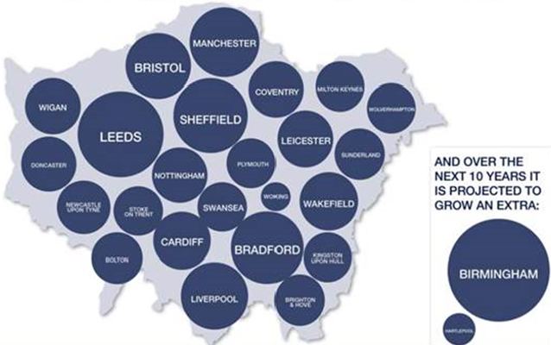
London: dynamic & divided
Different scale to all other UK cities and growing rapidly
Highly socially divided and rapidly changing demographics
Economically dynamic but under-developed TVET system – low levels of apprenticeships and tendency to import graduates
Highly competitive post-16 education and training sector with relatively poor employer engagement
Housing crisis – difficulties of working and living in London
Source: Skills Devolution and Area Reviews – GLA Feb 2016

Slide 6
ABR research approach
Scoping seminar involving principals and chairs of governors (Oct 2015).
Four sub-regional-based seminars with college staff involved with curriculum development (Jan-March 2016).
Round 1 (April – July 2016) interviews with GFE and SFC principals in each the four sub-region + chairs of the sub-regional review groups + representatives of JARDU and LGA.
Round 2 (Jan – March 2017) interviews with same participants
Round 3 (Jan – March 2018) interviews with sample of institutional leaders + all chairs of sub-regional review groups and LGA.
Periodic seminars to check out findings and to gain additional data and final conference in July 2018.

Slide 7
ABRs in London

Slide 8
ABR process in London
Involved 30 GFEs, 12 SFCs and 5 specialist institutions that opted in
Prior to the Review about half of the FE colleges in London involved in merger or alliance-based discussions
Five meetings per sub-group
Four final reports published February 2017
ACL review undertaken alongside
London Area Based Review
West sub-regional review
Central sub-regional review
South sub-regional review
East sub-regional review
Wave 2 of national process
Wave 3 of national process

Slide 9
Stakeholder perceptions of ABRs
College leaders – merger/collaborations already underway; ABRs seen as adding to this and thus supported, but ABR process seen as cumbersome and little added value.
SFC leaders – initially felt marginal to ABR and would have liked to see involvement of 11-18 schools, UTCs and also review of general education provision
LAs and GLA – important mechanism for looking at colleges and establishing collaboration and increased engagement with employers. ABR process too rushed and too focused on financial viability and not enough on learner progression and developing local economy
Curriculum leaders
Concern about ‘organisational distraction costs’ of planned mergers
Wanted more focus on curriculum and building Pan-London professional networks
  Network of personal cross-college contacts
  Creating joint area ‘road-maps’ of provision and developing progression pathways
  Building pan-London professional networks
  Providing peer review and development groups
  Focusing on specialisations across London
  Engaging with learners and employers
  Developing regional and sub-regional partnerships with wider stakeholders

Slide 10
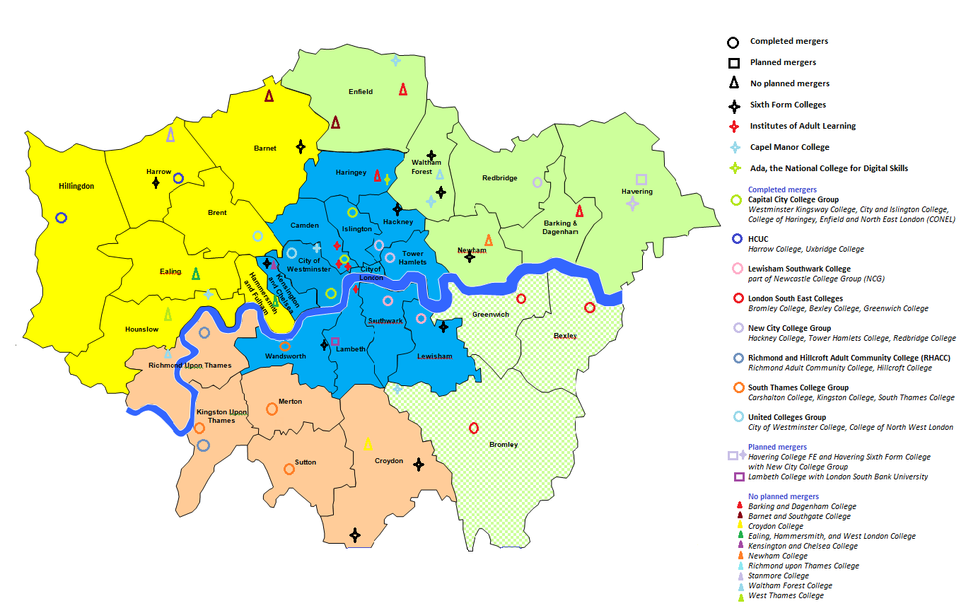
ABRs – what happens in London?

Slide 11
Analysis

Slide 12
Two logics of the ABRs
Logic A
Dominant process that continues logic of Incorporation
Narrow focus on college economic viability and mergers
Partial system approach - relative exclusion of schools; general education; the marginalisation of sixth form colleges and little input from wider stakeholders.
Review process conducted as a ‘sprint’ – did not consider provision issues
Logic B
Subordinate process that signals stronger collaborative approach
Comprehensive focus on the improvement of vocational specialisation; progression pathways for all; protecting and developing the whole curriculum, including general education; the engagement of wider social partners, particularly employers.
A Pan-London approach with holistic citywide picture and strong cross borough and sector frameworks.
A longer and more inclusive ABR process.

Slide 13
Historical trajectory 1993-2018
Centralised
Early FE Incorporation (1993-1997)
FE and LSC phase 1 (1997-2004)
FE and LSC phase 2 (2004-2010)
Coalition - Skills Funding Agency, new providers + use of Ofsted
Private
Public
ABR formal phase (2016) – Austerity and devolved ABR Review
ABR aftermath phase – London’s Sub-regional Skills and Employment Boards
Decentralised

Slide 14
Towards an English FE system?
Future of Logic A and Logic B relationship
Role of new sub-regional Employment and Skills Boards
Devolution of budgets to city regions
Mayor’s Pan-London Skills Plan as framework
Moving towards regionalization model?

Slide 15
High skills progression networks
Mediation of relations from above – the State
Evolution of the totality of relations over time
Shared mission, values, local identity and connective networking
Further education colleges as VET and progression hubs
Higher education institutions as technological & knowledge-led incubators
Local government economic regeneration and service provision
Industrial & business clusters involving a range of different types of enterprises
Mediation of relations from below – the Community

