Slide 1

RESTRICTED - Policy
Policy Learning from US School-based VET Models
Olly Newton
July 2018

Slide 2
Overview
Opportunities for US-UK policy learning
Model 1 – School Transformation in Nashville
Model 2 – High Tech High
Putting it into practice – Edge Future Learning Pilot

Slide 3
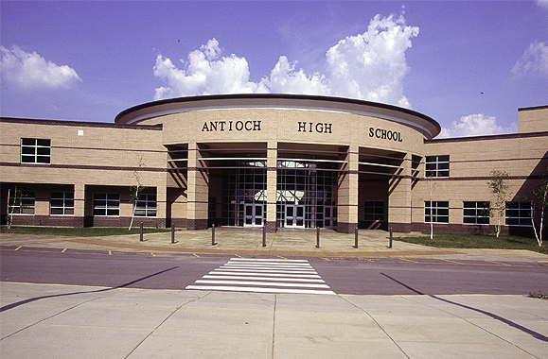



Model 1 - School Transformation in Nashville

Slide 4
Transforming the Secondary School Experience
Through Redesigning High Schools
Freshman Academies
All students belong to the Freshman Academy during their 9th grade year.
Academy Leadership
Every school has an Executive Principal, Academy Principals, an Academy Coach, and Academy Counselors.
Career Academies
During the 10th through 12th grade years, students belong to a thematic academy of their choice.
Workforce Projections
All Academies and Pathways are informed by workforce projections for the Middle Tennessee region.
Careers Guidance
Young people receive a tailored range of employer engagement and guidance experiences throughout their years in High School
Facilities
Classroom and learning labs are designed to model real world workplaces

Slide 5
Nashville – Evidence of Success (1)
Academies of Nashville Graduation Rate
+ 23.8% Since 2005
57.8%
82.5%
73.8%
74.6%
74.5%
78.7%
81.6%
81%
Graduation calculation rate changes
2005
2006
2007
2008
2009
2010
2011
2012
2013
2014
2015
2016
Notes:
The CBI’s annual skills survey shows that 69% of businesses were worried about filling skills shortages last year, up from 55% the previous year
UKCES employer skills survey shows more than a 100% growth in skills shortage job vacancies in four years.
Meanwhile, employers consistently tell us that work experience is the most important thing when recruiting.
And the returns from apprenticeships are higher than degrees.
NONE OF THIS IS TEACHERS’ FAULT. And yet in school the EBacc, performance measurement system and funding are squeezing out creative and technical subjects, employer engagement and careers guidance.
You have already come on a huge journey with the Career Benchmarks Pilot. This is an opportunity for you to continue to lead the way.

Slide 6
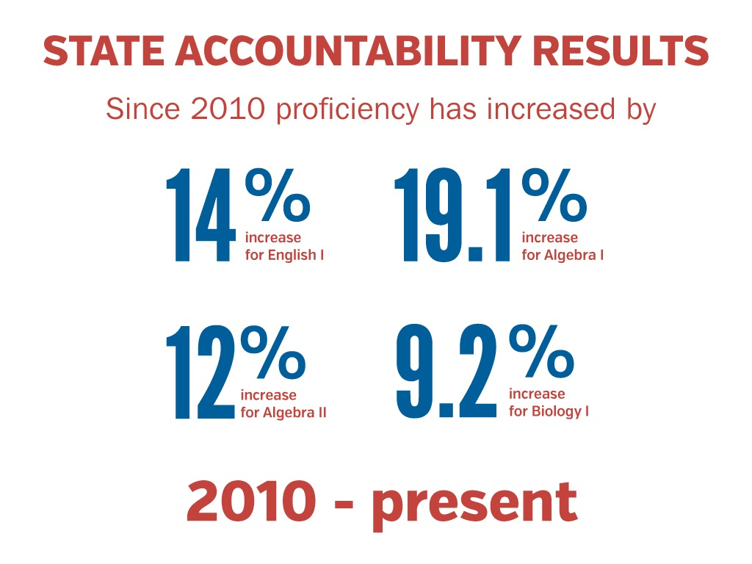
Nashville – Evidence of Success (2)
Notes:
The CBI’s annual skills survey shows that 69% of businesses were worried about filling skills shortages last year, up from 55% the previous year
UKCES employer skills survey shows more than a 100% growth in skills shortage job vacancies in four years.
Meanwhile, employers consistently tell us that work experience is the most important thing when recruiting.
And the returns from apprenticeships are higher than degrees.
NONE OF THIS IS TEACHERS’ FAULT. And yet in school the EBacc, performance measurement system and funding are squeezing out creative and technical subjects, employer engagement and careers guidance.
You have already come on a huge journey with the Career Benchmarks Pilot. This is an opportunity for you to continue to lead the way.

Slide 7



Model 2 – High Tech High

Slide 8
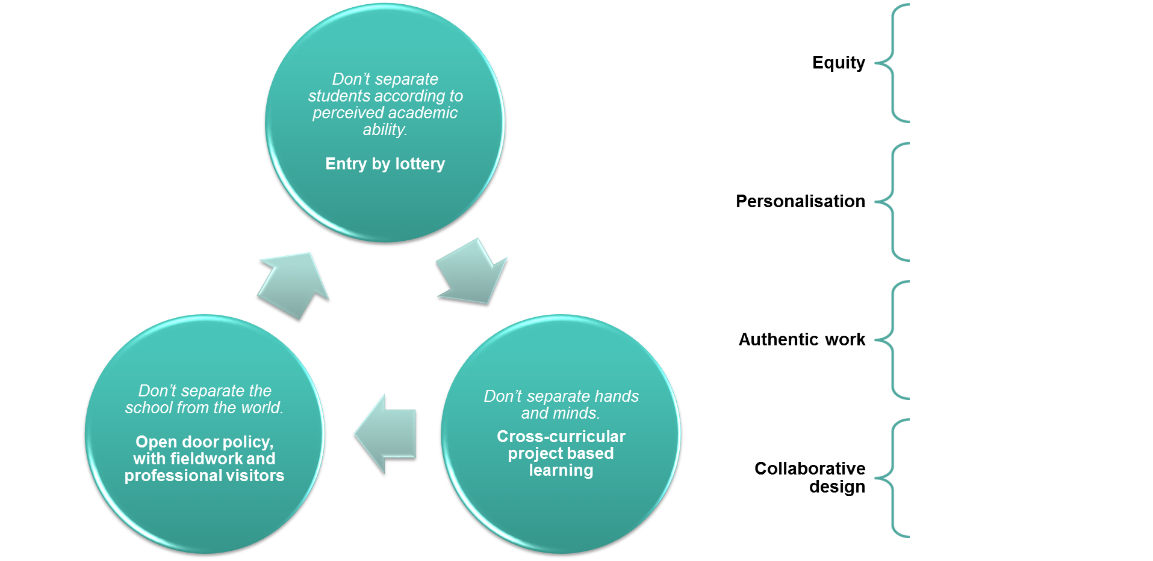
High Tech High – Key Principles

Slide 9

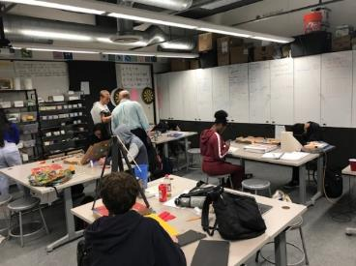
High Tech High – Project Based Learning
Project Launch
Assessment
Reflection
Essential questions
Brainstrorm
Critique
Drafting & Revision
Exhibition

Slide 10
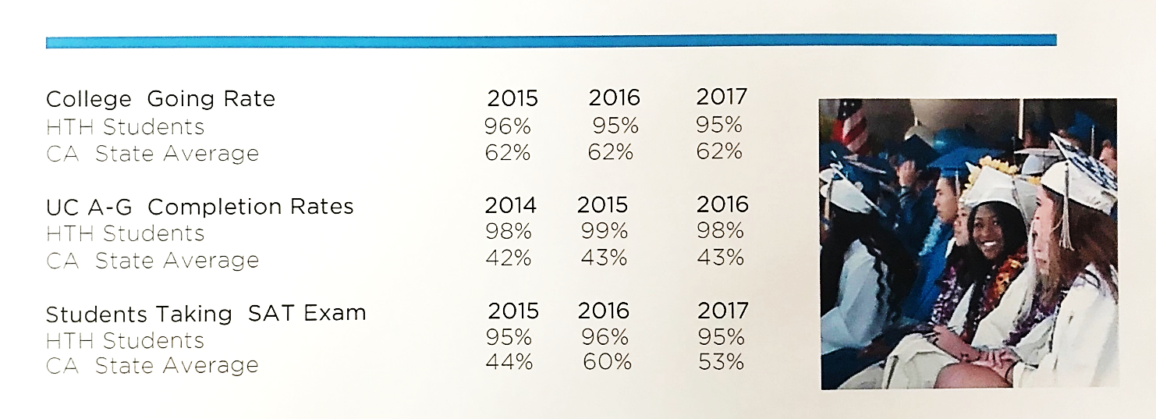
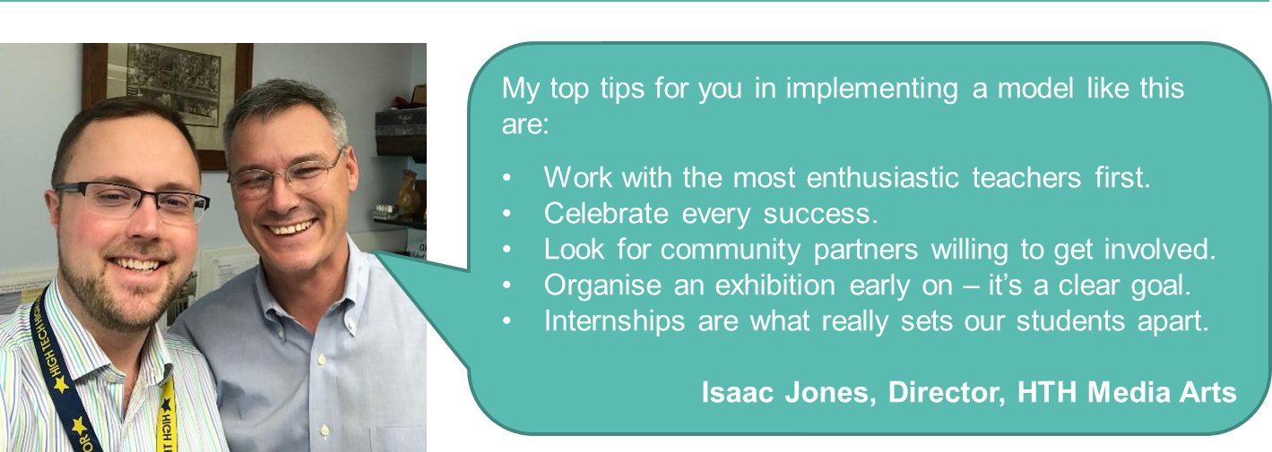
High Tech High – Evidence of Success
Notes:
The CBI’s annual skills survey shows that 69% of businesses were worried about filling skills shortages last year, up from 55% the previous year
UKCES employer skills survey shows more than a 100% growth in skills shortage job vacancies in four years.
Meanwhile, employers consistently tell us that work experience is the most important thing when recruiting.
And the returns from apprenticeships are higher than degrees.
NONE OF THIS IS TEACHERS’ FAULT. And yet in school the EBacc, performance measurement system and funding are squeezing out creative and technical subjects, employer engagement and careers guidance.
You have already come on a huge journey with the Career Benchmarks Pilot. This is an opportunity for you to continue to lead the way.

Slide 11

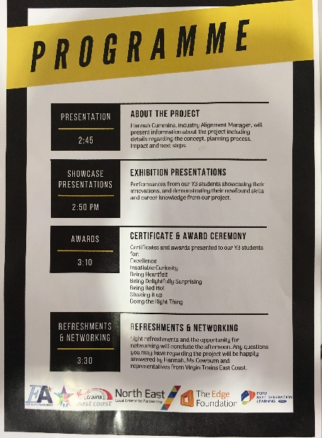
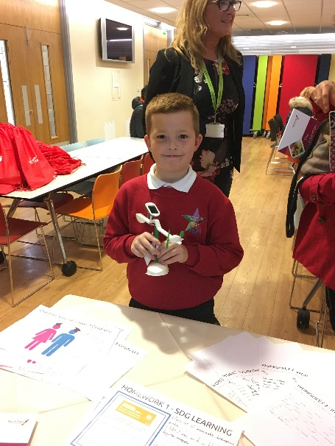
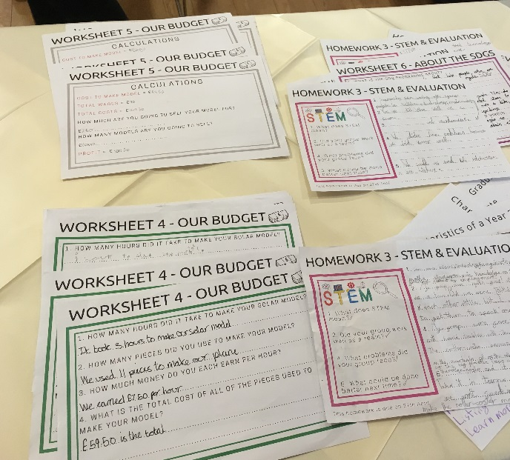







Edge Future Learning Pilot

