Slide 1
RESTRICTED - Policy
Our Plan for Higher Education
Olly Newton
July 2018

Slide 2
Overview
Changing trends in HE participation and the graduate premium
Research on perceptions of value for money
Employer perspectives
Case studies of leading practice
Policy recommendations

Slide 3
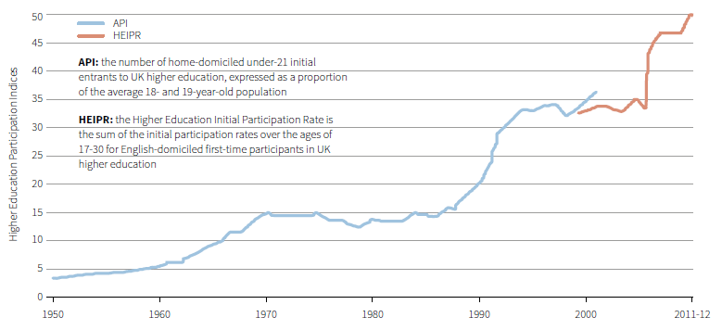
The proportion of young people going into Higher Education has risen rapidly in recent decades.
Growth in Higher Education participation rates since 1950
Source: The Edge Foundation (2017), Our Plan for Higher Education

Slide 4
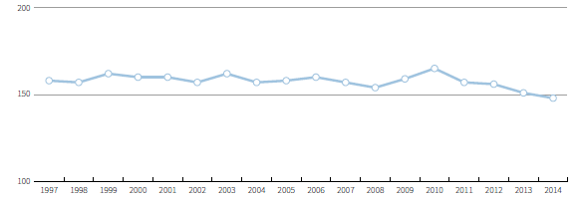
The wage premium for degrees is falling and is highly variable. Meanwhile student debt has risen rapidly.
Graduate premium, indexed against average earnings for those holding A-Levels or equivalent
Graduate Premium
Distribution of median earnings by subject, 5 years after graduation
Average student debt
> £58,000
Sources: OECD; Longitudinal Education Outcomes (LEO) dataset; IFS (2017), Higher Education Funding in England

Slide 5
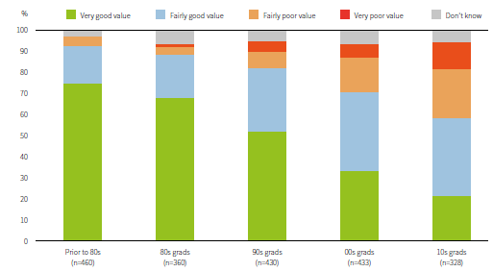
As a results, perceptions of value for money from graduates have reduced dramatically.
Perceptions among graduates of whether their degree offered good or poor value for money
Source: The Edge Foundation and YouGov (2017), quoted in Our Plan for Higher Education. Survey of 1,000 graduates.

Slide 6
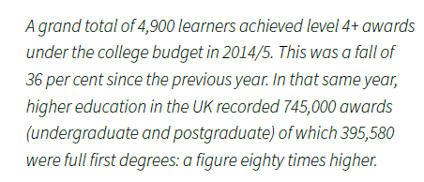
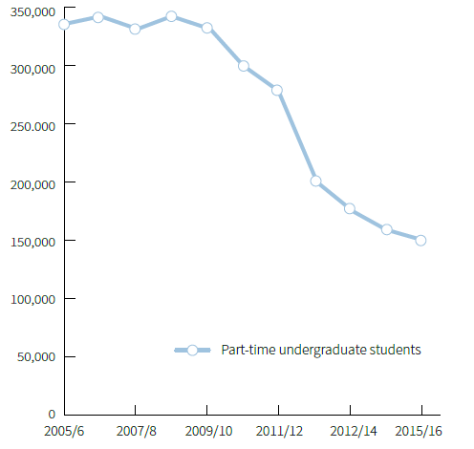
Higher Education delivery is becoming less diverse…
Decline in part-time undergraduates (2005-2016)
Sources: A Wolf, Remaking Tertiary Education (2016); HESA

Slide 7
…missing the very skills that employers are seeking.
Value placed by employers on different qualifications and experience when hiring
L3+ Engineers required every year
203,000
Sources: DfE (2017), Employer Perspectives Survey 2016; Engineering UK (2018)

Slide 8
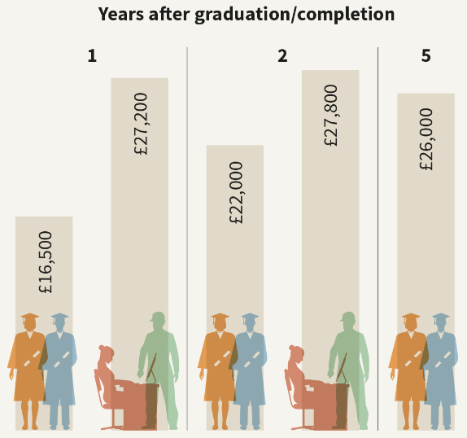
The value placed on these skills is clear when we compare L6 Degrees and L5 Apprenticeships
Comparison of average pay for those completing degrees versus L5 apprenticeships
Degree
L5 App
Degree
L5 App
Degree
Source: Longitudinal Education Outcomes (LEO) dataset

Slide 9
There are pockets of excellent practice in the UK and lots of excellent models to learn from internationally

Slide 10
Policy Conclusions
Diverse
More higher education opportunities delivered within Further Education.
More L4 and L5 opportunities, sandwich and part-time courses and accelerated courses.
A greater diversity of providers within the marketplace.
A significant expansion of higher and degree apprenticeships.
Employment-Focused
Value for Money
High quality careers services at the heart of every higher education institution.
A culture amongst all staff that employability is everyone’s business.
Intensive employer partnerships – providing real world context, exchanging staff, offering placements and collaborating on projects.
High quality and realistic careers advice at school about the range of options and likely returns.
A reduction in tuition fees, which should be much more differentiated based on the course.
Medium to long-term employment destinations should be the main measure of HE success.

