Slide 1
Different but equal? The role of equivalency policies in sustaining secondary VET
Amelia Peterson, Harvard University
5th International Conference on Employer Engagement in Education & Training
London, 5th July 2018

Slide 2
Why have secondary VET?
Typically, better employment prospects for school-leavers than a general diploma/qualification (Iannelli & Raffe, 2007; Ryan, 2001)
In some countries, employers take on some of the cost of secondary education
Potentially, more engaging for young people who would otherwise drop out of school
and in most contexts more years of schooling = better
Notes:
Always worth asking…

Slide 3
Higher education expansion
-> vocational decline?
Sociological theories
Relative Risk Aversion (Breen & Goldthorpe)
Effectively-maintained inequality (Lucas)
and political economy theories
Median skill-seeker (Busemeyer & Trampusch)
Varieties of Capitalism (Hall & Soskice)
predict yes

Slide 7
Decomposing secondary VET (as best we can)

Slide 8
Changes in Enrolment for 16-20 year olds, 2002 – 2012
 | Low VET systems |  | High VET systems
 | Australia | New Zealand | Germany | Austria
change in % upper secondary vocational enrolment, 16-17 yrs | - 3 | +7 | -15 | -3
change in % entry to academic tertiary education, 18-20 yrs | + 16 | +13 | + 11 | + 9
Source: OECD.stat Archive database: ISCED 1997 data: 2000-2012.
Notes:
First issue – “upper secondary education” is not just for young people now – things look different when you hone in on an age group
NB New Zealand’s story seems to be just that they learned how to count – they still have pretty low vocational enrollment rates

Slide 9
Proportion of enrolled cohort who are in vocational programs, by age 2015
 | Age 15 | Age 17 | Age 19
Australia | 3% | 14% | 32%
NZ | 2% | 12% | 13%
Germany | 2% | 32% | 51%
Austria | 57% | 58% | 61%
Notes:
Just to hammer that point home – things look very different depending on the age group we are talking about
That will be partly do to with institutional legacies – but also something developmental?
Main point – it is not the case that the half who are not going to university take vocational programs at school

Slide 10
Types of secondary VET
Categorisations tend to distinguish based on the location of learning (Green, Oketch, & Preston, 2004; Ryan, 2001)
Type I = work-based or apprenticeship programs
Type II = and school-based vocational education
But “school-based” can mean college, vocational schools, or general schools.
Type III? = school-based VET courses which form part of a high school diploma/certificate or general secondary pathway. Not in comparative stats.
Notes:
In most English-speaking countries, these students do not appear in international statistics as enrolled in a vocational program.

Slide 11
Estimates of enrollment in upper secondary VET by type, 15-19 year olds, 2015
 | Type I | Type II | Type III
Australia | 6% | 14% | 33%
NZ | 3% | 10% | 30%
Germany | 26% | 10% | [13%]
Austria | 35% | 24% | 11%
Sources: multiple; OECD and national records, estimated over 15-19 population
Notes:
NZ – school leavers (roughly equivalent to one year of the youth population) who got a “vocational pathway” award
Australia - Comparing 15 to 19-year-olds, post- school VET students more likely to be undertaking certificate III and above qualifications and VETiS students certificates I and II (Misko, Korpel & Blomberg 2017)
Germany – Type III figure = The proportion of entrants into “general secondary education” who enter into a vocational school. Another way to view the separation by types in Germany is in terms of the proportions of entrants to the VET system (so excluding all students in general education) who are in different types of VET: in 2015 this was 50.2% in the dual apprenticeship system; 21.5% in vocational schools; and 28.3% in the transition system. Source: Bildung in Deutschland 2016, p. 102, based on the Integrated Training Reporting System
Austria -
I: Share of year 10 students in a vocational school for apprentices; this increases to 42.0% amongst year 12 students. Source: BMBF Statistical Guide 2015, school year 2014/15, p. 37
II: Share of year 10 students in vocational colleges, leading to a recognized vocational qualification. The proportion for year 12 students is 28.3.
III: Share of year 10 students in schools for intermediate vocational education, not leading to an industry qualification. The proportion for year 12 students is 2.9.

Slide 12
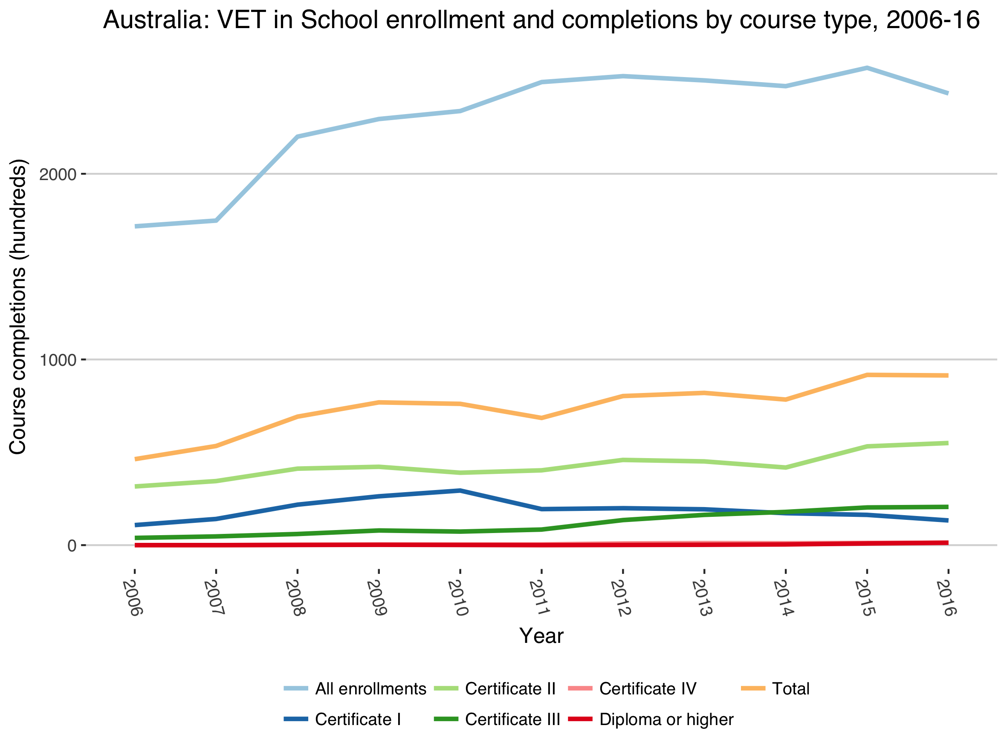
Notes:
So, breaking this down in the case of Australia, here we see a little of what the difference between Type II and Type III means

Slide 13
Enrollments -> some of these will be courses taken at part of a senior secondary certificate and not completed
All completed courses
Notes:
Just to understand more visually what that type III means…
Certificate Is and IIs are designed to take 0.5 – 1 year (according to the AQF volume of learning)

Slide 14
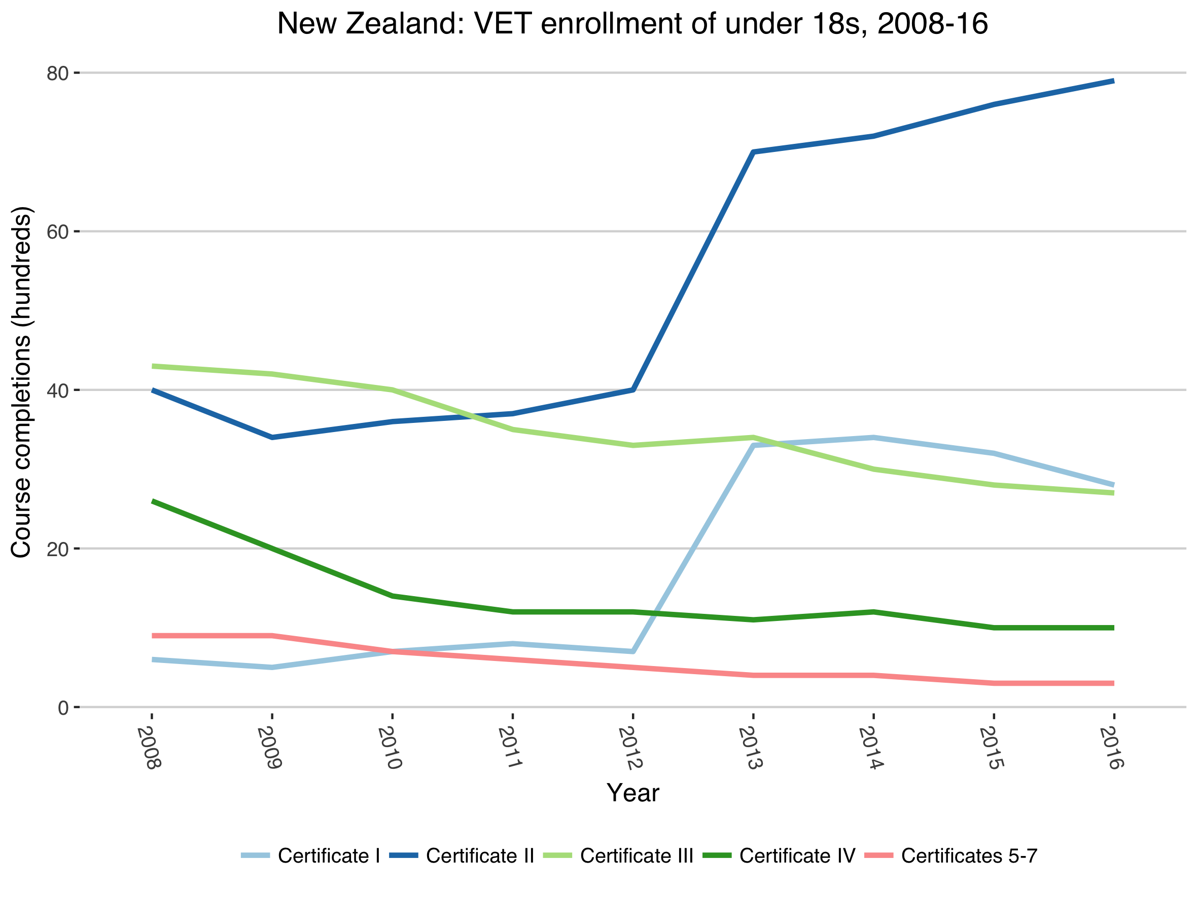
Notes:
From a baseline of c. 60,000 in a single year age cohort
The vast majority of people taking certificate IIs, IIIs, etc are over 20.

Slide 15
The Australia vs New Zealand story
Australia:
Big rise in general upper secondary associated with Year 12 completion target (deflates the vocational share)
With university cap (formally) university entry requires an “ATAR” -> students take senior secondary certificate subjects
”VET in Schools” courses can count towards Year 12 completion, senior certificates and, in some cases, ATAR; other VET (e.g. leaving for full-time TAFE) does not
New Zealand:
Measurement error: New funding regimes -> increase in counting younger students in the Tertiary sector, which covers all of VET
Substantive factor? Less risk in choosing VET; over the age of 20, anyone can apply for university without general qualifications
Notes:
2008/9 – new Tertiary Education Strategy in New Zealand and new caps on numbers came into effect
2012/13 – start of the Better Public Services targets

Slide 16
Comparing Germany and Austria

Slide 17
University entrance in Austria
Any students with the Matura can access almost any university course, regardless of grades (Medicine, Psychology, and a growing number of courses at the University of Vienna are exceptions). Typically studied over 4 years at an AHS (high school).
Students who complete a five year Vocational College (berufsbildenden höheren Schule, BHS) also get general university access (allgemeinem Hochschulzugang).
Students who have completed an apprenticeship can gain full university access via the Berufsreifeprüfung (BRP = “vocational-maturity-exam”) introduced in 1997 and from 2008 as the “Berufsmatura”.
Notes:
Students may also gain access to specific HE courses via the Studienberechtigungsprüfung (SBP = “study-authorization-exam”).
For the SBP, the curriculum is based on the 12./13. school level (connecting class of a BHMS). The exam is taken by the commission at the university.

Slide 18
University entrance in Germany
The main form of access is with the Allgemeine Hochschulreife (general higher education entrance), taken in the form of the Abitur (or “Abi”) at a Gymnasium or comprehensive. Only a small number of vocational schools (Fachgymnasium, Berufsoberschule) offer the Abitur.
A range of entrance qualifications known as the “Fachabitur” provide access only to technical colleges or some specific vocational/professional university courses.
Fachabi =/= Berufsmatura
As of 2009, those with a professional vocational qualification (a “Meister” level or equivalent) can gain access to specific university courses
Notes:
The main difference between the Abitur and the Fachgebundene Hochschulreife – the subject-specific version of the Fachabi – is having a second foreign language

Slide 19
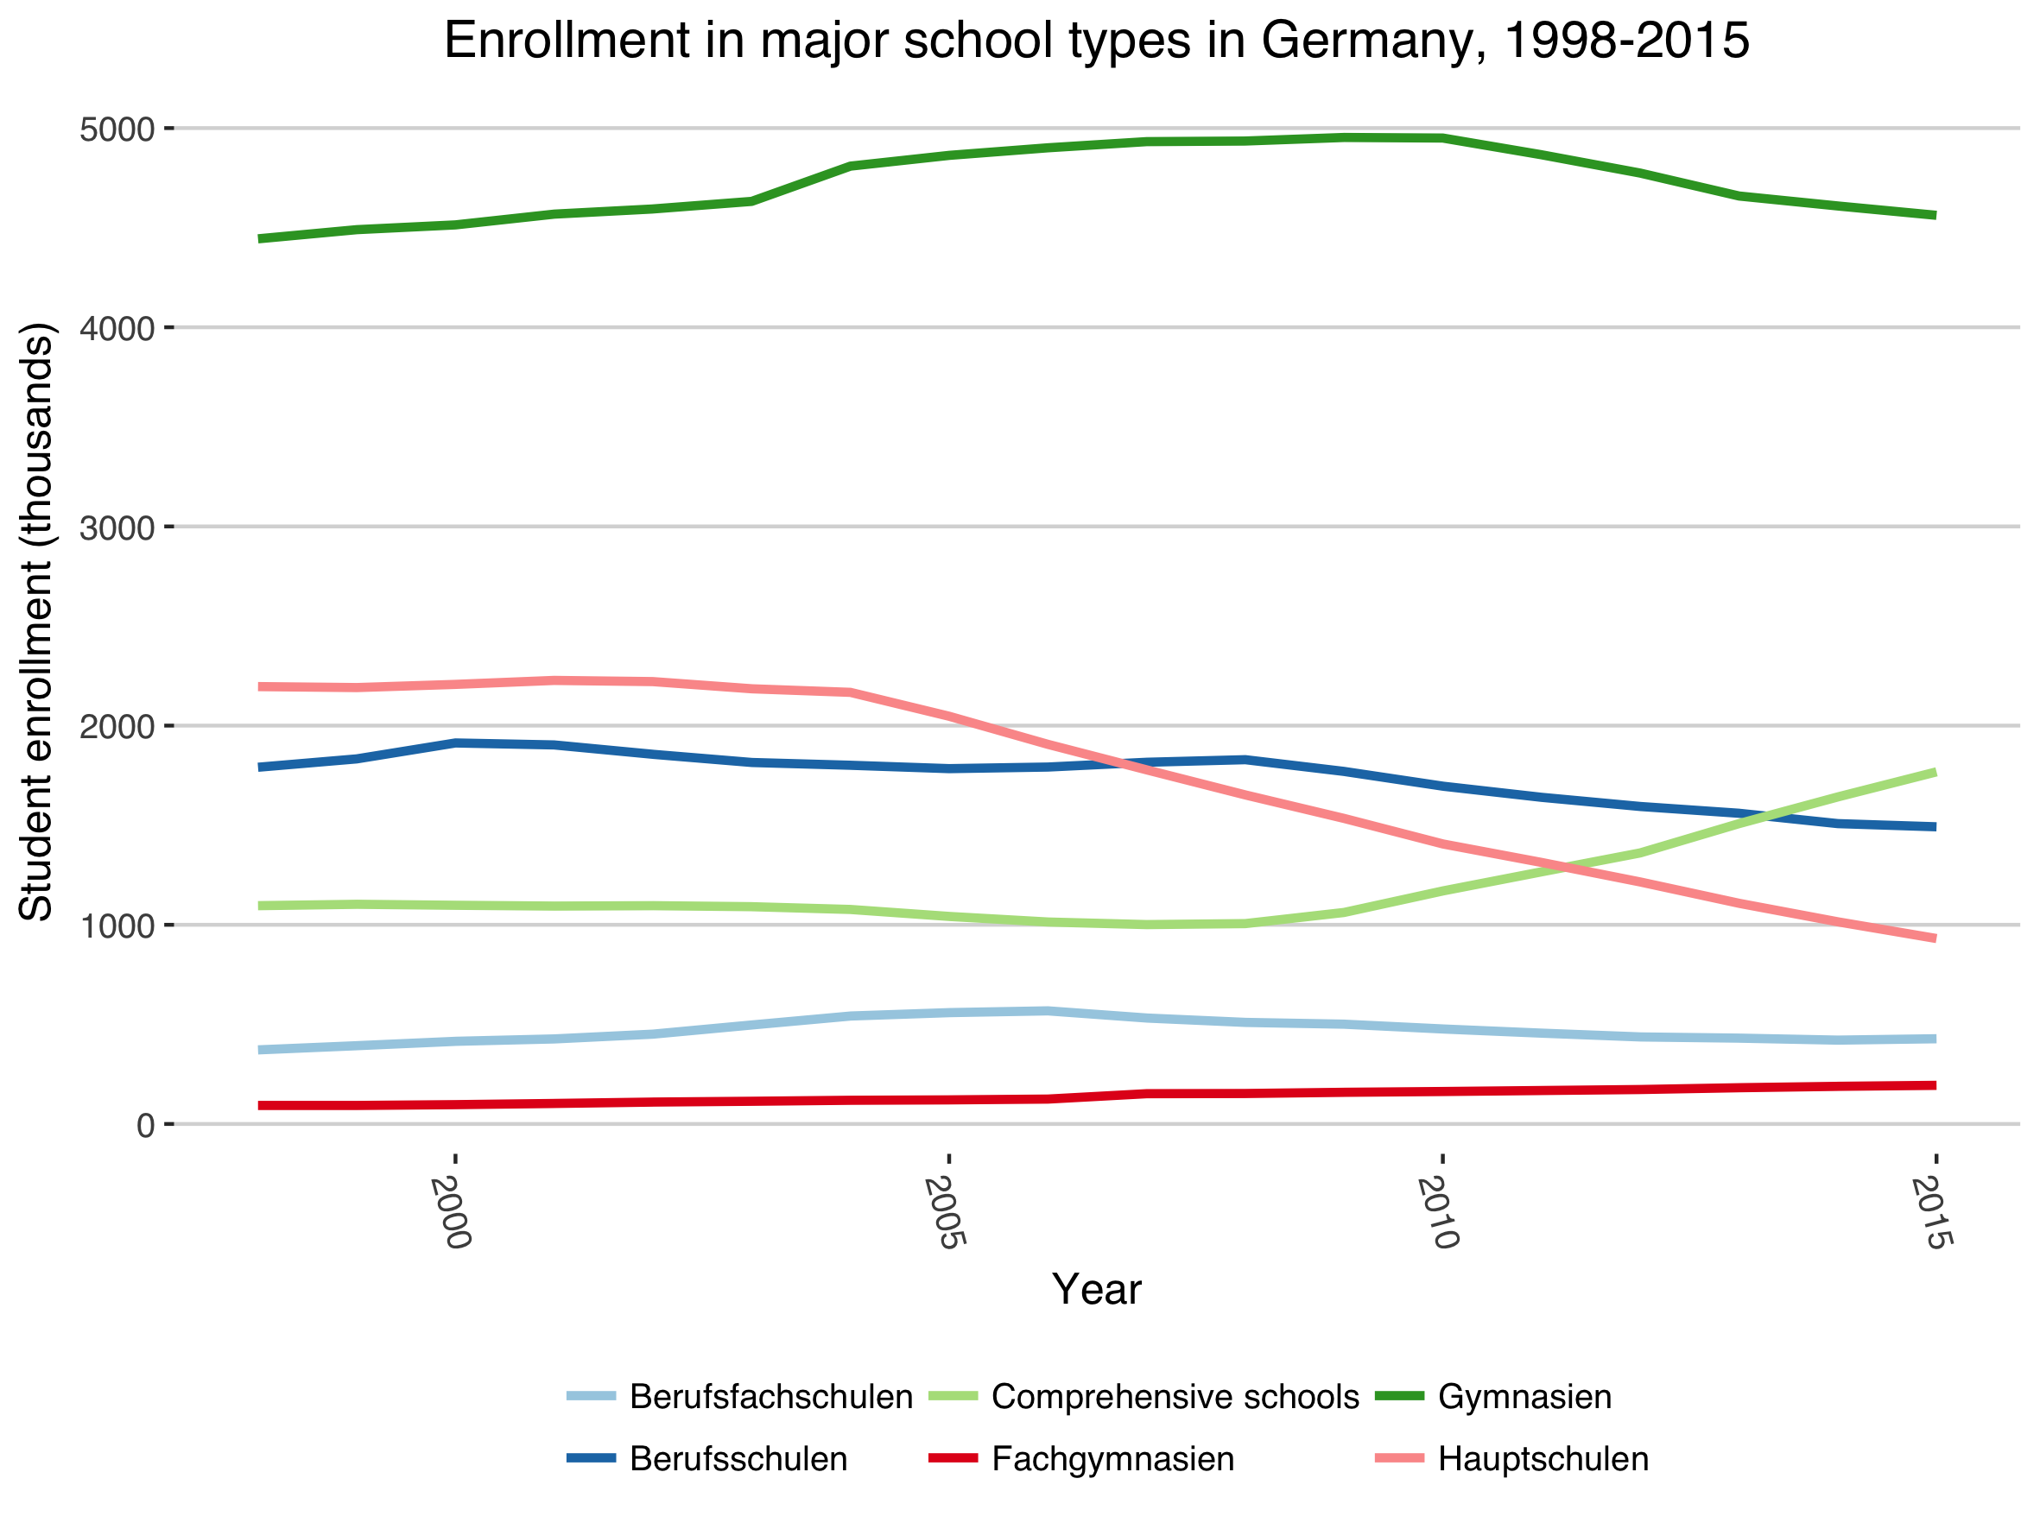
Notes:
All you need to note here is the switching trend from Hauptschule to comprehensive schools – students are trying to keep their options open
And there is a distinct regional variation to this pattern

Slide 20
Berlin
Decline in vocational schools for apprentices
Maintenance of Gymnasia despite the G9 to G8 switch
Eradication of Hauptschule and introduction of more comprehensive schools
Notes:
Let’s look at this in more detail
Summarize patterns across German Lander:
Common pattern across diverse German Länder:
Disappearance of Hauptschule (linked to population decline and structural changes)
Growth in comprehensive schools
In most areas except the south:
Decline in vocational schools
No rise in the higher level vocational schools

Slide 21
Bavaria
Large southern, west German Land
Socially conservative, industrial heartland
Similar pattern, but more muted
More stability in vocational school enrolment

Slide 22
Mecklenburg Pomerania
Former east Germany
Less industry, decline in secondary school population post 2000 due to low birth rates in late 1980s
Rapid fall off in vocational schooling in the dual system (apprentices)
Comprehensives and higher level vocational schools remain steady

Slide 23
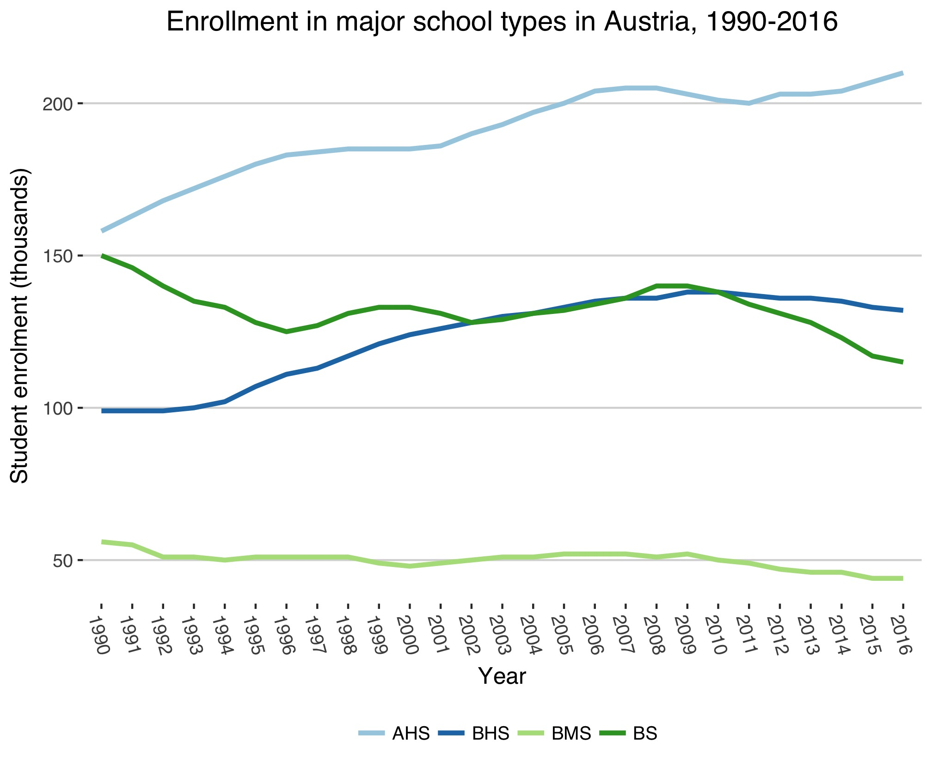
Notes:
In Austria, there are some similarities in the patterns, but the options on the table are quite different

Slide 24
Vienna, Austria
Fluctuating but steady enrollment in normal vocational schools (for apprentices)
Rapid increase in enrollment in schools leading to the Matura (AHS)
Steady rise in enrollment in higher level vocational schools (BHS)
Notes:
Summarize patterns across Austrian Lander:
Increased enrollment in the academic schools
But also increased enrollment in the higher vocational schools (BHS)
BHS enrollment peaks in the high-industry Länder in the mid-2000s, but continues to rise in other areas
Enrolment in Berufsschule (BS) that are part of the dual system of apprenticeship fluctuates – related to the flow of apprenticeship places
Enrollment in the BMS falls away

Slide 25
Lower Austria
Large, populous state, surrounding Vienna
Similar pattern to Vienna, greater divergence between vocational and higher vocational schools

Slide 26
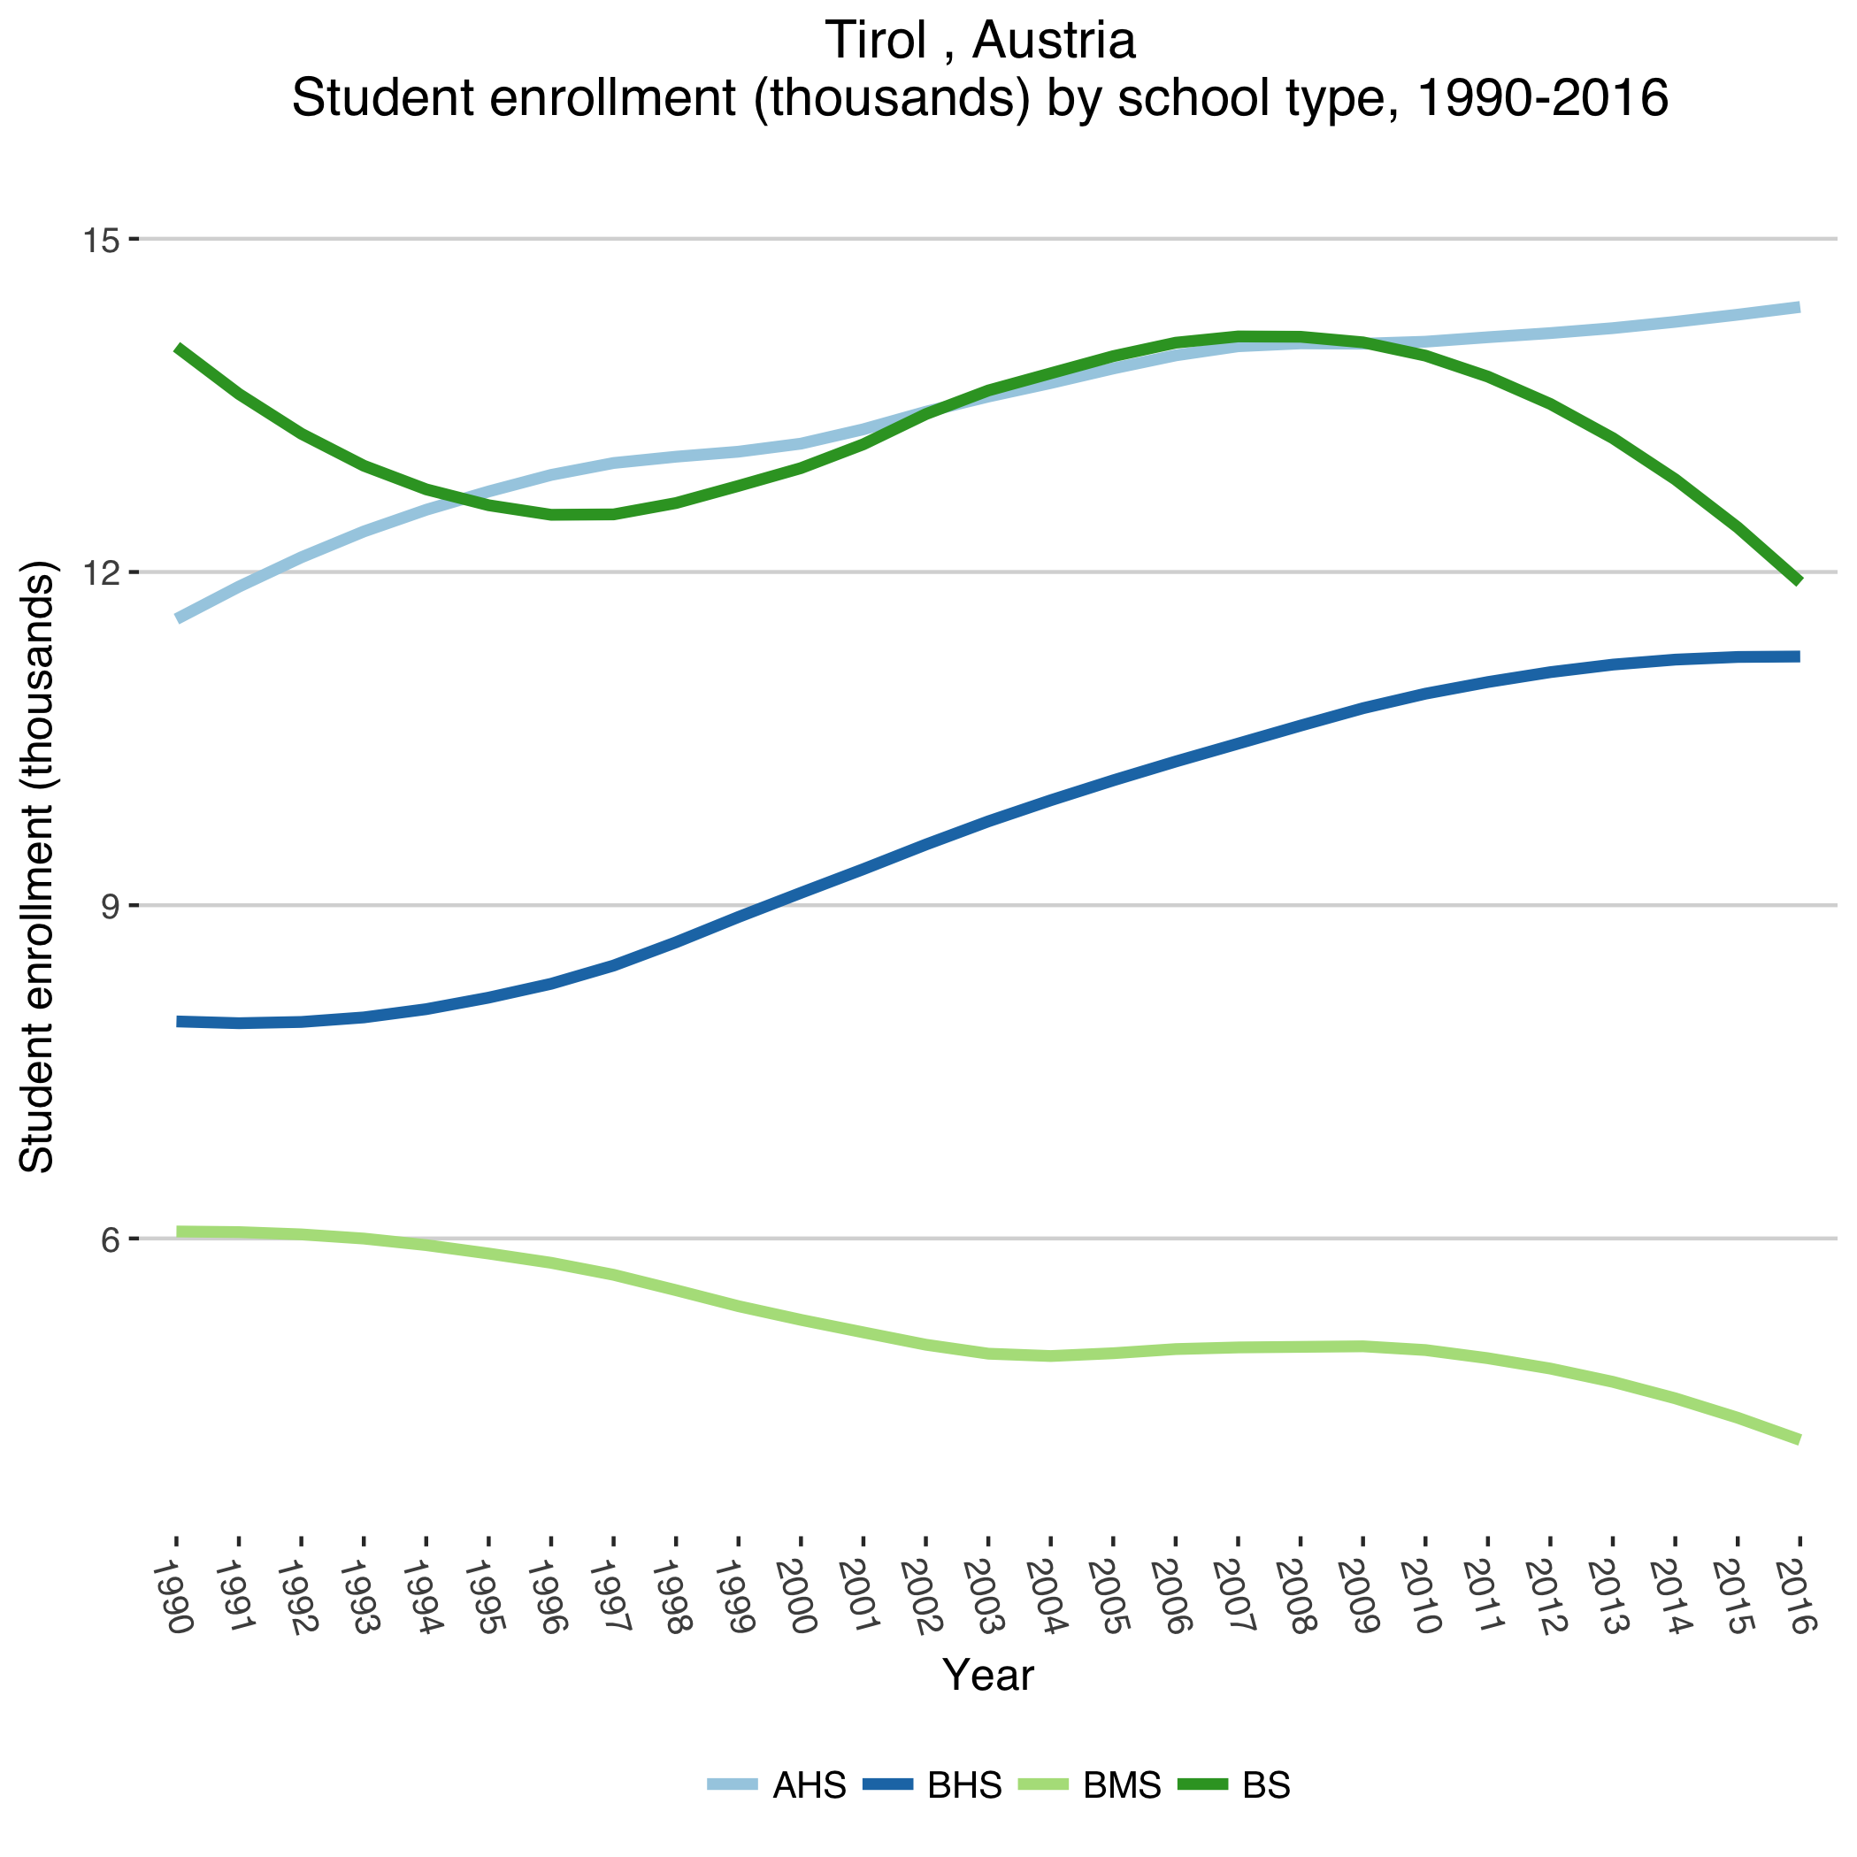
Tyrol
Medium-sized state, between Bavaria and Italy
Similar increase in AHS enrollment
Sustained increase in enrollment in higher vocational school (BHS), decline in other types

Slide 27
A closer look at the BHS
A Berufsbildende höhere Schulen is typically translated as a “vocational college”. It lasts 1 year longer than the AHS (high school/grammar school)
The individual economic returns of BHS qualifications are higher than for BMS, and higher even than for AHS (Vogtenhuber, 2009)
Average PISA scores for BHS (Vocational colleges) are around 90 points higher than at the BMS. But a larger portion of BHS performance can be explained by parental background (Lassnigg, 2009).
Notes:
So it’s not a magic wand

Slide 28
The BHS achieves a high reputation
Commenter 1: I would definitely recommend to my child to go to a BHS, because everything important is covered anyway, and really no one needs Latin any more.
Commenter 2: Of course a BHS degree is worth more than an AHS degree. As the name suggests, you have at least a job after that. It would also be surprising if it were different, after all, a BHS takes a year longer and you have 25% more lessons.
Der Standard, online, 24 Nov. 2015
Notes:
https://derstandard.at/2000026353051/Berufsbildung-Die-vergessenen-Schulen

Slide 29
…But is not without competition
Commenter A: Unfortunately, the BHS were devalued in the course of the "academization" by the introduction of these unspeakable FH’s [Fachschule]
Commenter B: It’s a completely different segment [of the education system]: The FHs are academic, the HTL [a type of BHS] just school graduate level.
Commenter A: The typical prepotency and arrogance of many FH graduates.
Commenter B: Cute. I'm not even a FH graduate. Incidentally, it is neither prepotency nor arrogance, but the technically correct classification. HTL [a type of BHS] graduates have high school and professional titles …while the FH is an academic institution with academic degrees …
Der Standard, online, 24 Nov. 2015

Slide 30
Equivalency policies: AT vs AU
Austria: BHS and Berufsmatura
Recognisable, easy to understand differentiation within vocational pathways (not without its costs…)
(General) university entrance qualification is taken alongside a full vocational qualification
Australia: Senior Secondary certificates with VETiS
General qualification comes first; students are penalized for taking “too much” VET
HE entry is course- as opposed to exam-based – harder to make up for

Slide 31
Conclusion 1: No high-income countries have sustained secondary VET without creating institutional pathways which combine VET and general HE entry
Conclusion 2: We know more about gross enrollments than enrollment shares within a given cohort, but both are important for designing and maintaining secondary VET systems (really markets…)
Notes:
Systems – or really markets

