Slide 1
Capabilities and habits of mind
Global education solutions to skills mismatches
Prof Bill Lucas
Centre for Real-World Learning
@LucasLearn

Slide 2
Which skills matter most for employability?

Slide 3
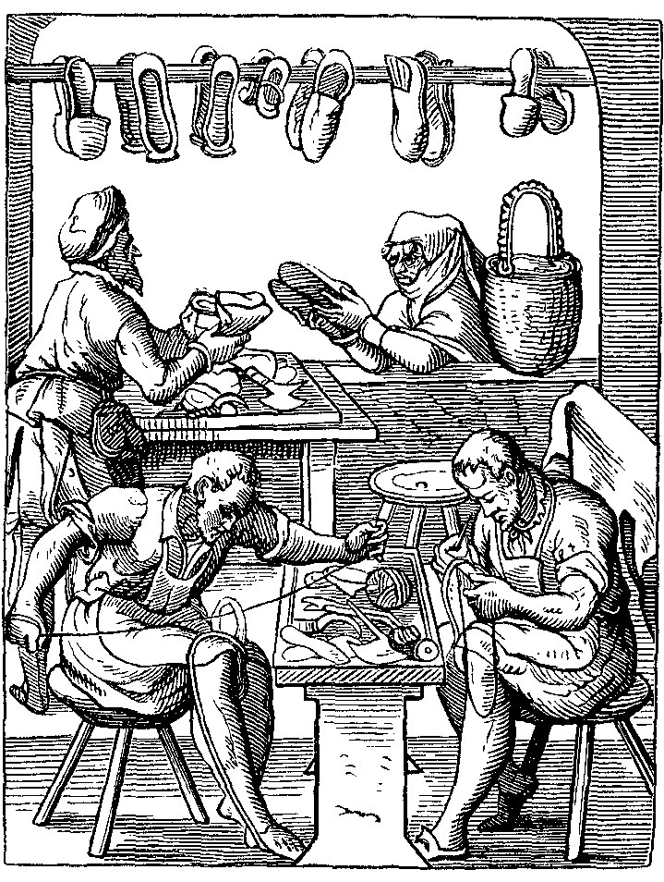
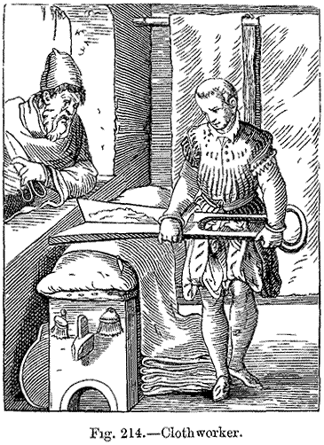

Slide 4
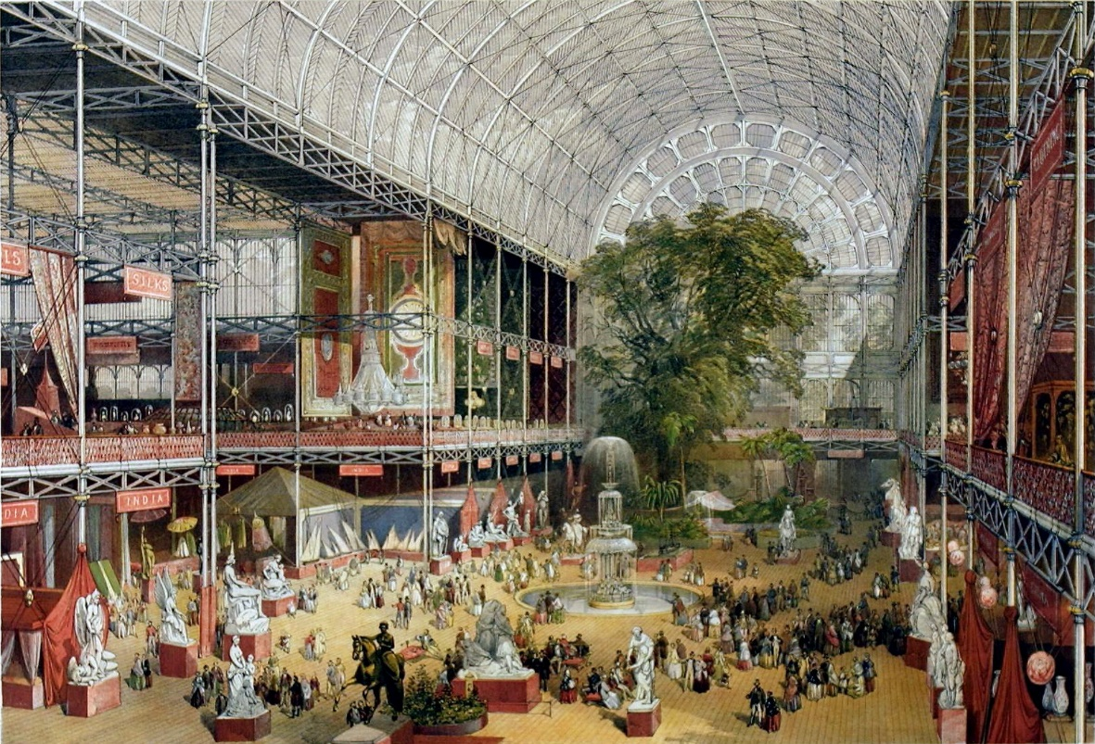
‘The original meaning of [the 3Rs] was completely different in Regency times, at the beginning of the 19th century. The three Rs were reading, wroughting and arithmetic - in other words, literacy, making things and numeracy…And then in the era of Mr Gradgrind and the Great Exhibition of the 1850s, the wroughting got dropped in favour of writing.’
Sir Christopher Frayling, Rector of the Royal College of Arts, interviewed in The Guardian 29/6/04

Slide 5
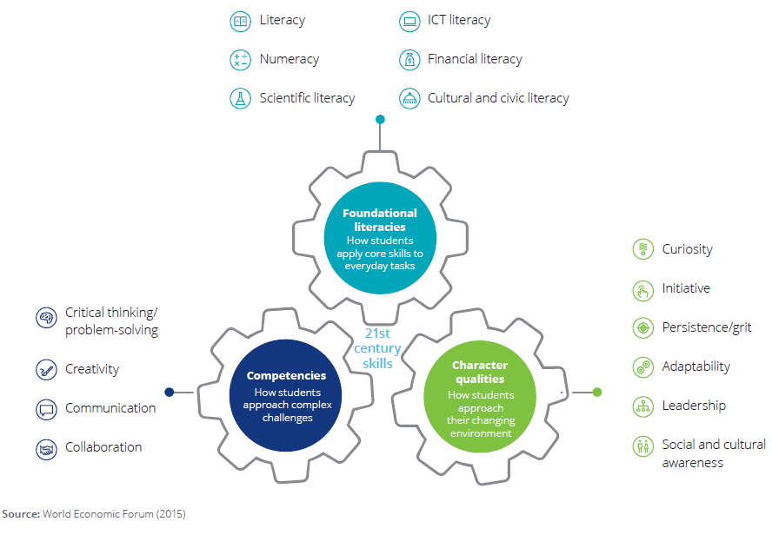

Slide 6
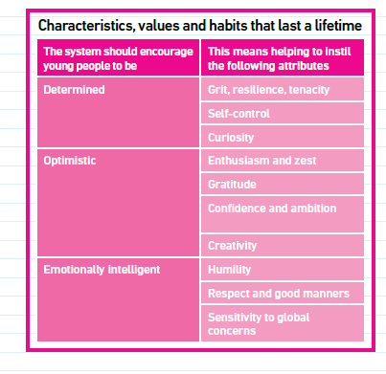
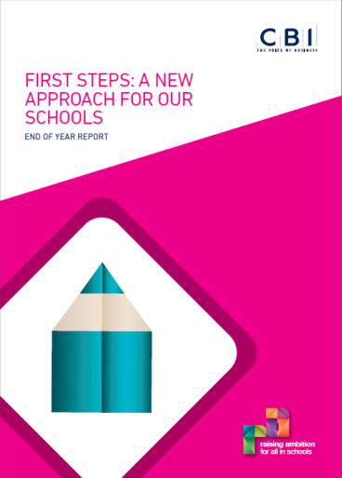

Slide 7
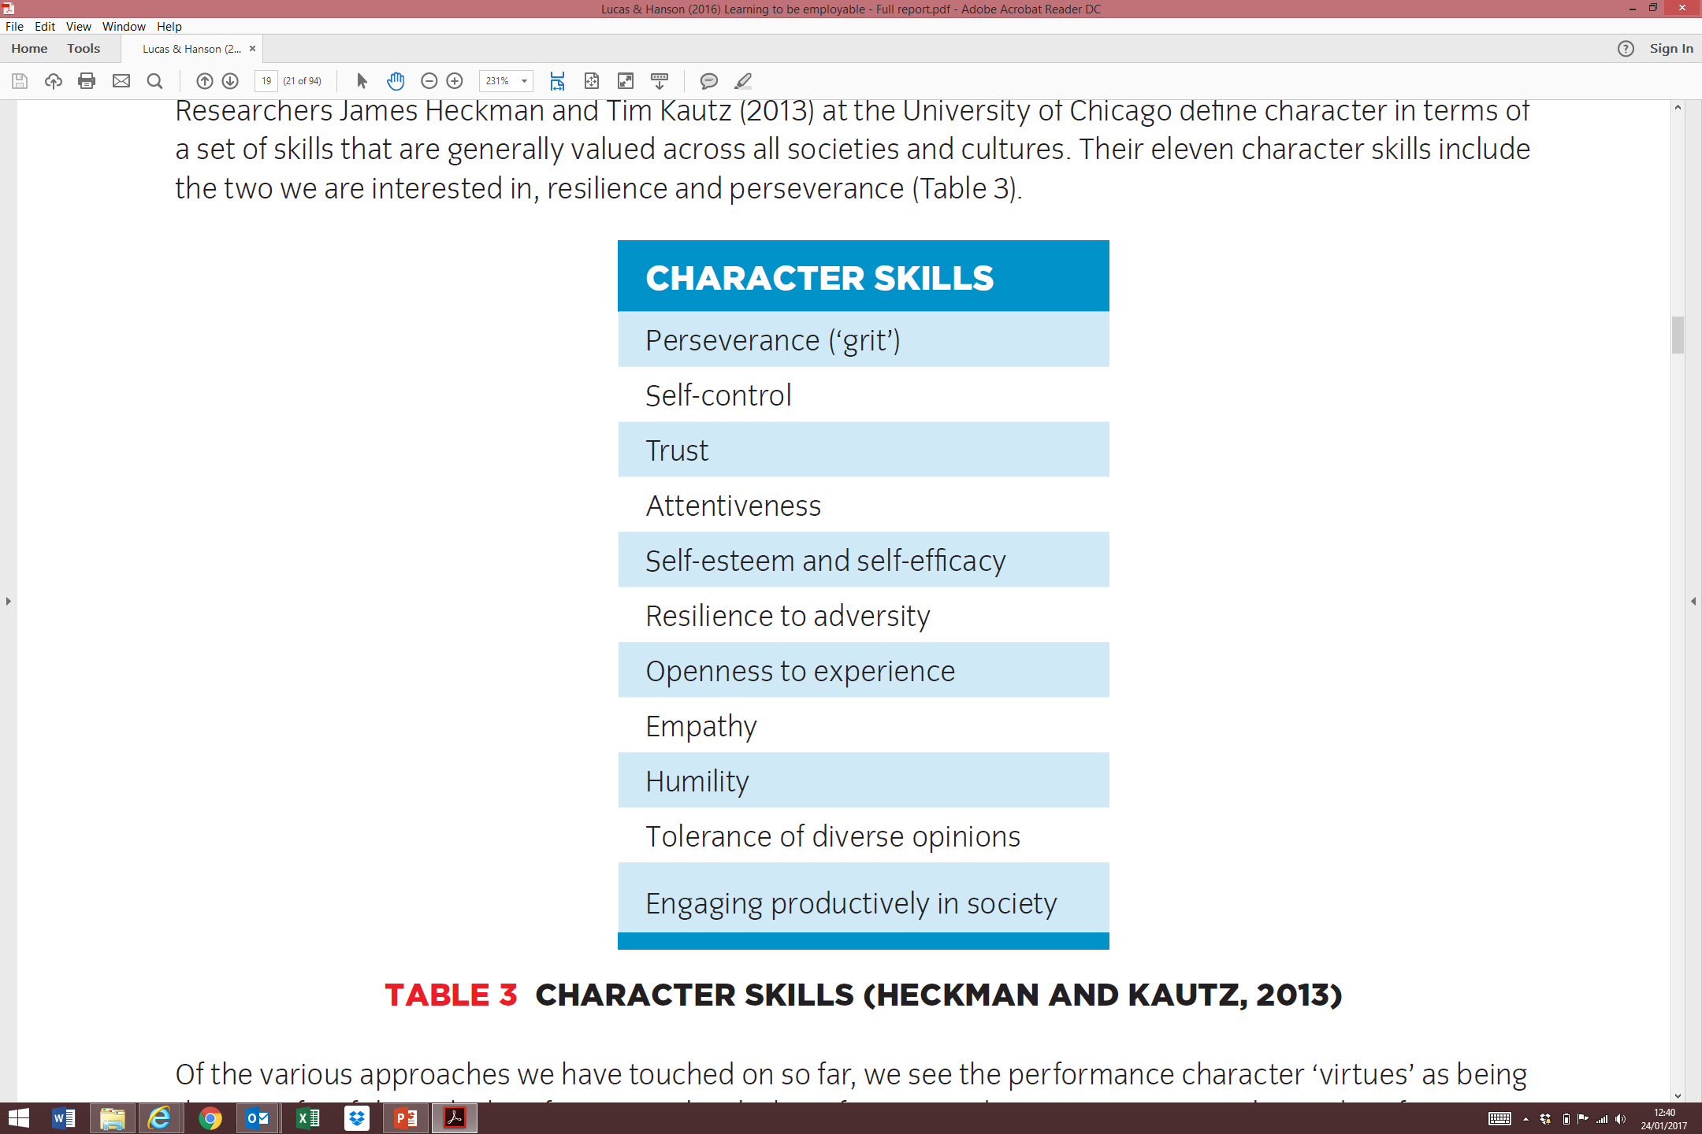
James Heckman & Tim Kautz (2013) Fostering and measuring skills interventions that improve character and cognition.
Bonn: Institute for the Study of Labor.

Slide 8
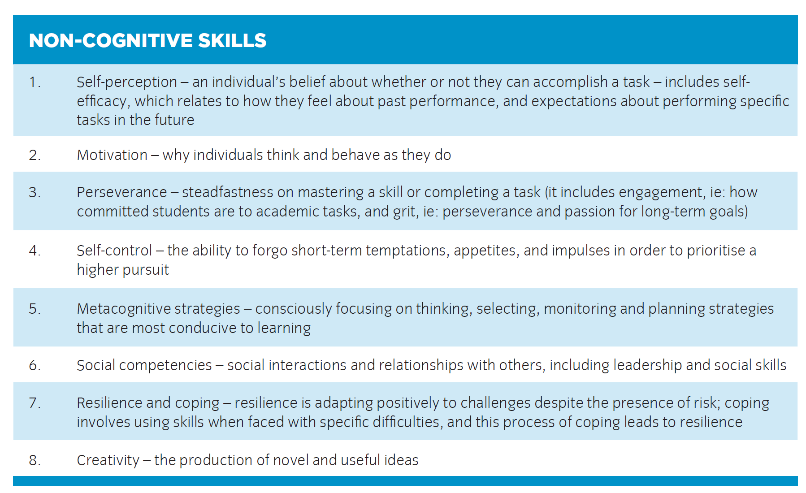
Leslie Gutman & Ingrid Schoon (2013)
The impact of non-cognitive skills on outcomes for young people.

Slide 9
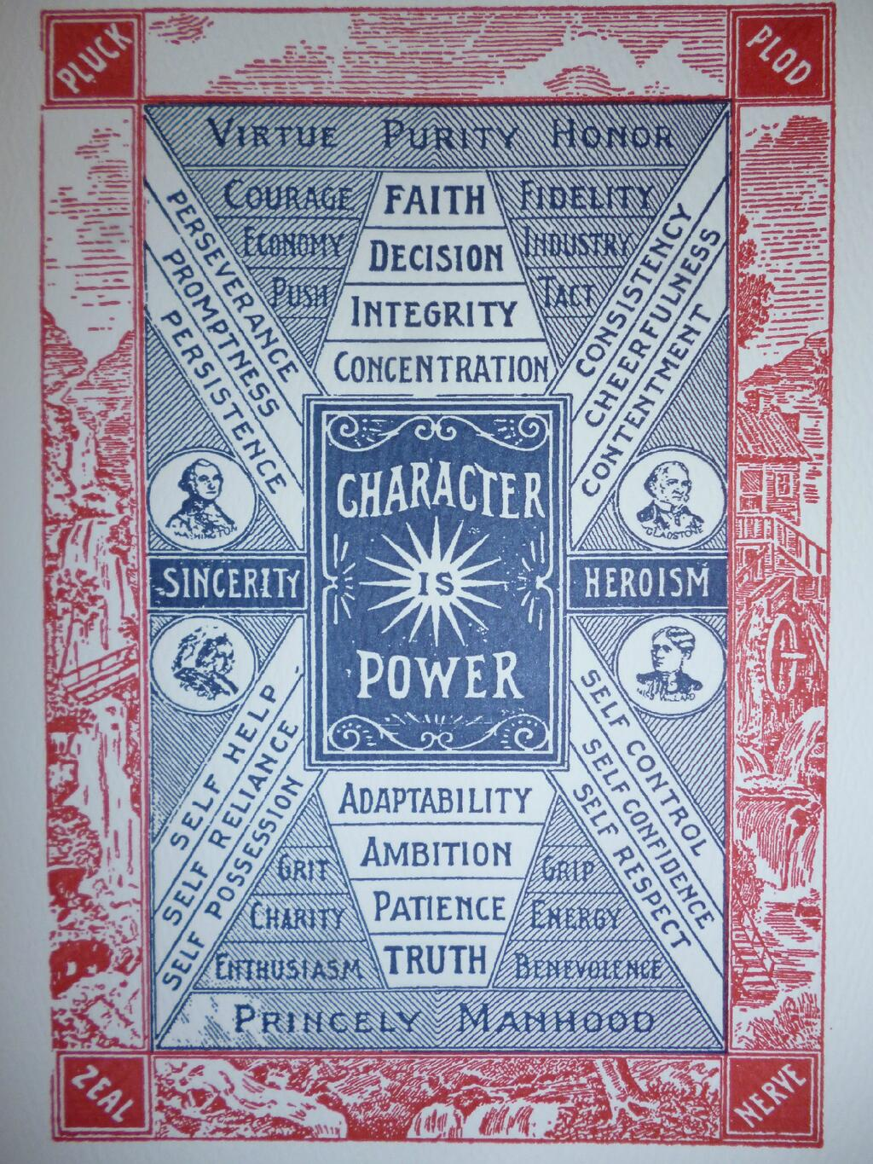
?
Henry Kletzing (1898)
Traits of Character

Slide 10
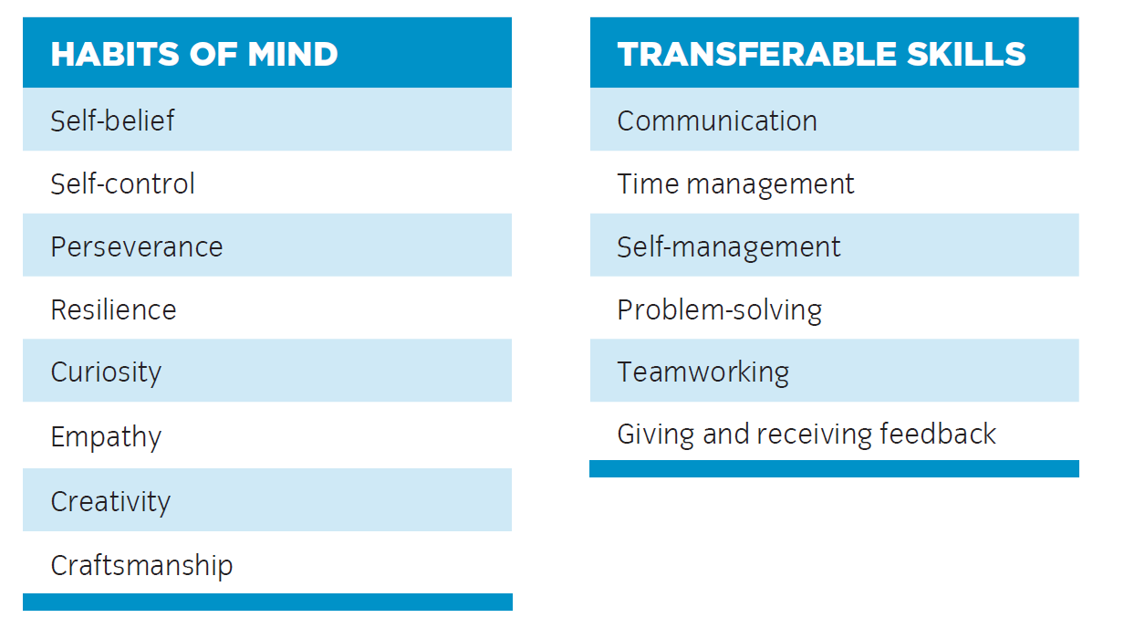
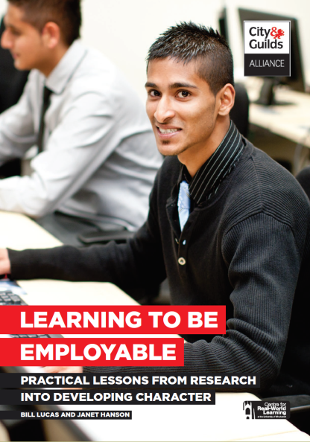

Slide 11
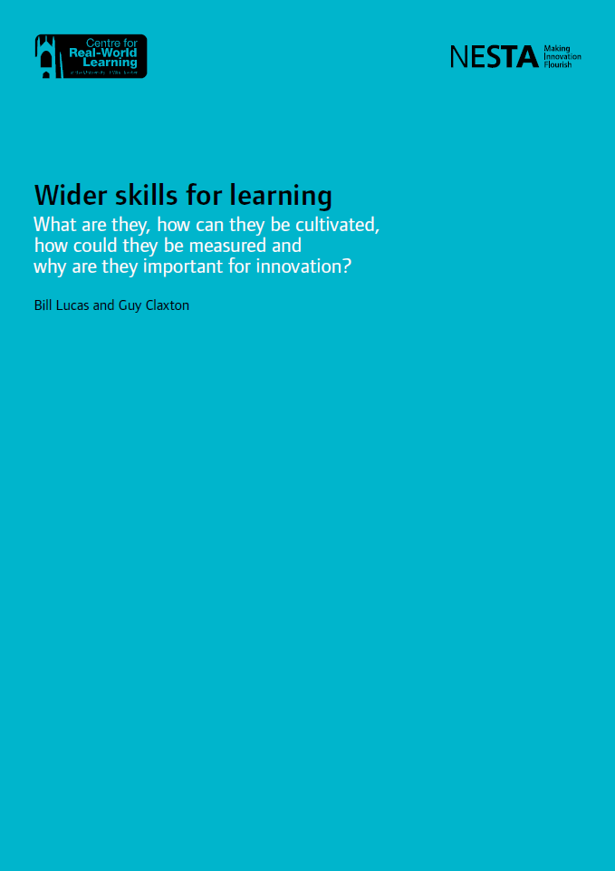
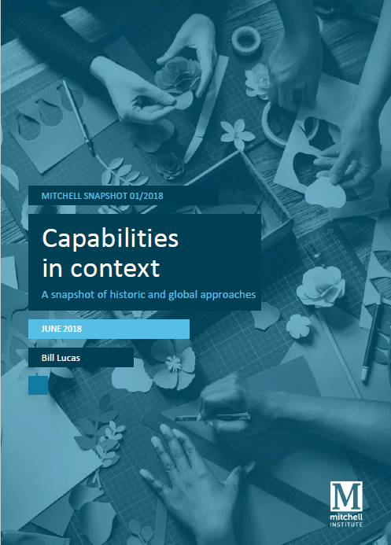

Slide 12
Some educational solutions [1]
REFRAMING

Slide 13
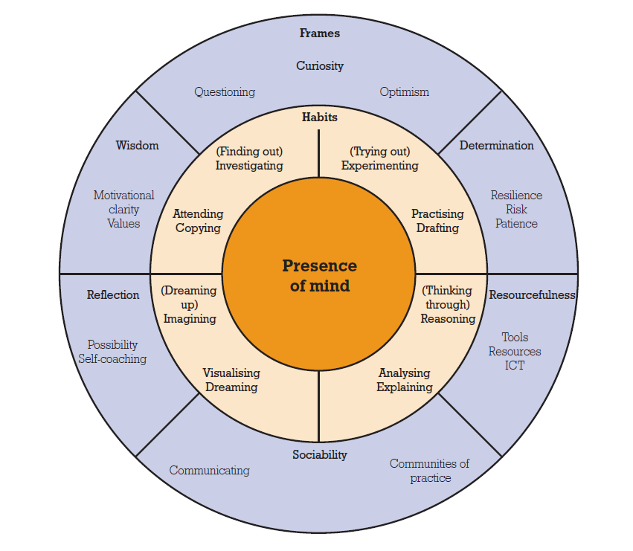
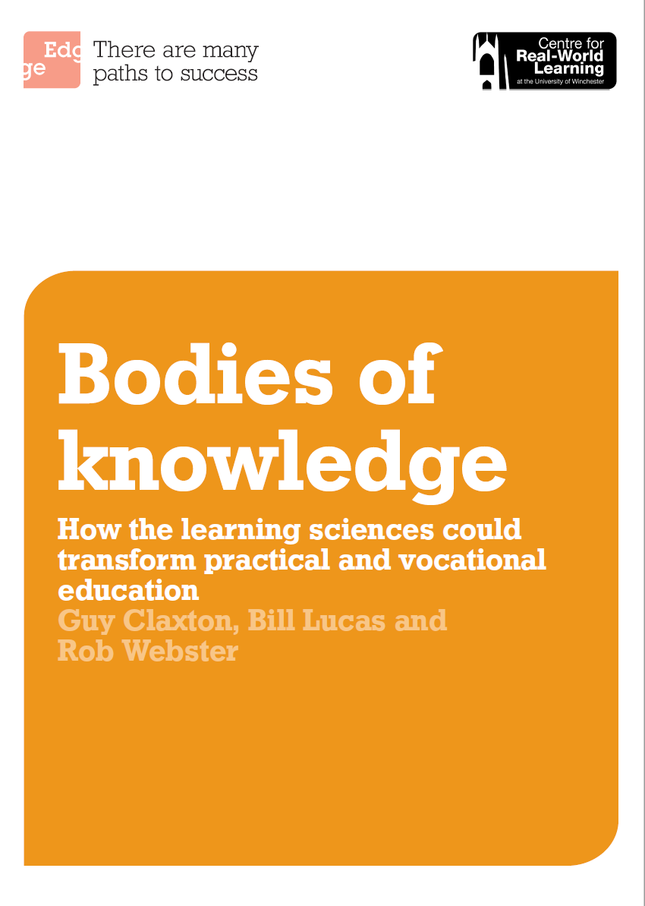
4-6-1 A better model of real world learning

Slide 14
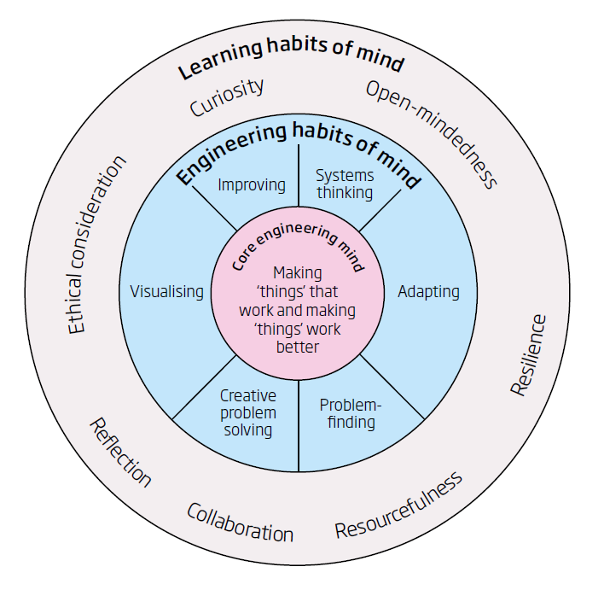
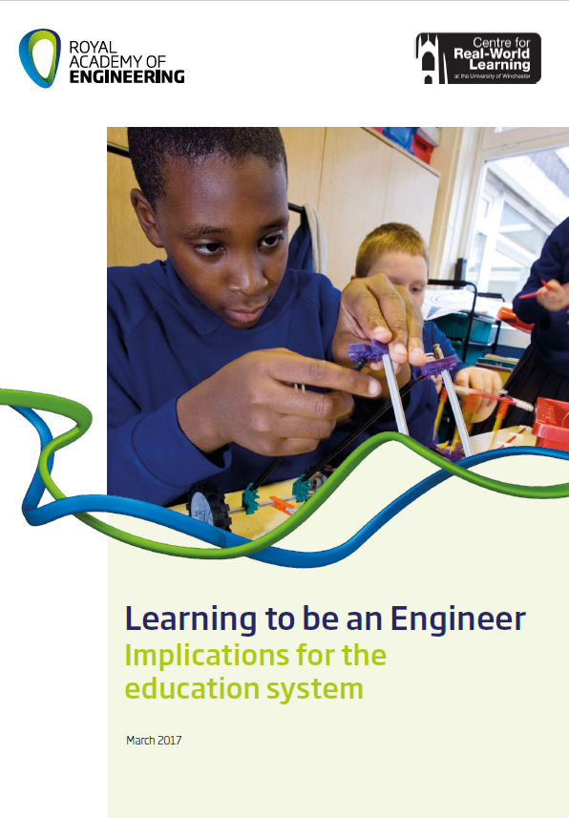
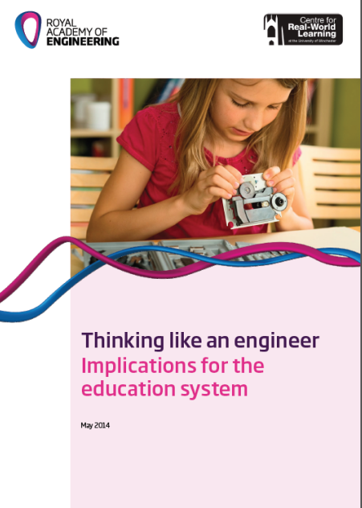
A reframing of engineering

Slide 15
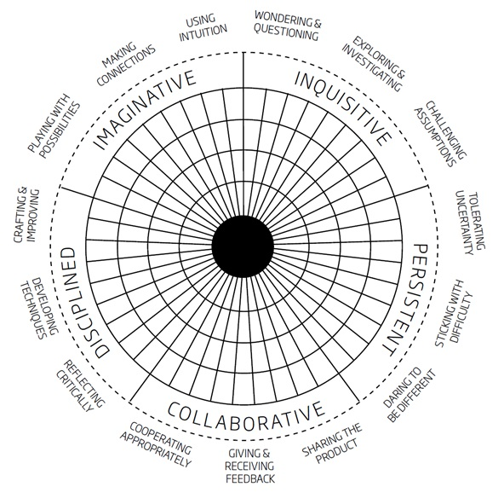
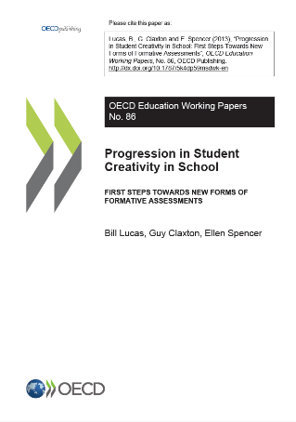
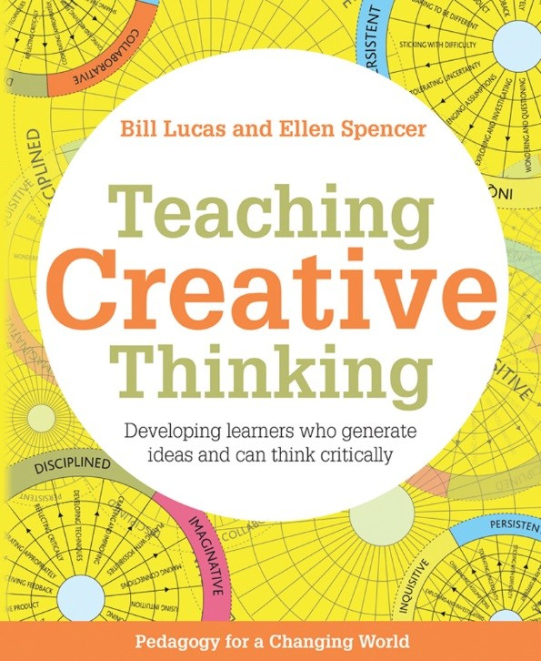
A five-dimensional model of Creative Thinking
Notes:
ADD OECD AND PISA LOGOS

Slide 16
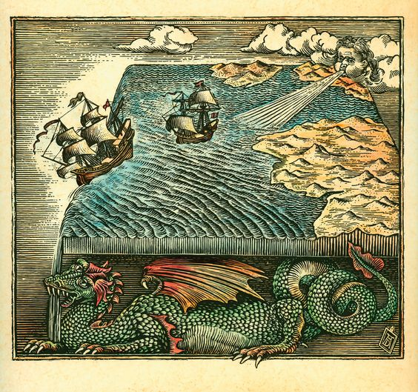

Slide 17
Some educational solutions [2]
PROTOTYPING

Slide 18
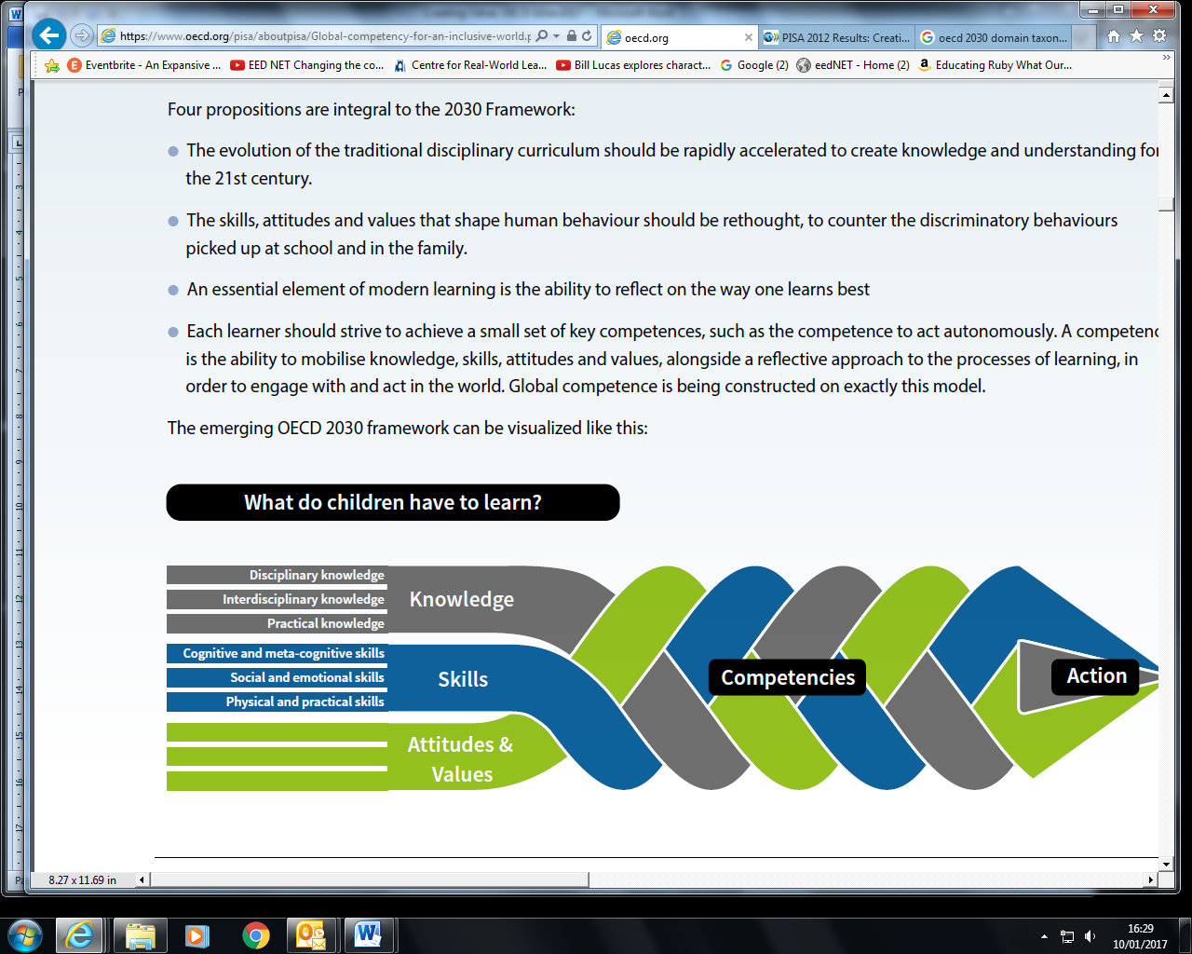
OECD 2030 Framework for Education

Slide 19
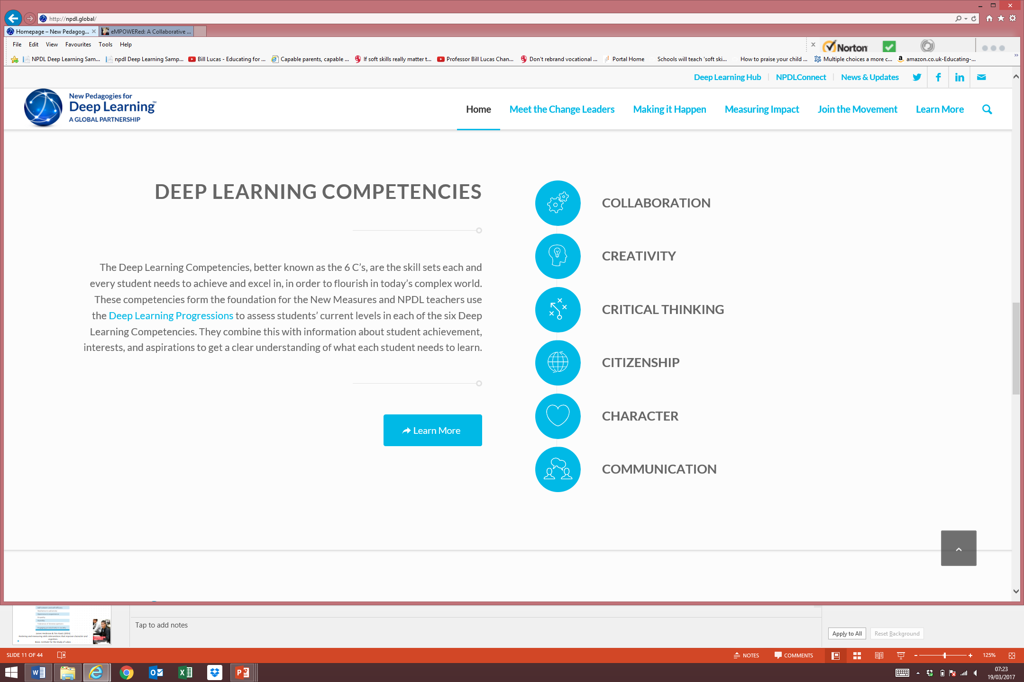
Canada

Slide 20
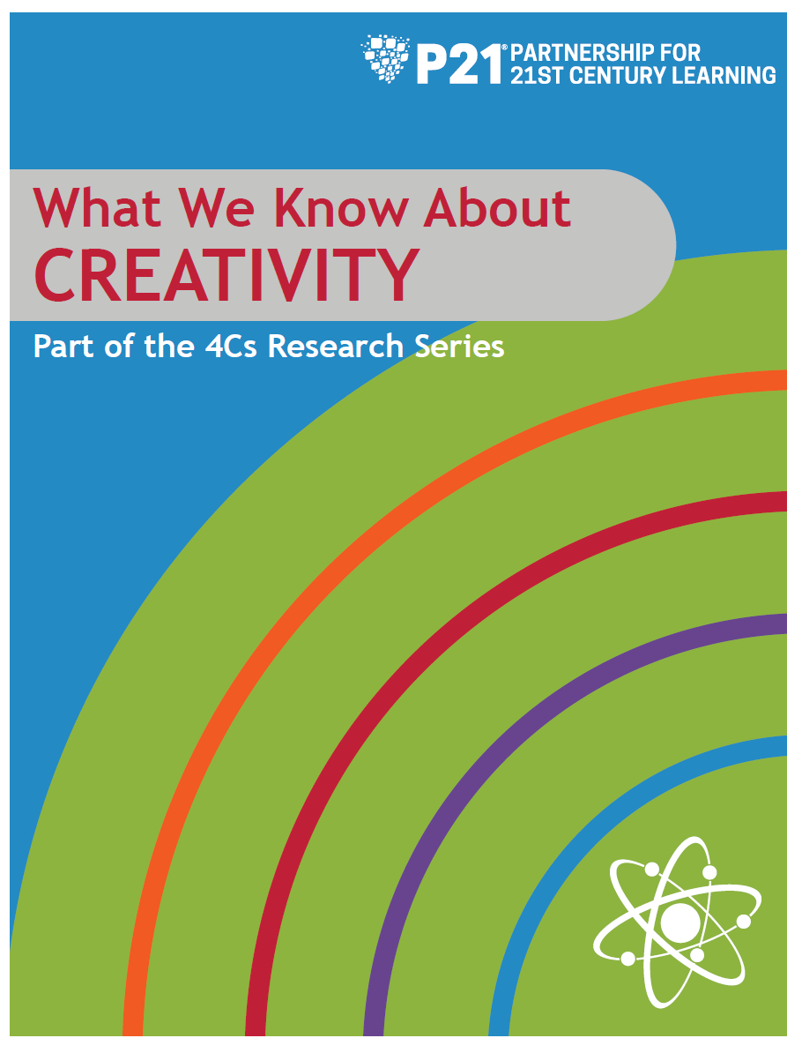
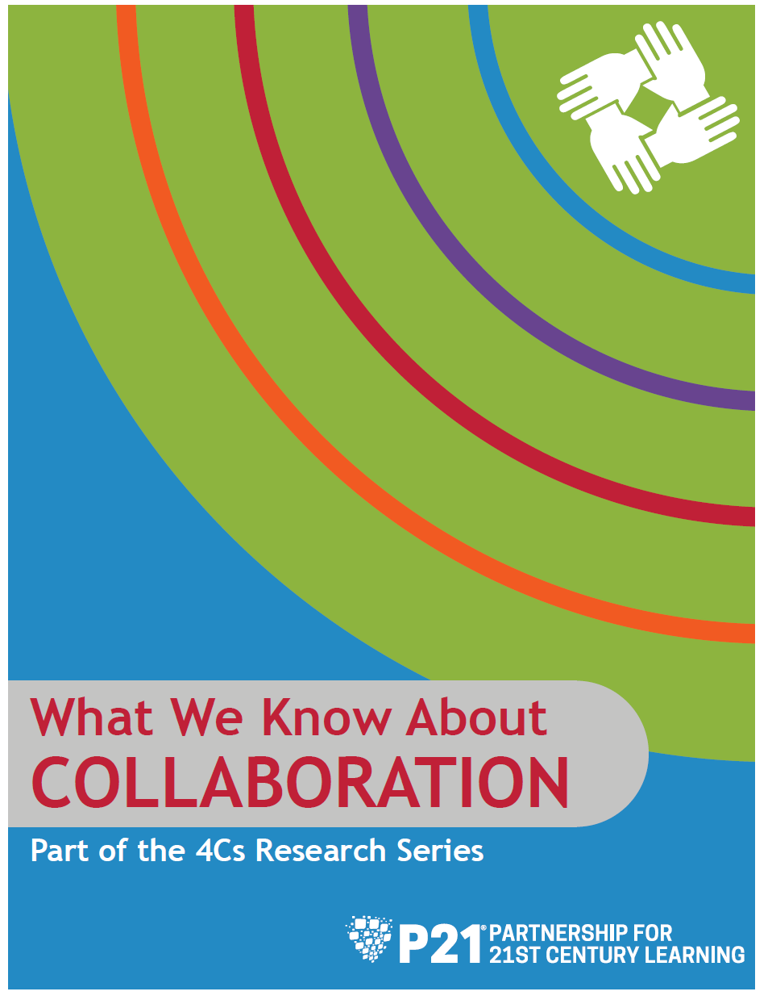
USA

Slide 21
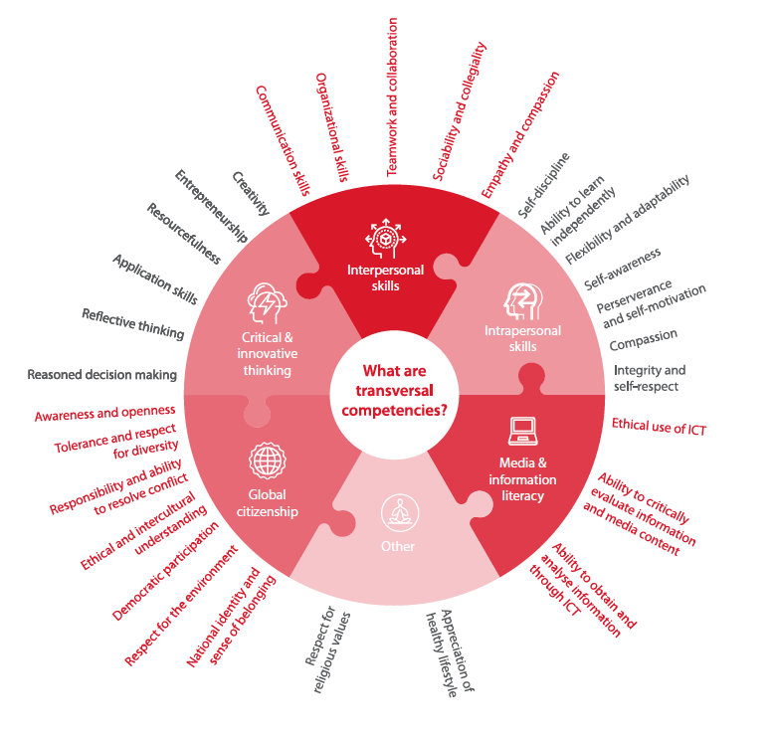
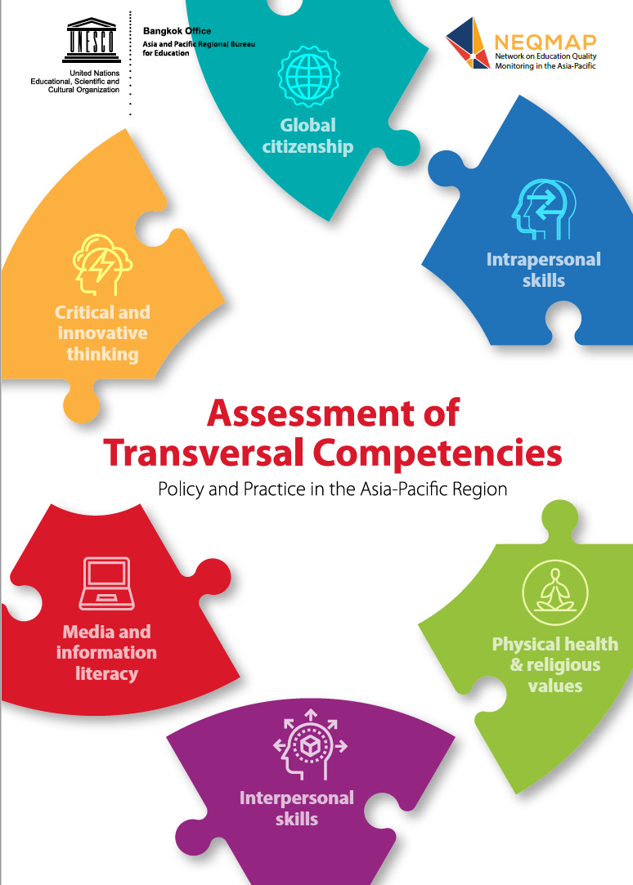
Asia-Pacific

Slide 22
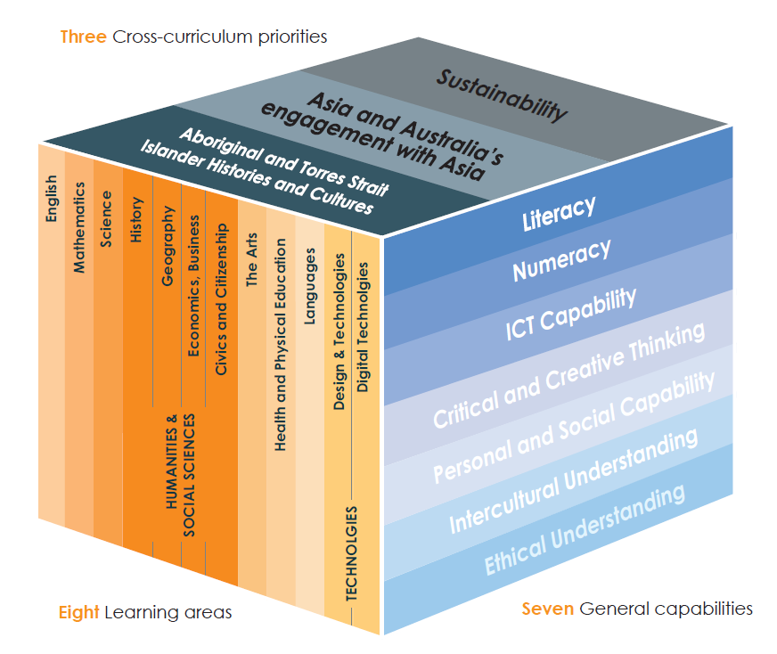
Australia

Slide 23


National curricula are specifying capabilities
76 countries somewhere in educational documents
36 countries in their vision or mission statements
51 in their curriculum documents

Slide 24
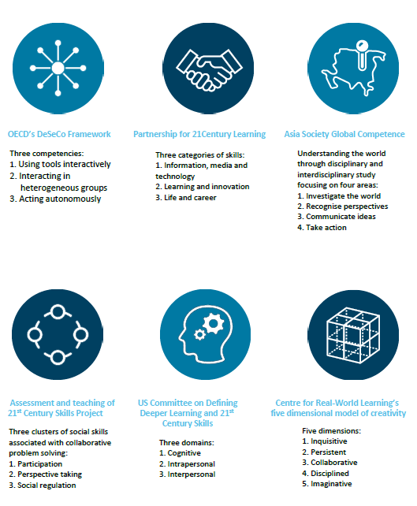
Trans-national capability frameworks are taking root

Slide 25

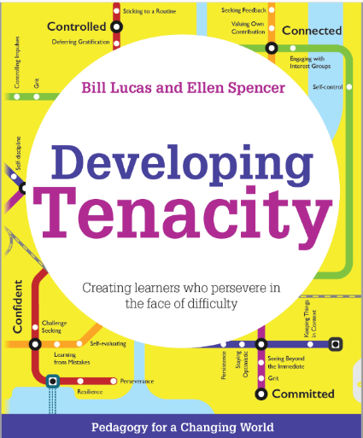
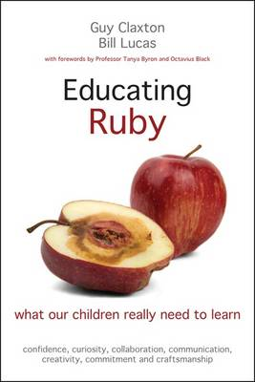
Ruby Power
Confidence
Craftsmanship
Commitment
Curiosity
Creativity
Collaboration
Communication

Slide 26
Some educational solutions [3]
PEDAGOGY

Slide 27
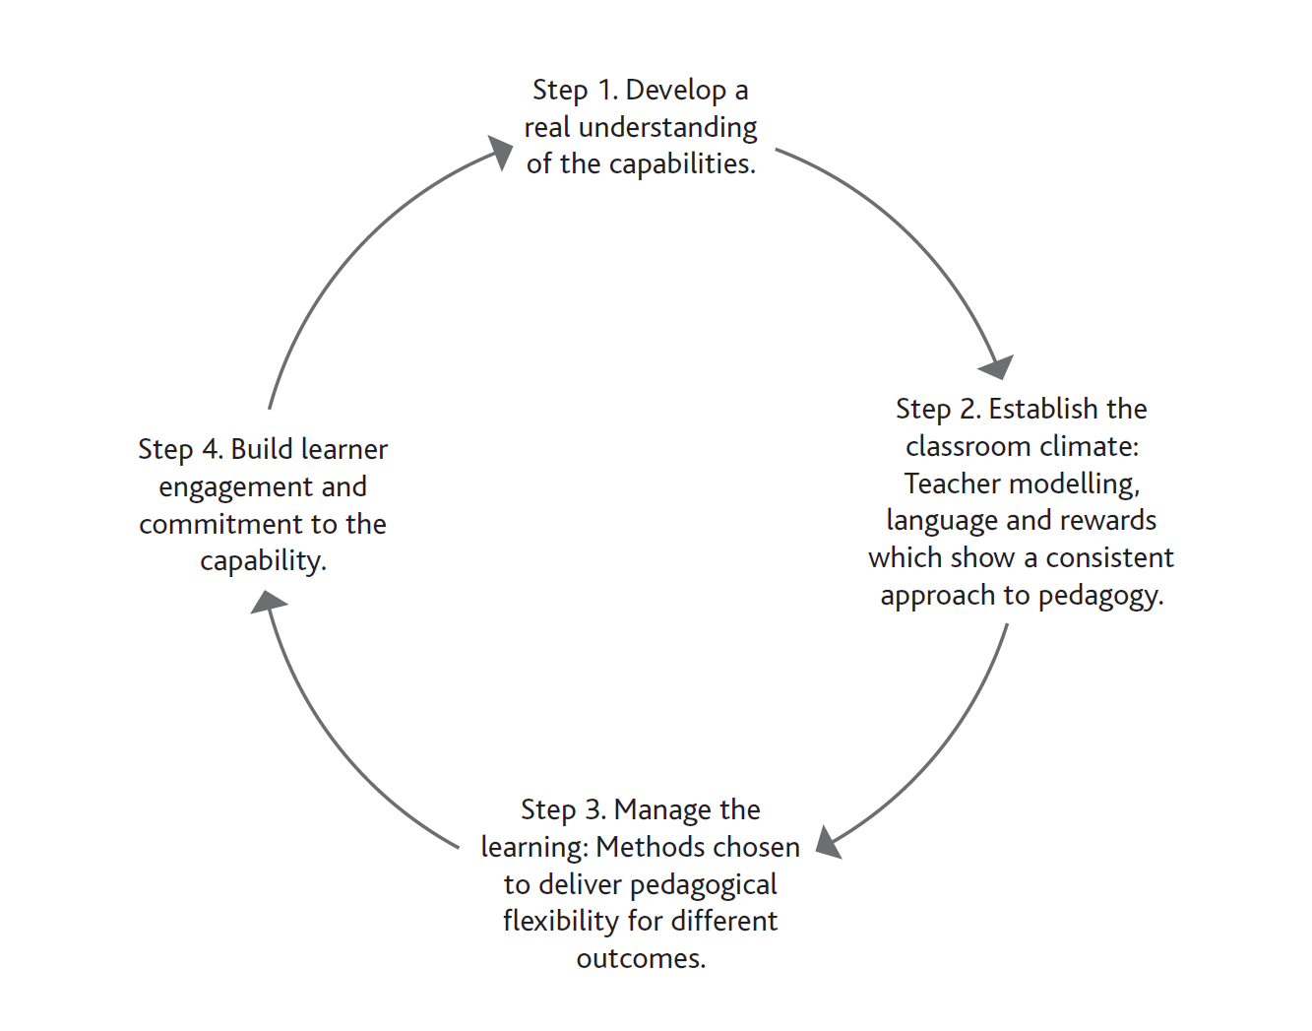

A cyclical process of embedding capabilities

Slide 28
Some signature pedagogies
Playful experimentation
Problem-based learning
Growth mindset
Deliberate practice
Developmental self-evaluation
Positive psychology
Service learning
Classroom as a learning community
Notes:
Through our earlier literature reviews and research with teachers in schools, we have found that there are in fact distinctively different teaching methods that help young people to become more inquisitive or persistent or imaginative.
If you want a child to be inquisitive then you need to use teaching methods that encourage them to be confident in developing questions, in exploring ideas, and in challenging assumptions.
An established approach to doing all these things is problem-based learning. Teachers have found this distinctively different teaching method allows them to cover the curriculum / syllabus / standards in a way that is particularly good at getting learners to generate their own meaningful questions, to undertake their own inquiry. It’s not a replacement for content; IT’S NOT ABOUT SUBTANCE BUT ABOUT STYLE.

Slide 29
A move away from skills?
attribute, capacity, capability, character, characteristics, cognitive skill, competence, competency, cross-functional skill, disposition, habit of mind, key competence, non-cognitive skill, soft skill, trait, transferable skill, transversal skill, twenty-first century skill, wider skill

Slide 30

Web E-mail Twitter
bill.lucas@winchester.ac.uk
www.expansiveeducation.net www.winchester.ac.uk/realworldlearning www.educatingruby.org
@LucasLearn @Pedagogy4Change

