Slide 2
What is Food for Thought ?
Growing Food
Growing People
GROWING BUSINESS

Slide 3
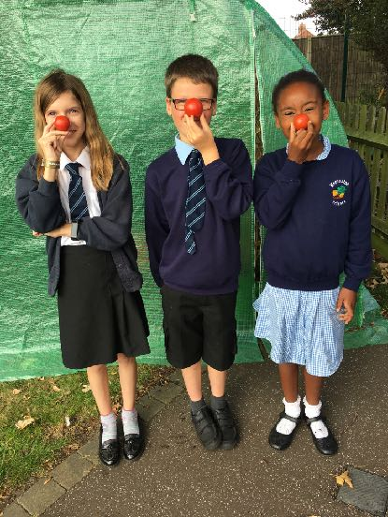
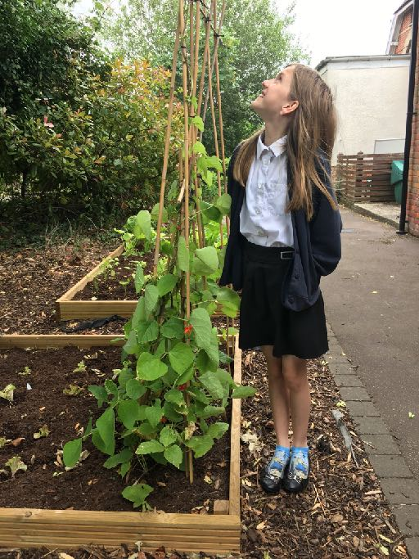
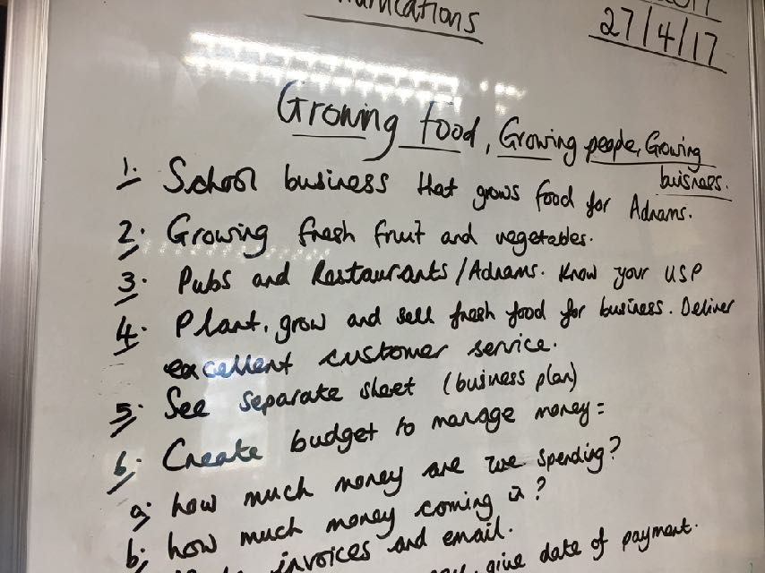
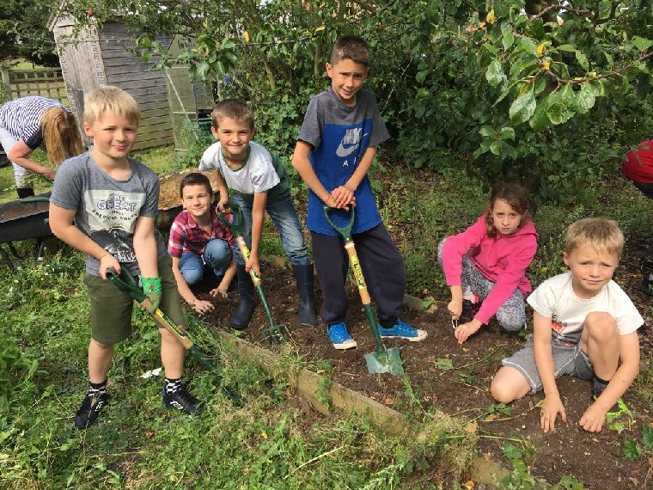
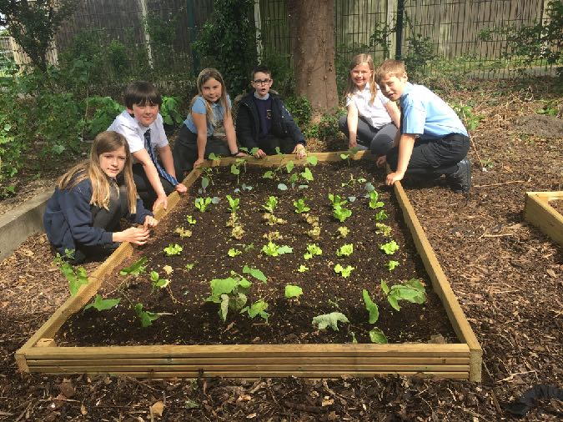

Slide 4
10 Skills we Nurture and Grow
Healthy Eating : knowledge, awareness and benefits
Improved well-being : social, emotional, physical, raises aspiration
Business and employability skills and self-awareness
Enterprising and innovative skills and attitudes
Confidence , self-esteem and ‘can do’ mindset
Communication skills : verbal and non-verbal
Team-player and Leadership skills
Creativity and collaboration
Resilience , problem-solving, risk management
Independent learning, ownership and responsibility

Slide 5
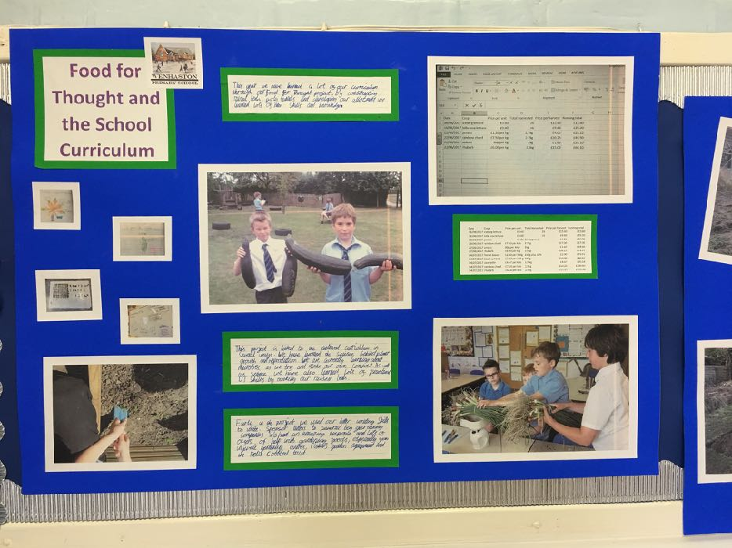
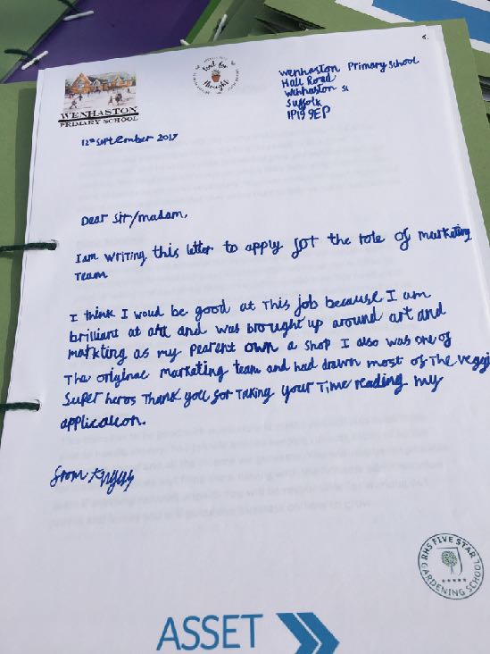
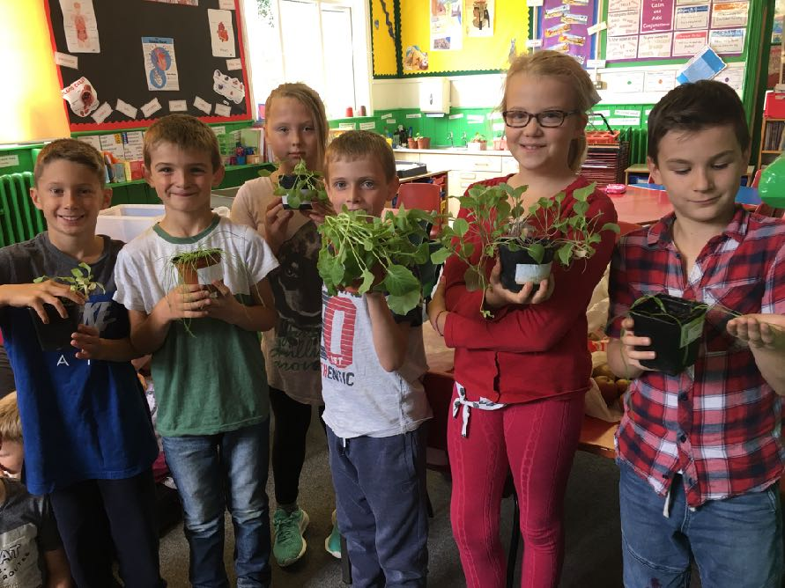
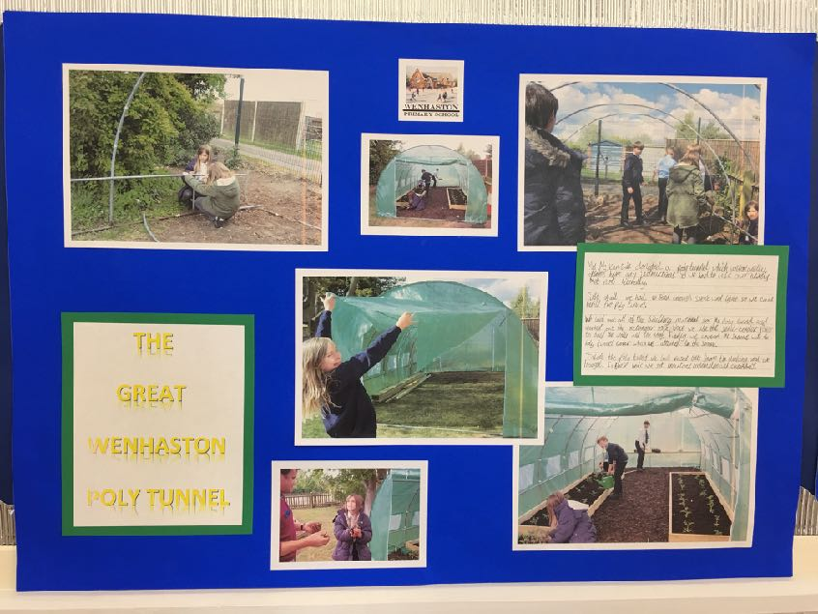

Slide 6
Seeds to sustainable success
FOOD FOR THOUGHT 8 sessions
Our goal is by the end of the 8 sessions to have sown the seeds of a sustainable, viable school business which will grow and sell fresh, quality produce to Adnams
During the 8 sessions we aim for every pupil to grow our 10 skills and attributes.Sessions include : unearthing talent ; team talk : key teams; mind map business plans; running the business operations; communications, event planning; action/business plan, job roles, accountability, targets.

Slide 7
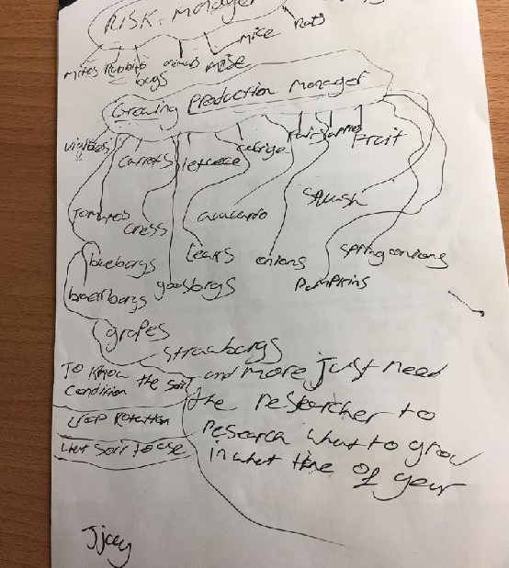
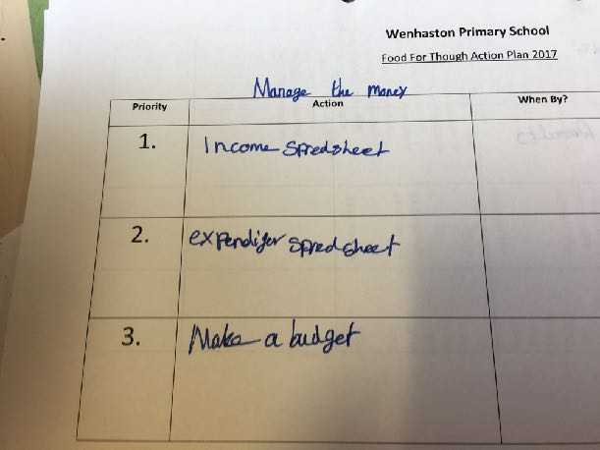
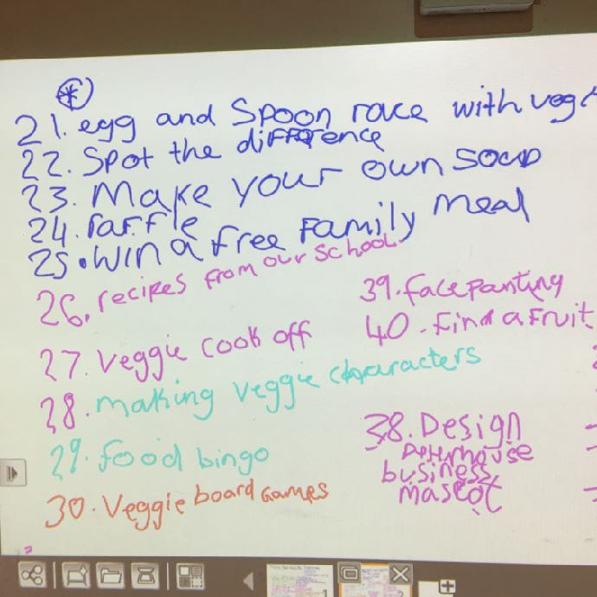
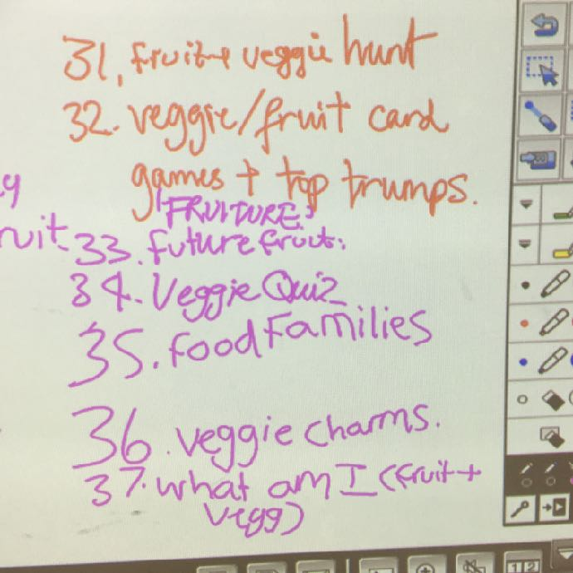
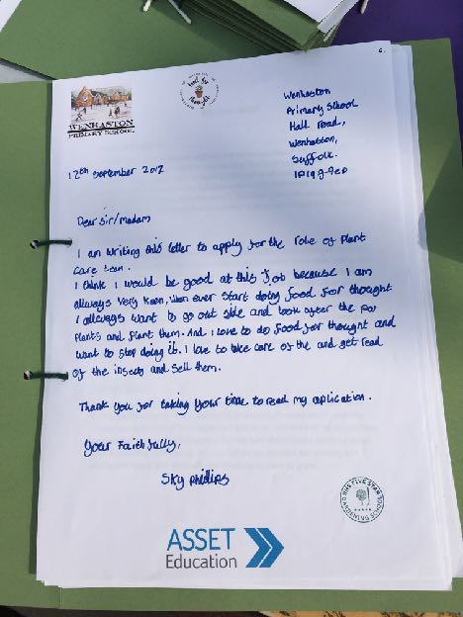
EMPOWERING PUPILS

Slide 8
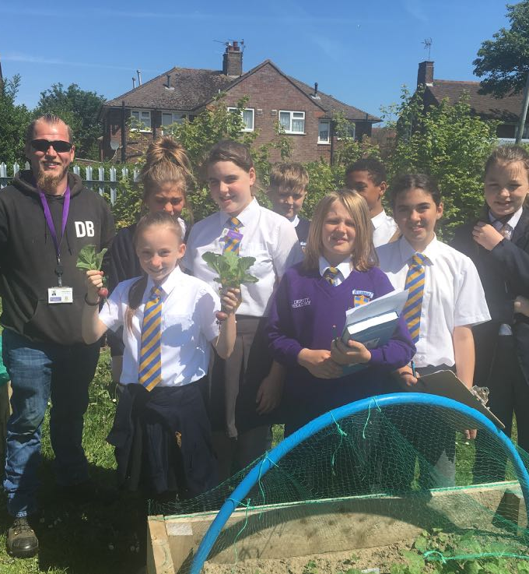
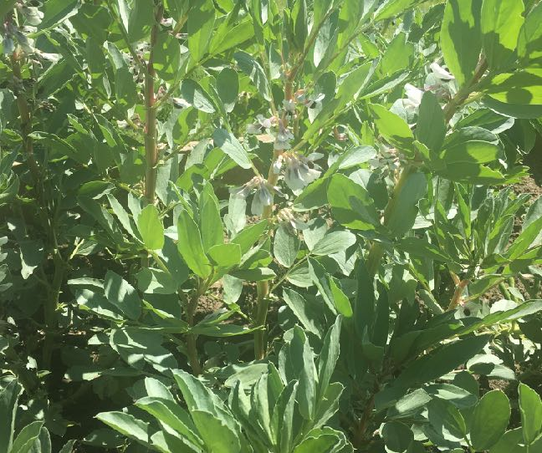
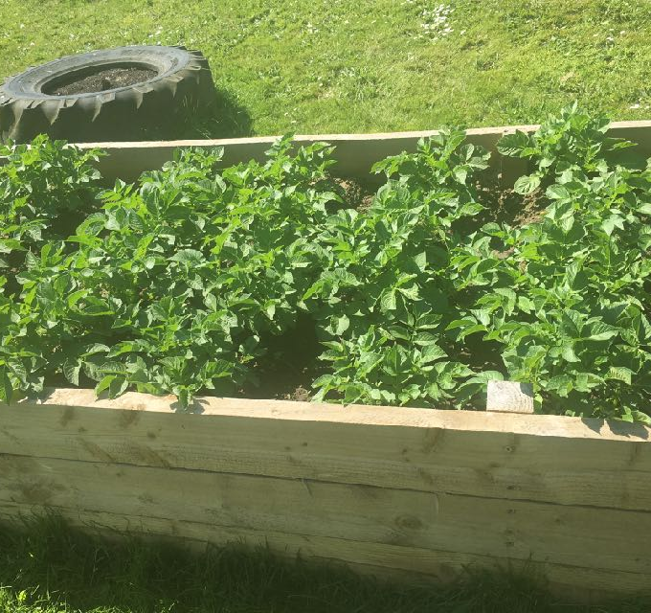
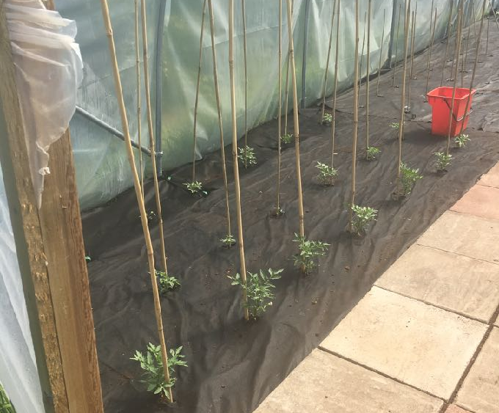
Broad beans
Peterhouse Primary Business Team
Potatoes
Tomatoes

Slide 9
Food for Thought supporting ‘Sponsors’
We have received approx £3000 + of product and donations for our first 2 schools from the ‘win win’ pupils’ letters :
Flegg High
Spear and Jackson
“ We receive hundreds of letters asking for things but your letter resonated…”
approx £1500 of gardening tools and equipment
East Coast Growers : Young Plants ; fertiliser ; financial donation
Elveden Estate : Vegetable Seeds
Tesco’ : plants
Wenhaston PRIMARY
Cobbold Trust £700 donation
Fiskars : 30 x children’s gardening tools worth about £500
Wyevale Garden Centre : £500 to spend, equipment, over 30 large bags compost
Parent : Poly tunnel and Wood for raised beds

Slide 10
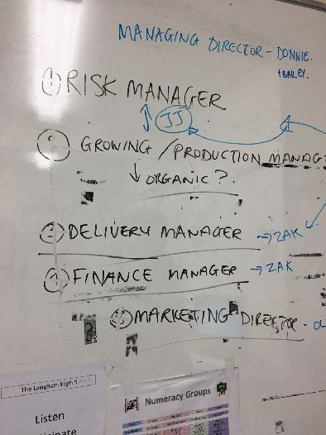
Seeds, Shoots… Success
3 ways for Schools to partner…
1. Growing school
One term, weekly, 2 hours x 8
Handbook coached sessions
CPD; Termly Business Meetings
2. Seedling school
Food for Thought Enterprise Day,
CPD; option to sell produce
3. Producer school
Simply sell us their produce
…Just so you know …the fresh produce is collected by Adnam’s drays and delivered to our pubs & restaurants

Slide 11
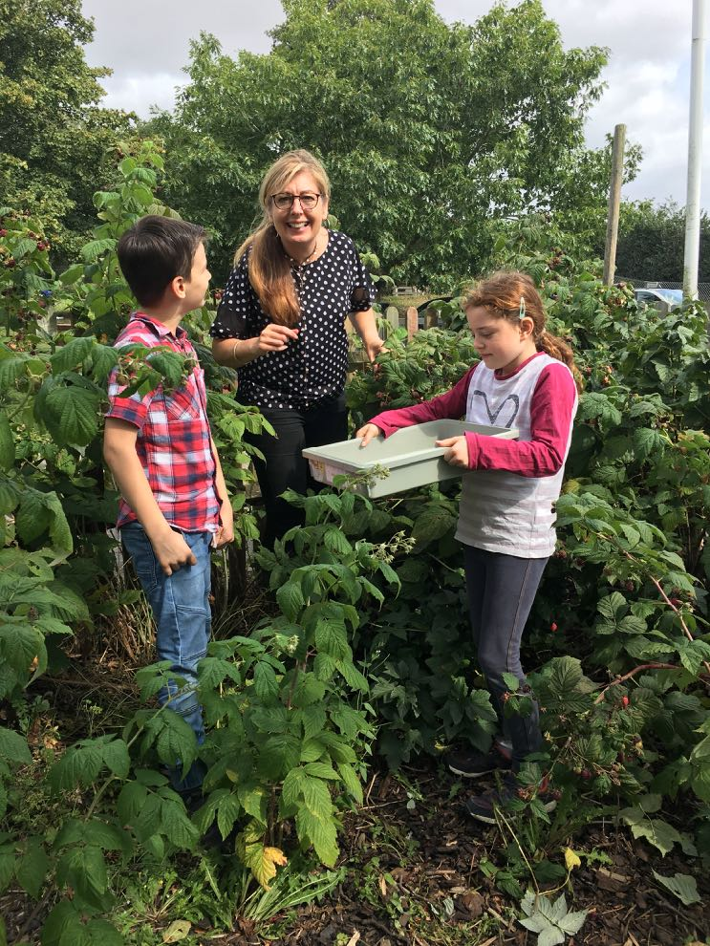
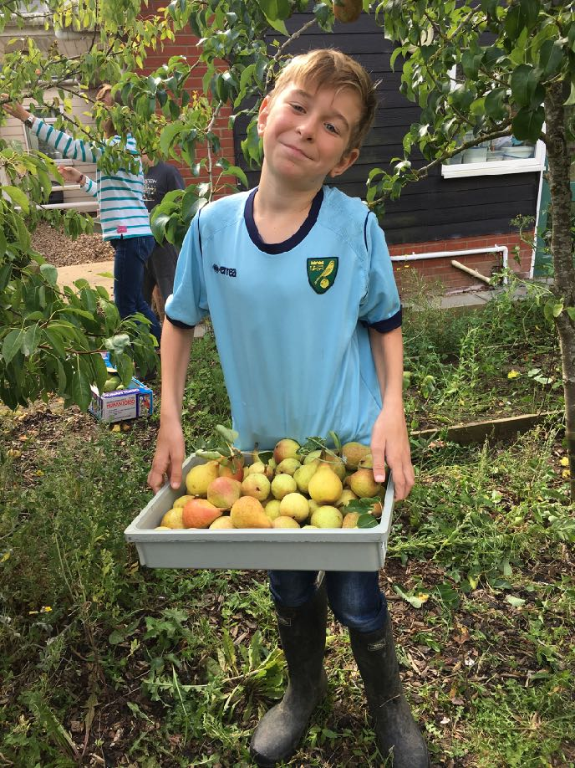

Slide 12
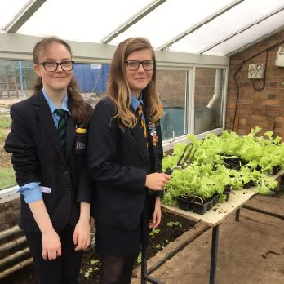
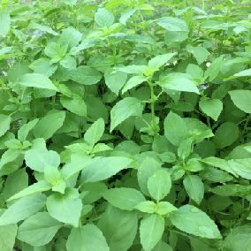
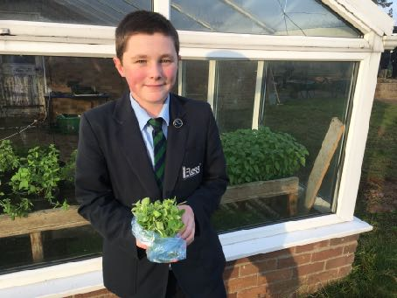
“Growing PEOPLE, GROWING Business…”
8 schools : 3 High 5 Primary : 20 schools waiting , 3 charities …
Pilot seeds planted 2016: Flegg High, Norfolk and Wenhaston Primary ,Suffolk
Flegg awarded Norwich & Norfolk ‘Eco’ school of the year 2017. Worked with all pupil abilities with excellent success / evaluations across all abilities. Rejuvenated old growing space: grow ‘all seasons’; ‘Great Growing Company’ pupil ‘MD’
Year 1 : Wenhaston : zero crops 2016 … June 2017 : 21 ‘crops’, RHS Gold star award, featured in print press BBC TV ‘Look East’, allotment where they grow food for their school canteen ..
Langham School (for excluded boys),15 year-old pupil shortlisted RHS Young Gardener of the Year
Peterhouse Primary: by Year 2 every class growing something : over 15 crops!
Food for Thought ‘Big Dig :Adnams employees, local people involved.
Food for Thought stand at Norwich Food and Drink, June 2017 : “I just have to come up and congratulate you on your team…” 12 pupils from Primary in Great Yarmouth, part of the team of 60, Year 5 pupils May - July 2017
Peterhouse Pupils created and designed Food for Thought marketing kit which promotes healthy eating, makes good food fun!

Slide 13
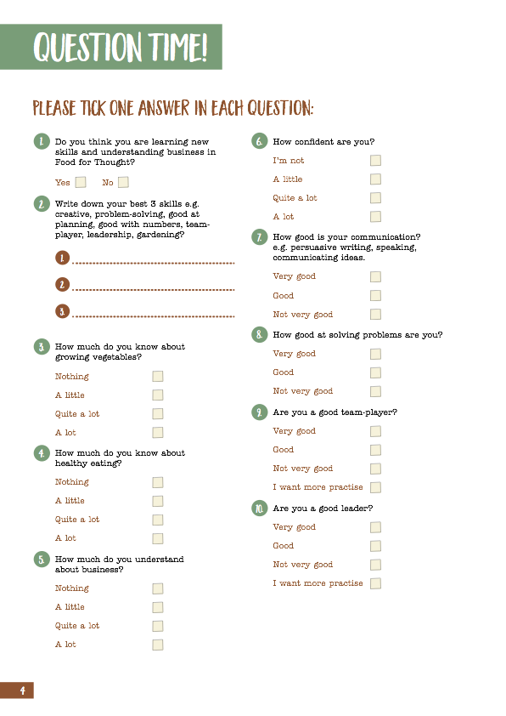

Slide 14
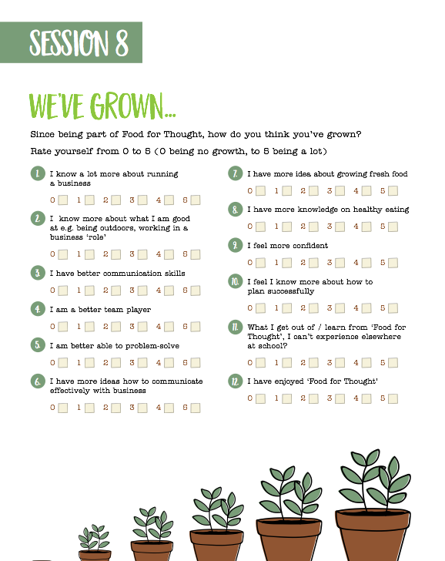
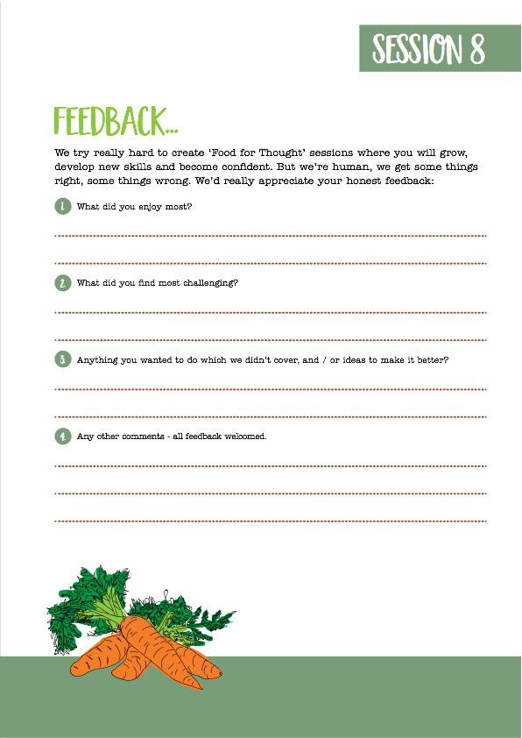

Slide 15
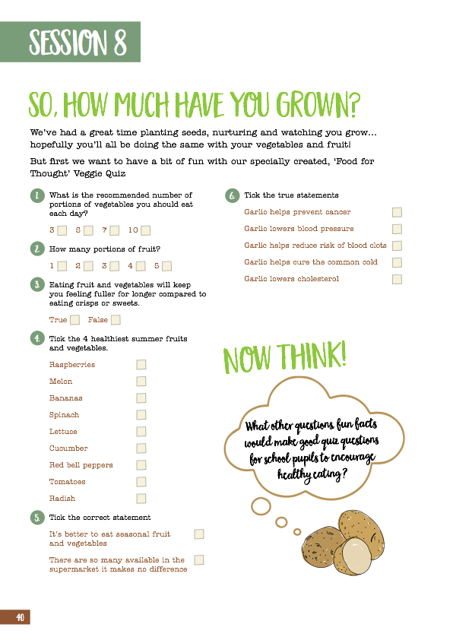
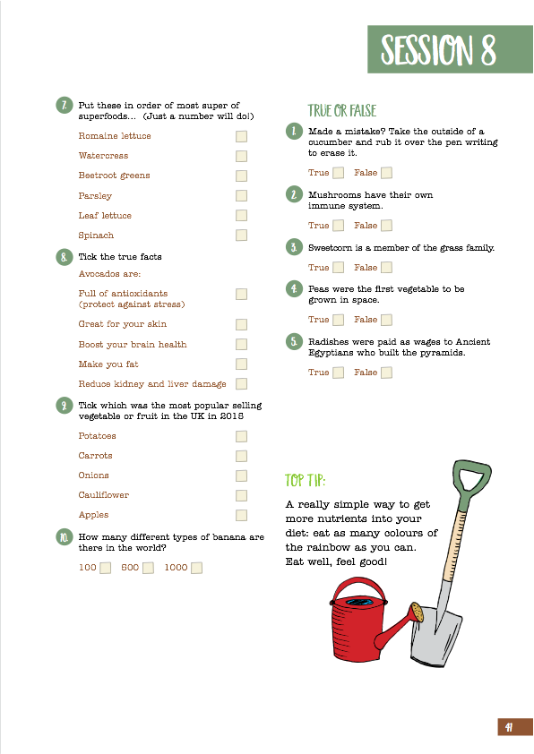

Slide 16
Growing PEOPLE ….EvaluationS
Highly positive from both teachers…
“As a whole project it appeals to all learning styles.No matter what style suits a pupil best (auditory, visual or kinaesthetic) there is something within this project where every pupil has an opportunity to shine and every pupil can develop a deep knowledge of themselves and their strengths…giving an insight into future directions (VERY lacking in today’s education!)
‘“How many pupils can say they have been part of developing a successful business at primary school?”
Andy Rollings, Wenhaston Primary Teacher
“Every pupil should do Food for Thought”
RNAA Education ManagerTony Bellinger
“this has been very successful and for some students, their engagement has been life changing”
“..social, emotional, physical benefits…”
“From an educational point of view it is a vehicle for learning..”Ruth Bullard, Director of Business & Enterprise
…and pupils…
Wenhaston Primary
95% said what they had experienced in Food for Thought they couldn't find elsewhere in school;
85% said they now know more about what they are good at.
“I’ve loved it so much I want it to continue” Samuel
“I want to make a lot of food…” Sky
Flegg High
100% scored Food for Thought 5/5 or 4/5
100% agreed they ‘now know a lot more
about running a business’
“I have learnt to “think both logically and creatively…how to write in a business manner” Debbie
“I enjoyed being outside the most” Charlie

Slide 17
FOOD FOR THOUGHT PROJECT GROWTH
1. Uniquely created Food for Thought Handbook .. 52 + pages.
2. Food for Thought Logo : Flegg High and Adnams
“In my long experience of working with young people, I know that this kind of experience changes lives…
It will be a day that our students will never forget.” Flegg teacher
“Today has given me an insight into what I want to do in the future.” Flegg Pupil
3. Food for Thought marketing designed by pupils and includes a “family activity pack’ we can use in our family-orientated pubs : searches word searches, quizzes, crosswords, colouring in sheets and postcards …
4. ..and roadshow stand for events …

Slide 18
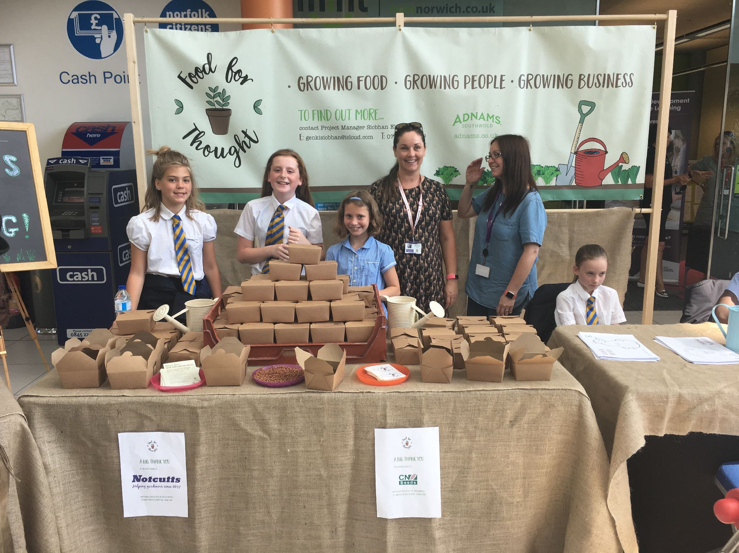

Slide 19
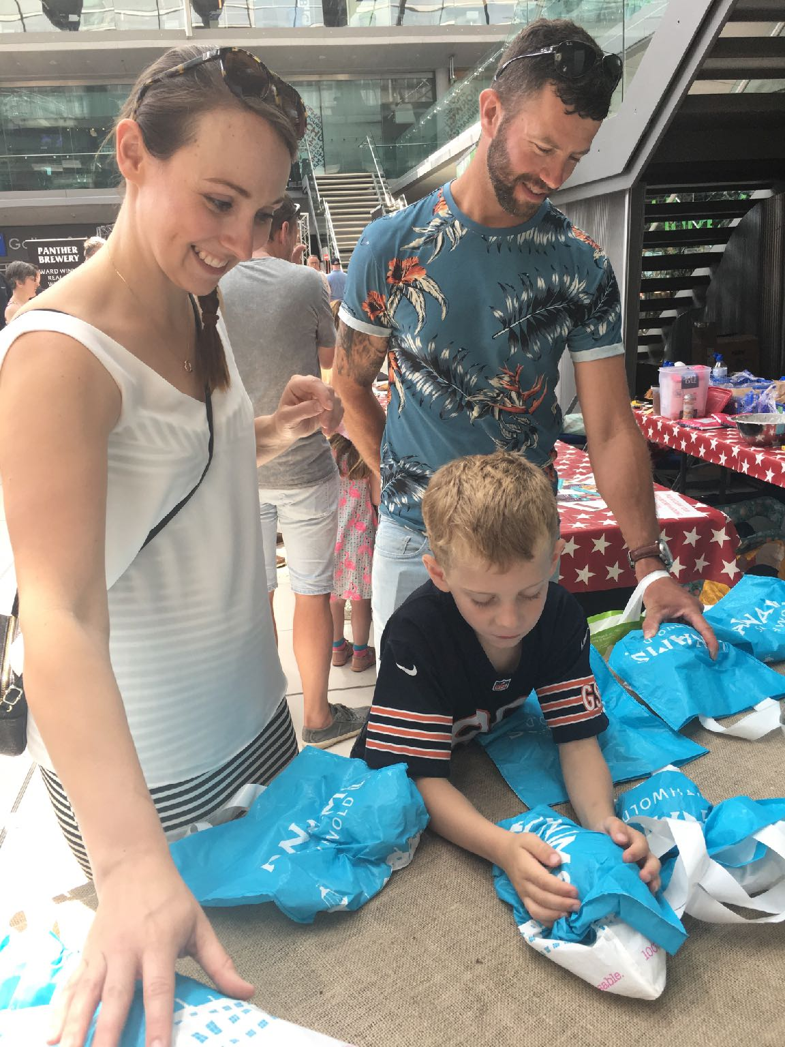
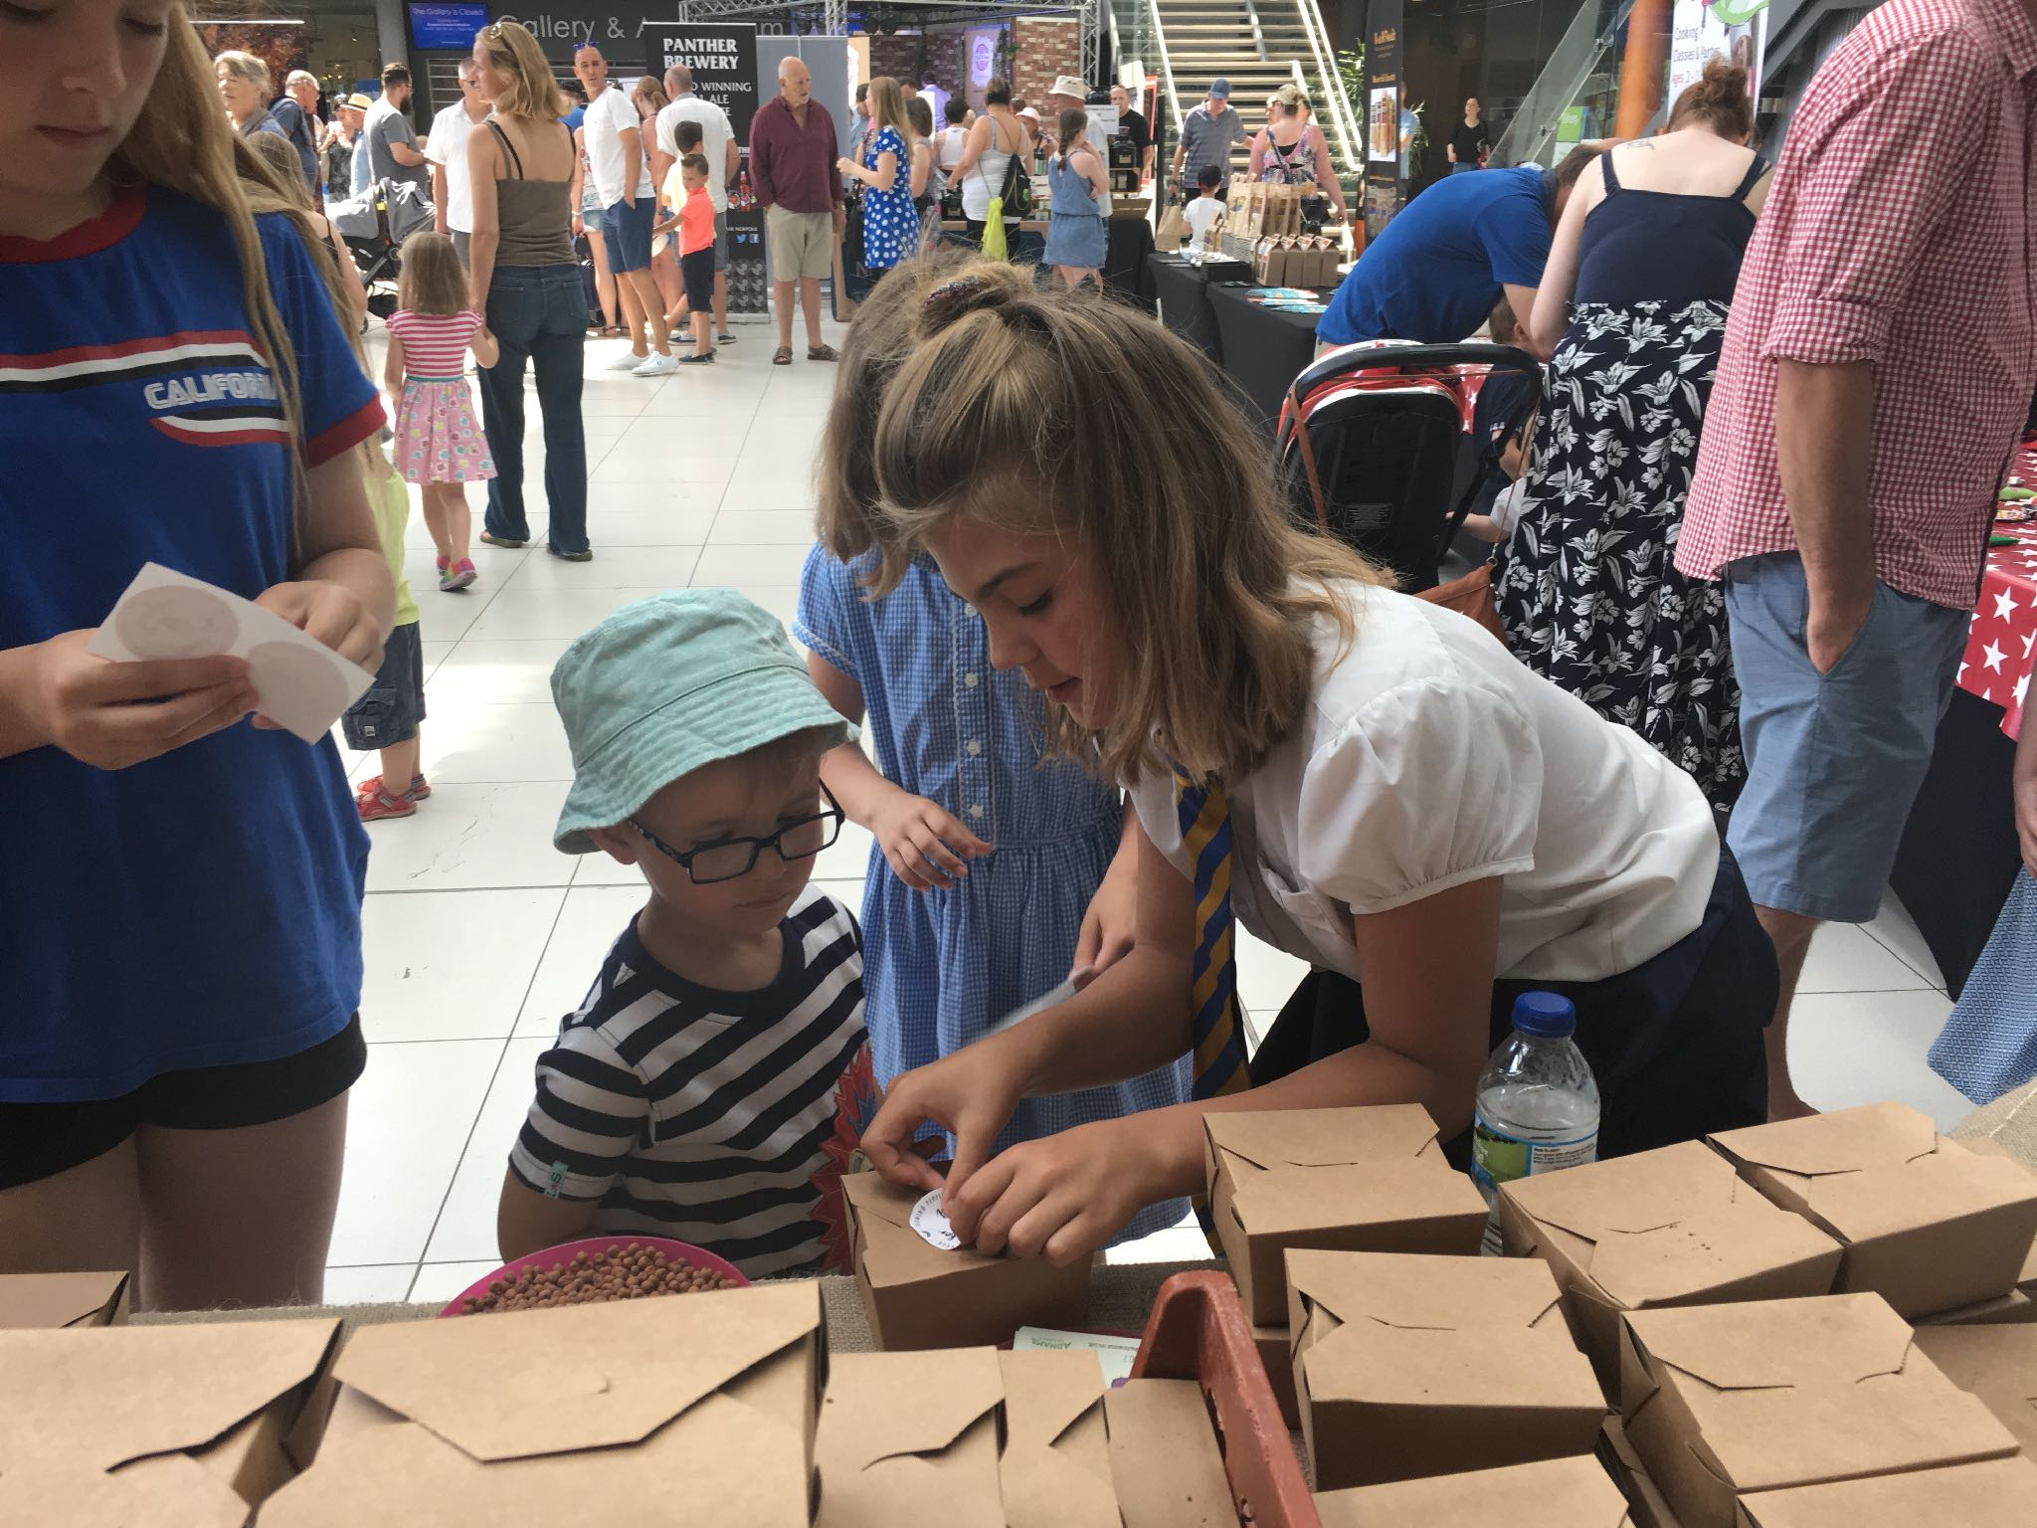
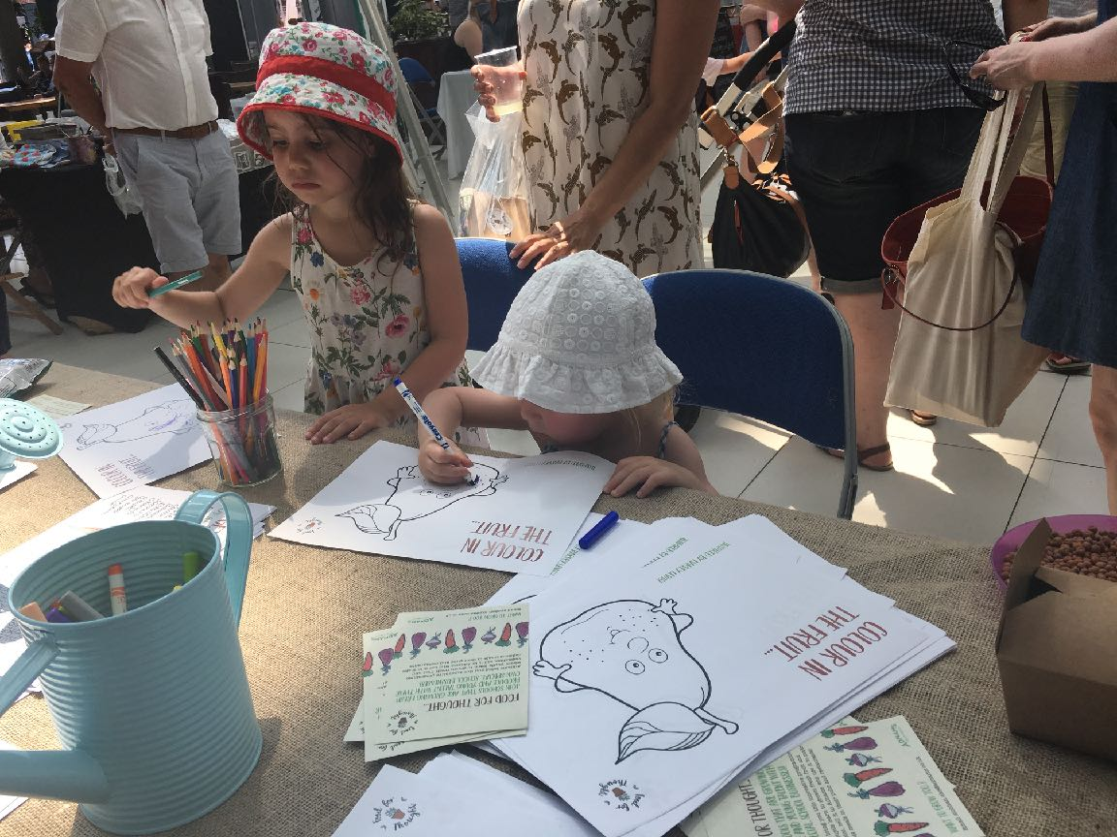

Slide 20
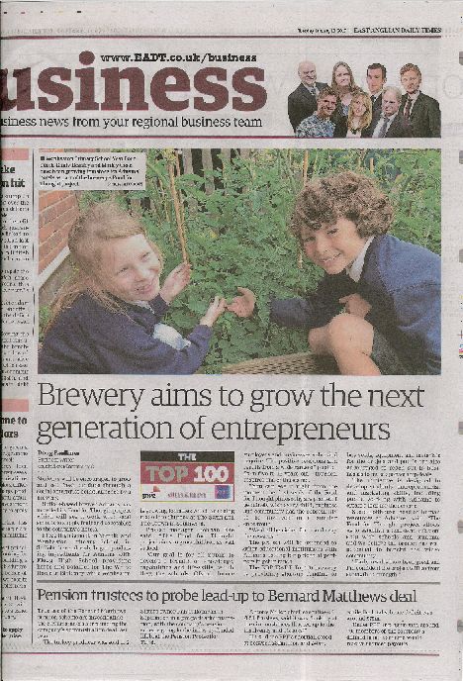
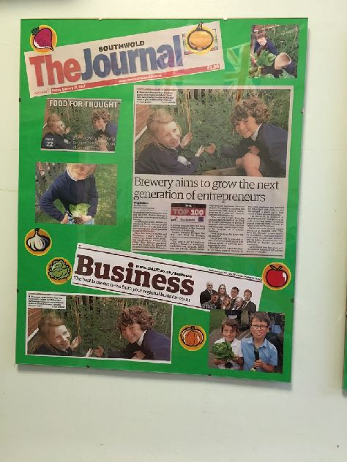
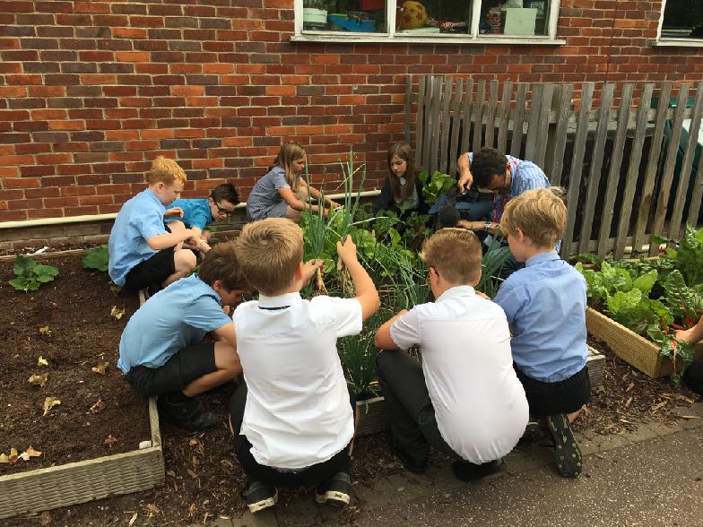
Media coverage 2017
BBC Radio Suffolk
BBC Look East June 2017
EADT
EDP
Beccles and Bungay Journal
The Southwold Journal
The Mercury

Slide 21
FOOD FOR THOUGHT BENEFITS
School Partners
Corporate Partners
Ticks boxes:
Enterprise,
Well-being, Healthyeating
Unique business enterprise, & employability experience
Social mobility, personal development, raise aspiration
CPD … SCALEABILITY
Unique CSR
Brand fit
Digital Content
Collaborative Event opportunities
CPD / mentoring, employee
Media / PR Interest
Content for digital / social media promotion
Community / Stakeholders connections
Can see the ‘growth’
Positive pilot evaluations evidence the broad benefits
Long-term potential
Collaborative stakeholder opportunities

Slide 22
Food for Thought Needs You
We now have over 20 schools, including 2 charities across Norfolk, Suffolk who want to be part of Food for Thought, plus 4 schools in Essex
Imagine how many more would want to get involved once they knew about us?!

Slide 23
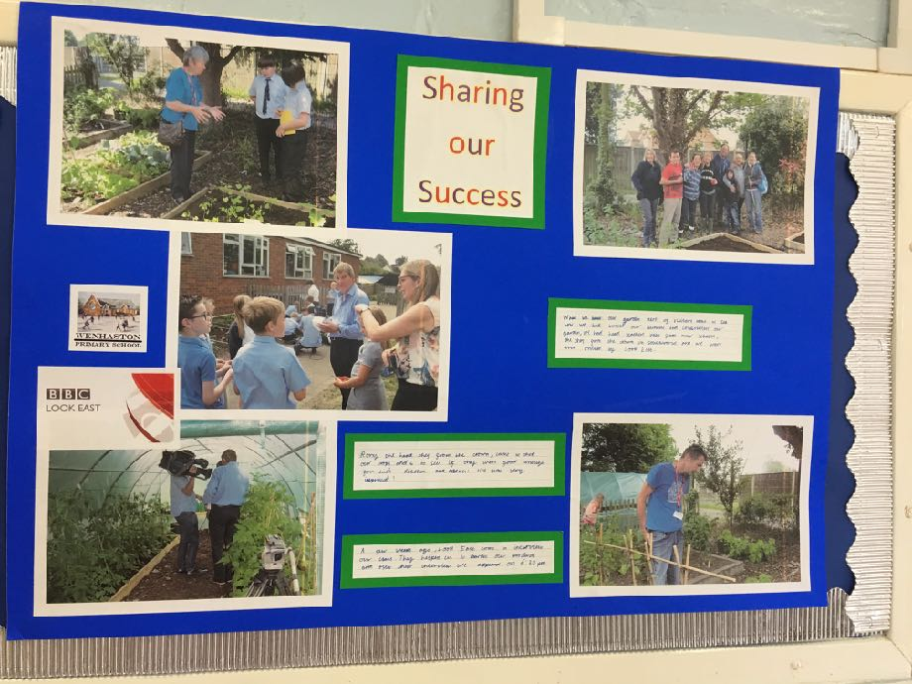
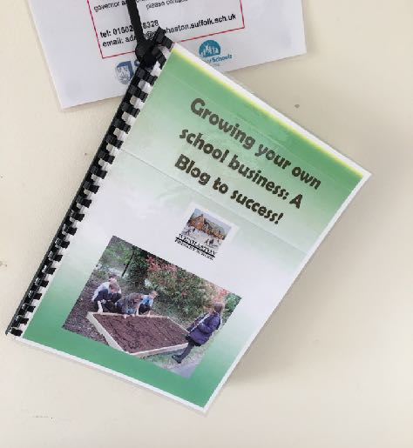
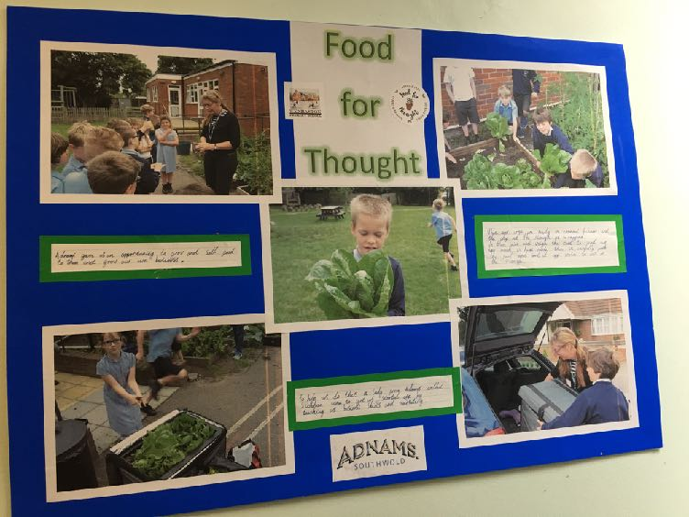

Slide 24
“…so far I think its been absolutely brilliant …
…I’ve enjoyed it a lot…”
– Charlie, Wenhaston Primary, aged 10.
Future CEO ?..

Slide 25
