Slide 1
Employability as a personal construct: understanding the role of employers in education for employability
Presenter: Stella Williams
Co-authors: Karypidou, A., Steele, C., & Dodd, L.
Notes:
15-20 minutes

Slide 2
What is employability?
Systematic review
Little sampling of employers
Often restricted skills based responses
Value of academic theory for employers?
(e.g. Francis-Smythe, Robinson, & Ross, 2013; Hogan, Chamorro‐Premuzic, & Kaiser 2013)
Are educators actions informed by theory?
(e.g. Pond & Harrington, 2013)
Notes:
Add limited role of academic research in informing managers evidence-based practice.
A lack of focus on academic literature as a means of informing working practice is supported by Francis-Smythe, Robinson, and Ross (2013) whose investigation of evidence-based management practices within senior managers showed research evidence represented minimal importance. This content was overlooked in favour of evidence from other professionals, both within and outside of their organisation, their intuition/instinct, and their personal values. These later two factors are expected to be integrated within individual’s personal construing system. This reflects the value of sourcing this information, for understanding the understanding of employability within the work context.
Furthermore, the application of these theories within HE contexts is unknown. Pond and Harrington’s (2013) work within business departments of HEI’s uncovers patchy application of employability theory within the design of development initiatives.
Background: Numerous perspectives surrounding employability exist within the literature. However, surveying of employer’s viewpoints often constrains responses to specific skills. This presents a narrowing of the contribution employers can make to understanding employability as a holistic concept. In this study a Personal Construct Theory stance is taken to understand the role of employers in informing our understanding of employability, and its development.

Slide 3
“Businesses 'forced to provide basic skills training for graduates'” (Times Higher, 13th July 2015)
“Employers still irked by lack of graduate skills”
(Times Higher, 11th September 2008)
“Half of employers say graduates are 'not up to the job': Findings fuel fears universities fail to equip students with life skills” (Daily Mail, 12th September 2013)
“Too many graduates are mismatched to their jobs. What's going wrong?” (The Guardian, 25th January 2018)
“Employers worried about graduates' 'resilience' and attitude to work ” (Sky News, 10th July 2017)

Slide 4
Personal Construct Theory
Kelly’s eleven corollaries
Kelly (1955)
Everyone is a scientist.
Our behaviours are driven by personal construing systems.
Construing systems are based on personal experience.
Corollaries | Definition
Construction | “A person anticipates events by construing their replication” (Kelly, 1955, p.50)
Individuality | “Persons differ from each other in their construction of events” (Kelly, 1955, p.55)
Organisational | “Each person characteristically evolves, for his convenience in anticipating events, a construction system embracing ordinal relationships between constructs” (Kelly, 1955, p.56)
Dichotomy | “A person’s construction system is composed of a finite number of dichotomous constructs” (Kelly, 1955, p. 59)
Choice | “A person chooses for himself that alternative in a dichotomized construct through which he anticipates the greater possibility for extension and definition of his system” (Kelly, 1955, p.64)
Range | “A construct is convenient for the anticipation of a finite range of events only” (Kelly, 1955, p. 68)
Experience | “A person’s construction system varies as he successively construes the replications of events” (Kelly, 1955, p.72)
Modulation | “The variation in a person’s construction system is limited by the permeability of the constructs within whose range of convenience the variants lie” (Kelly, 1955, p.77)
Fragmentation | “A person may successively employ a variety of construction subsystems which are inferentially incompatible with each other” (Kelly, 1955, p.83)
Commonality | “To the extent that one person employs a construction of experience which is similar to that employed by another, his psychological processes are similar to those of other people” (Kelly, 1955, p.90)
Sociality | “ To the extent that one person construes the construction processes of another, he may play a role in a social process involving the other person” (Kelly, 1955, p.95)

Slide 5
Method
22 Employers
High
Moderate
Low
14 HE Instructors
In what ways are these two people similar in terms of their employability?
Notes:
Method: The present research applied a repertory grid technique to access 22 employers and 14 educators’ implicit theories of employability. Participants identified 6 students/employees, representing a range of employability levels. During the interview, bi-dimensional constructs were elicited through comparisons of individuals employability. Resulting constructs were aggregated via means of a content analysis. Following which, a differential analysis was conducted to identify any variation in the representation of these categories across employers and educators.

Slide 6
Example grid.
Construct | Similarity | Contrast pole
1.1 | Taking the back seat and going with the flow | Driven
1.2 | Completely academic | Work ethic: Looking for ways to work and develop
1.3 | Not involved in extracurricular activities | Can demonstrate leadership
1.4 | Handed things | Take ownership of career, do what it takes
1.5 | Wholly focused on one thing | More well-rounded-getting involved
1.6 | Stressed out about being in a role | Passion for providing exceptional customer and sales service
1.7 | Waiting to be told | autonomous
1.8 | Can’t carry a conversation | Can build rapport
1.9 | Weirdo | Can relate to other employees
1.10 | Nothing about them | Uses their personality
717 constructs
Notes:
Results: Four main distinctions were identified, relating to: Interpersonal Competencies - competence to interact with others appropriately; Commitment- being directed, pledged or bound to engage with the role; Proactivity - showing a tendency towards action, to creating or controlling a situation for themselves; and Vision - managing time effectively, prioritising tasks to achieve their goals, having a vision and effective planning skills. Results indicated a discrepancy between the views of employers and educators.

Slide 7
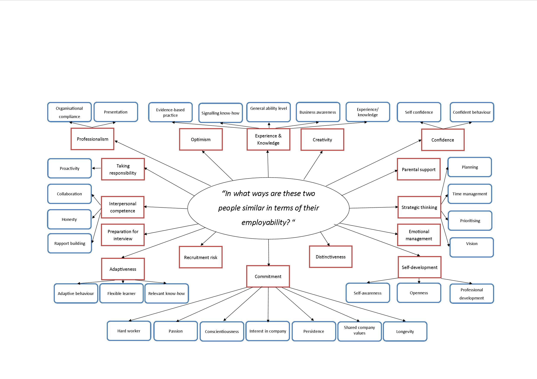
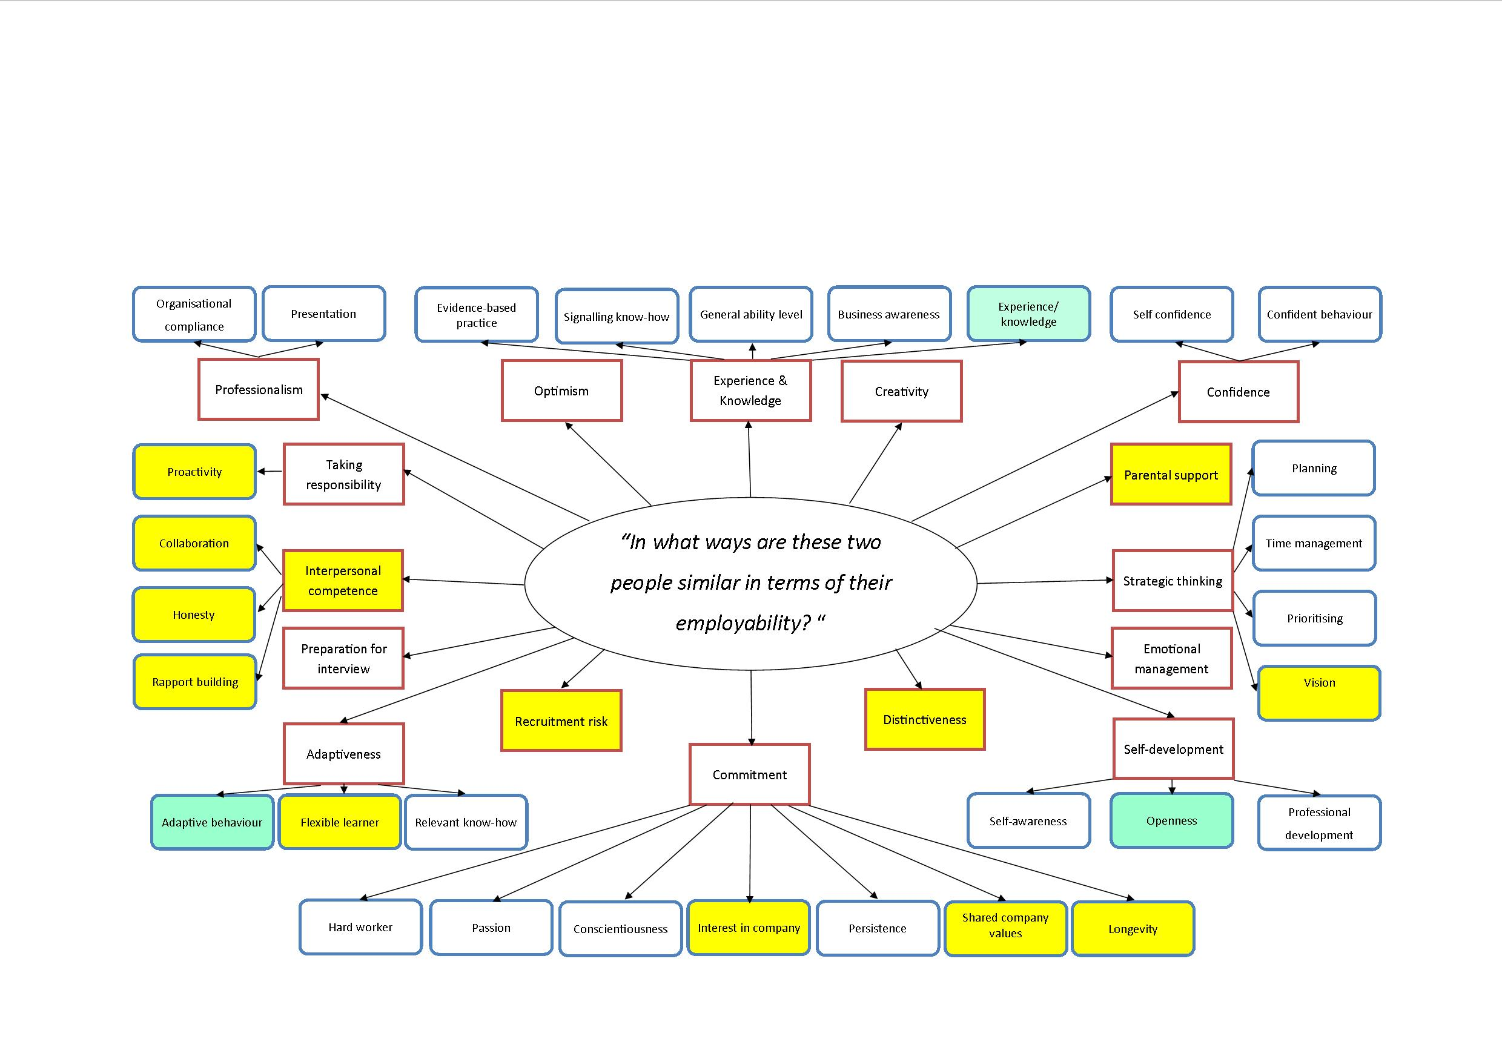
Notes:
Make biggest section

Slide 8
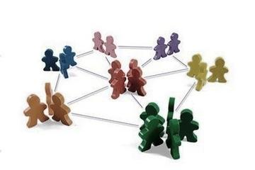
Interpersonal competencies
Competence to interact with others appropriately.
Rapport building vs. egocentric: “can build rapport – concerned with only themselves”
Collaborative vs. lone worker: “out for themselves – a team player”
Honesty vs deception: “hide mistakes – honest about mistakes”
Contextualising of skills?
Reflected in delivery?

Slide 9
Commitment
Being directed, pledged or bound to engage with the role.
Longevity vs. stop gap: “choosing to stay within the field – a means of testing the role out”
Shared company values: “may ruffle people’s feathers – fit in with organisation”
Interest in company vs. just a job: “committed to the company- committed to themselves”
Information relevant to context
Impact on consideration of interests and values?

Slide 10
Implications
Inclusion of employers
Value of academically generated employability conceptualisations
Curriculum mapping and quality assurance assessments
Recruitment, induction, and CPD design
Notes:
Inclusion of employers in research and initiative design
The application of academically generated employability conceptualisations should be viewed with caution
The current conceptualisation of employability
from a PCT standpoint, in addition to variations
across employer and educators personal theories
presented within the data, emphasise the
uncompromising role of employers in informing HE employability research, and development initiatives.
Current findings suggest the need for regular sampling of employer’s viewpoints, unconstrained by existing skills list.
Implications: The current conceptualisation of employability from a Personal Construct Theory outlook, and cross- variety of employability conceptualisation presented within the data, emphasise the uncompromising role of employers in informing HE employability development initiatives. Implications for research and practice include the need for regular sampling of employer’s viewpoints, unconstrained by existing skills list. Future conceptual developments need to consider consistency between recruiters and candidate’s implicit theories of employability, in understanding employment-related outcomes.

Slide 11
Further research
Comparison via explicit naming of skills
Exploring translation into initiative content
Investigating successful development of collaboration

Slide 12
Any questions?
If you would be interested in receiving this follow up survey, please leave your business card or email address at the end of the presentations. Or email me at….
stella.williams@newman.ac.uk

