Slide 1
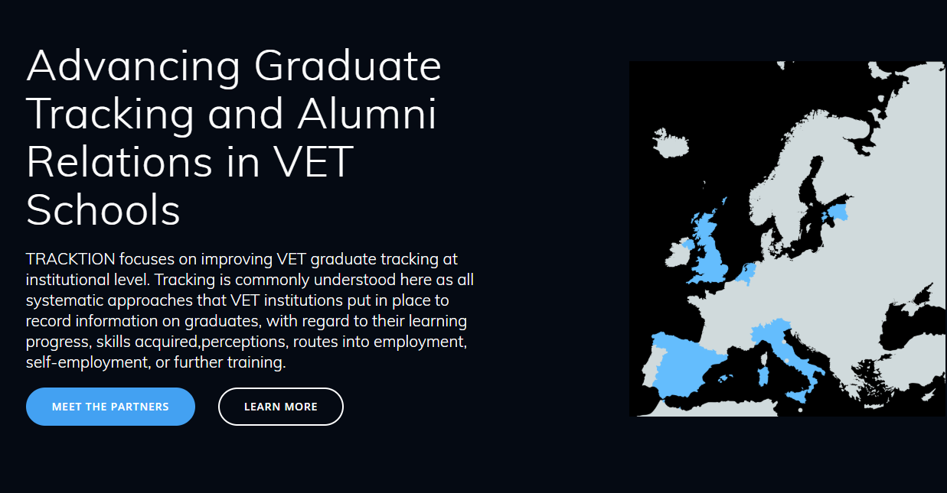
www.tracktionerasmus.eu
Notes:
To establish a more coordinated and appropriate set of VET Graduate Tracking measures at VET-provider level.
To increase institutional capacity to act on and use results for a variety of purposes, such as enhancing study programmes and alumni services.
To strengthen Alumni Culture in VET Schools.

Slide 3
three acts
SETUP
frame the discussion against the background of recent policy moves at European level
CONFRONTATION
showcase the main findings of a small-scale survey in VET schools
RESOLUTION
advance some working hypothesis informing the next moves for the project.

Slide 4
SETUP
frame the discussion against the background of recent policy moves at European level

Slide 5
The 2009 Recommendation set out 10 indicators which can be used to support the evaluation and quality assurance of VET systems. They are part of a “toolbox” from which member states and others can select in order to meet their own circumstances and requirements.
Indicator 1. Relevance of quality assurance systems for VET providers
Indicator 2. Investment in training of teachers and trainers
Indicator 3. Participation rate in VET programmes
Indicator 4. Completion rate in VET programmes
Indicator 5. Placement rate in VET programmes
Indicator 6. Utilisation of acquired skills at the workplace
Indicator 7. Unemployment rate
Indicator 8. Prevalence of vulnerable groups
Indicator 9. Mechanisms to identify training needs in the labour market
Indicator 10. Schemes used to promote better access to VET

Slide 6
Indicator no. 5
Placement rate in VET programmes
(a) destination of VET learners at a designated point in time after completion of training, according to the type of programme and the individual criteria
(b) share of employed learners at a designated point in time after completion of training, according to the type of programme and the individual criteria
Indicator no. 6
Utilisation of acquired skills at the workplace
(a) information on occupation obtained by individuals after completion of training,
according to type of training and individual criteria
(b) satisfaction rate of individuals and employers with acquired skills/competences

Slide 7
COUNCIL RECOMMENDATION of 20 November 2017 on tracking graduates
The objective of the proposed Council Recommendation is to improve the availability of qualitative and quantitative information about what graduates from tertiary education and vocational education and training (VET) in Europe do after they complete their education and training.
Notes:
Slowly building up… Peer Learning Activities… but 2017 – The need for speed…
COMMISSION COMMITMENTS
Development of a pilot European tertiary graduate survey
Mapping study on VET graduate tracking measures in the Member States
Mutual learning/capacity building such as peer reviews and exchange of good practices
Support the use of EU funding such as Erasmus +
Forward looking projects call , EQAVET NRP call, etc
MEMBER STATE COMMITMENTS
Creation or further development of graduate tracking systems
(administrative data and longitudinal surveys)
Participation in a network of experts - mutual learning and discussing comparability of data
Dissemination and exploitation of graduate tracking information

Slide 8
24
Member States with VET tracking measures
of which 19 have national measures
Member States with at least one regular VET graduate tracking measure
19
AT, BE, CZ, DE, DK, EE, ES, FI, FR, HU, IE, IT, LU, MT, NL, PT, SE, SK and UK
17
Member States with regular measure(s) cover employment and educational indicators
AT, BE, CZ, DE, DK, EE, ES, FI, HU, IE, IT, LU, MT, NL, PT, SE and UK
Notes:
In two countries (FR, SK), measures only cover employment results and do not also refer to indicators related to education and training. In one case (BE), the regular measure that refers to education and training related indicators does not include results related to the progression to further education and training.
Of the 85 measures identified, 59 used surveys and 35 used Administrative learning and employment data (such as social security and tax data). Nine measures in six countries (DE, EE, IE, NL, SE and UK) use administrative and survey data.
The robustness of the data collected varies. Of the 85 VET tracking measures analysed, 44 have measures which cover the whole reference population, while the others use samples. From those using samples, 19 use convenient sampling, which limits the generalization of results to the full reference population. In the in-depth review, comparator groups were used in only a third of measures.
Longitudinal measures are rarely implemented. VET graduate tracking data appears to be used differently across Member States. For instance, from the measures reviewed in depth, some appear to systematically feed data into policy making (e.g. to plan VET offer, inform quality assurance processes) while others are likely to have more informal arrangements. Moreover, a few, but not all, use VET graduate tracking data to provide prospective students information on career prospects or progression.

Slide 9
CONFRONTATION
showcase the main findings of a small-scale survey in VET schools
Notes:
Ok, so we have a clear picture of what’s going on at system-level, but let’s report from the trenches of VET providers.

Slide 10
To take stock of existing initiatives, tools, needs and challenges concerning the progression paths of graduates at VET provider level.
10 schools, 6 regions, 4 countries
Sections
Graduate Tracking Procedures
Alumni initiatives
Recommendations & Conclusions
Notes:
The present report is the first part of the How-to-Guide. It aims at providing a concise summary of the state of art of tracking and alumni initiatives in nine VET schools in four European countries (Estonia, Italy, Netherlands and Spain). Descriptions are supported by factual information on reasons, uses, methods and obstacles encountered. While the coverage area is constrained to the countries represented in the consortium, lessons learned and protocols have a strong transferability potential. It expects to attract attention in the European and national debates towards what are considered key elements in Quality Assurance in VET Schools (EQAVET Toolkit).

Slide 11
WHAT & HOW
So far, so good?
Measure(s) in place cover employment and educational indicators (coarsely-grained) …
Response rate is NOT an issue
Largely a survey-based thing…
Telephone interviews preferred method followed by digital questionnaires

Slide 12
OLIVER TWIST SCUOLA
No legal obligation
Regular measure: Administrative data & survey
Total reference population
Multiple measurement points
Response rate (>90%)
Internal use: planning, no info circulated to families or students

Slide 13
WHO
Graduates
Teachers/Tutors
QA Dept/Head of Studies
DfE (Reg/Nat) *
Graduates
External organization
DfEducation
DfEmployment
VET Schools??

Slide 14
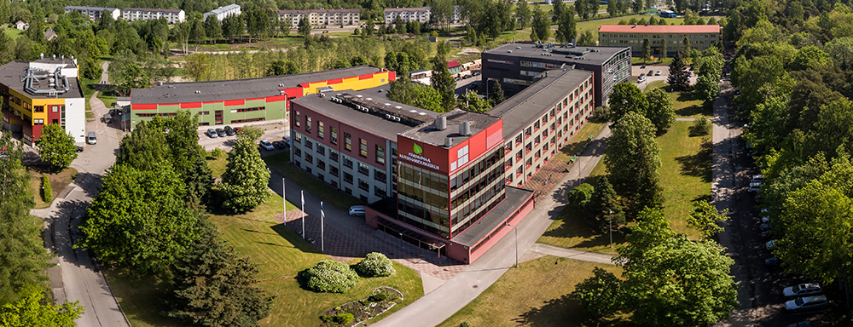
PARNUMA KUTSEHARIDUSKESKUS
Regular measure: Survey-based
Teachers involved
Total reference population
6 months after graduation
High response rate (90%)
Ad-hoc measure: Survey-based
External organization
Sample
1 to 2 yrs after graduation
Low response rate (<20%)
Notes:
In Estonia, all vocational education institutions are required by the Ministry of Education and Research to gather information from their alumni 6 months after graduation as to their current employment status.
The class teacher manage to reach the graduates quite easily and the average response rate has been ca 90% in all the years.
We also do an additional graduate survey that asks the students a bit more question. For example how happy they are with their obtained education and skills, the teachers and the school in general. This is an online survey that we also send out by e-mail ca 6 months after graduation and the response rate is usually around 20-25%.
Additionally a centralized alumni survey was done in Estonia in 2017 involving all the vocational schools in Estonia. This was lead by Ministry of Education and Research.

Slide 15
WHEN
Before graduation
Only ALFA COLLEGE (NL) gathers info on students plans after graduation and starts building an alumni network.
Shortly after graduation
Single measure
6-12 months
Longitudinal
OLIVER TWIST SCUOLA (IT) contacts last year graduates every 3 months, «older» graduates twice a year.

Slide 16
ALFA COLLEGE
No legal obligation
Survey-based. Digital (X-monitor)
Graduate population sample
Before and 6 months after graduation (*)
The info is disseminated to educational teams and management

Slide 17
WHY
So what??
…often limited to simple descriptive
information about the labour market success of the graduates
… not really accessible
… does seldom lead to any action other than self-reassurance or marketing

Slide 18
ALUMNI
Not a longstanding tradition
…loose and disconnected initiatives
… schools eager to do more

Slide 19
CIFP CISLAN
Legal obligation (Regional)
Regular measure: Survey-based.
Total reference population
6 months after graduation
High response rate (ca 80 %)
Alumni initiatives: in-house incubation unit, job placement office, alumni association, networking events.

Slide 20
RESOLUTION
advance some working hypothesis informing the next moves for the project.

Slide 21
NEXT
2018
Aug 2018 – First draft of Tracking Protocol
Sep 2018 – Feedback from partners on draft
Oct 2018– Testing with small group (Alfa College)
Nov 2018 – EQAVET Forum (Vienna)
2019
Jan 2019 - First round (100 students/school)
Mar 2019 - Internal report of students destination
June 2019 - Second round (same 100 students).
Sep 2019 – Publication of findings

Slide 22
WHAT
How deep is too deep?
Compliance with existing requirements
Balance what’s desirable with what’s feasible
Comparability…”partial harmonisation”

Slide 23
WHEN
Before and after graduation
Bring to the surface the “pre-learning” history of learners
Multiple measurement points
6 and 12 months after graduation

Slide 24
PRE
Demographic info
Motivation to join VET programme
POST
Demographic info
Employment status
Earnings, contract, full/part-time
Relevance of training to current employment
Skills learnt at college that are useful in current position
New skills since becoming employed that are useful
Course information
Working while studying
Course satisfaction
Preparedness for the world of work/further study
Post-grad plans
Contact info

Slide 25
WHO
A collaborative effort
Graduates … informed beforehand, those moving abroad harder to reach
Teachers …relational bond, trust… accuracy, workload??
Education & Employers will provide much needed analytical muscle…

Slide 26
HOW
Stick to what works…
Mixed methods approach…phone/online
Access to administrative data seems difficult
Make the best use of precious little time
Issues regarding GDPR

Slide 27
While the learner is still at the organisation
Explain why they are being surveyed, explain when they can expect to be contacted after graduation
Contact details and preferred contact method
When contacting the learner
Explain importance of the data
Personalising contact (include name of course and plans the learner described, mentioning name of tutor, asking if they have any questions)
Multiple contact methods
Alumni engagement
Dissemination of information – keep alumni informed
Creation of online platform or social media group (LinkedIn, Facebook)
Alumni events

Slide 28
WHY
Acting on data: Closing the loop?
Context , as usual, is king
Beware, Graduate destinations alone are not good proxies for the value of learning
Graduate Tracking can support better matching of training and jobs only if used in combination with other sources of LMI

Slide 29
www.tracktionerasmus.eu

Slide 30
Iván Diego ivan@valnalon.com

