Slide 1
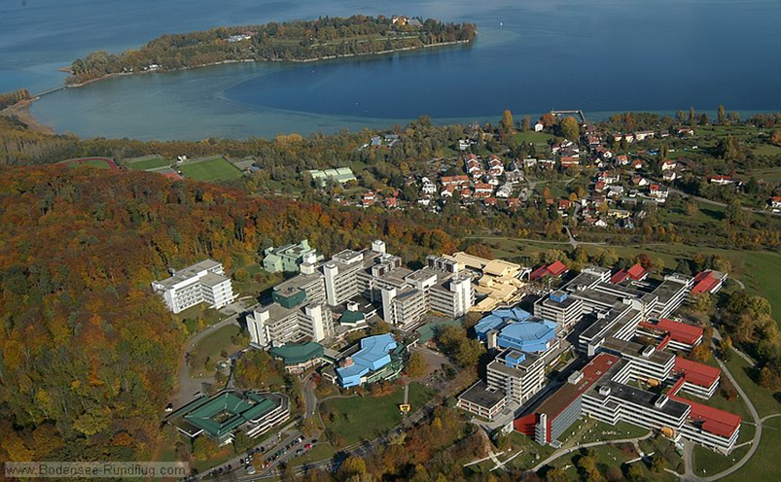
Conference on Employer Engagement and Training, London, 5/6 July 2018
Employer commitment in the German apprenticeship system - tensions, paradoxes and the challenge of academisation
Prof. Dr. Dr. h.c. Thomas Deissinger University of Konstanz/Germany – Chair of Business Education I

Slide 2
Agenda
The dual system of initial vocational training - system sub-optimalities
Tertiarisation and new forms of „vocational higher education“

Slide 3
Key institutional elements of the German dual system (apprenticeship system)
Strong commitment of employers to offer training places
High degree of formalisation
Strong involvement of social partners / consensus principle
Part-time education at school, both vocational and general subjects
Chambers as monitoring and examining bodies
Trainer qualifications required for company-based training
Specialised teacher training for vocational schools
High esteem of practical learning in society
Qualifications must be portable on „occupational labour markets“
Sources: Harris/Deissinger 2003; Euler 2013; Deissinger 2010; Greinert 1994
London Presentation Thomas Deissinger 5 July 2018

Slide 4
Some statistical facts (1) – German VET
Some 1.3 million young people (2015) undergo apprenticeships in the dual system (mostly 3-year courses)
Around 1 million attend full-time courses in VET (2014)
As against some 2.8 million students in higher education (2015/16)
Companies and vocational part-time schools train young people in 328 different training occupations
90 % of initial training contracts are exclusively financed by employers
Share of training companies = 20.3 % (2014)
27 % of apprentices (2015) get their training in the craft sector (trades)
Apprentices amount to 5.2 % of the workforce (2014)
Sources: BMBF 2016; BIBB 2016
London Presentation Thomas Deissinger 5 July 2018

Slide 5
Some statistical facts (2) – German VET
26.2 % (!) of apprentices (2014) have a higher education entrance qualification
Highest shares of these “premium apprentices” are reported in “industry and commerce” (some 32 %) and in the public sector (some 50 %)
In banking, more than 70 % of apprentices hold such a qualification
Craft sector mostly recruits school leavers with a lower secondary school qualification (some 46%)
“Transition system” still a reality (some 250,000 p.a. entering)
Source: BMBF 2016; BIBB 2016
London Presentation Thomas Deissinger 5 July 2018

Slide 6
Essential: Employers‘ role in the dual system
Offering and funding apprenticeships for school leavers
Developing and revising training regulations, together with trade unions
Functions in examination boards
Functions in chamber commissions and at the BiBB
Chamber presidents are always employers of the respective region
Cooperation with vocational part-time schools through training and personnel departments
Employers shape and influence VET policy through the chamber organisation and employers organisations
Sources: Stender 2006; Deissinger 2010; 2015
London Presentation Thomas Deissinger 5 July 2018

Slide 7
Volatility of the German training market (entrants per year)
Source: BIBB 2016
London Presentation Thomas Deissinger 5 July 2018
Notes:
BIBB (2016). Entwicklung der Zahl der neu abgeschlossenen Ausbildungsverträge nach Ländern von 1997-2015. Erhebung zum 30.09.

Slide 8
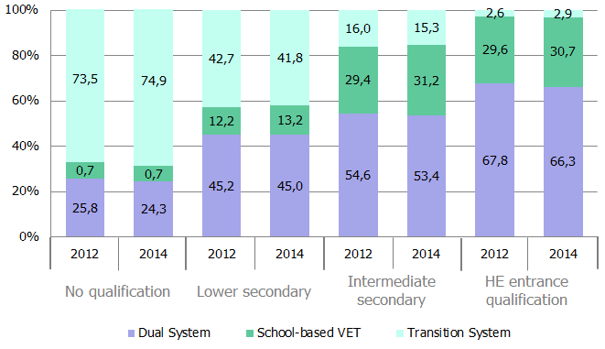
Destinations of VET beginners in Germany – according to school leaving qualification
Source: Integrierte Ausbildungsberichtserstattung 2014; Autorengruppe Bildungsberichterstattung 2012
London Presentation Thomas Deissinger 5 July 2018

Slide 9
Paradoxes on the training market
Companies articulate the „battle for apprentices“
However, companies offering occupations that would normally be open for „disadvantaged“ school leavers cannot „fill“ their places
Companies have high expectations in terms of social skills etc.
Young people have high expections, too, including academic aspirations
Demographic change and regional factors aggravate mismatches
Source: Matthes/Ulrich 2014; Ulrich 2011
London Presentation Thomas Deissinger 5 July 2018

Slide 10
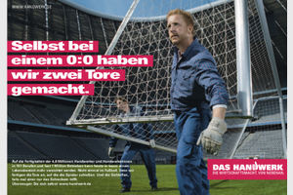
Image-Kampagne des Handwerks
… a short history of the craft sector: wheel invented, pyramids built, Mars explored, drainage system repaired…
… even when they play 0:0 we have made two goals …

Slide 11
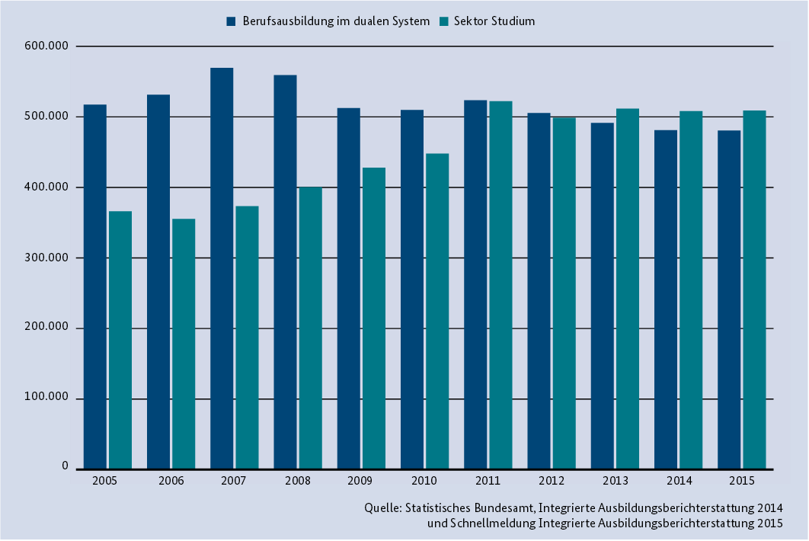
Intakes: Dual system vs. Higher Education
(Germany, 2005 - 2015)
Source: BMBF 2016, p. 42
London Presentation Thomas Deissinger 5 July 2018

Slide 12
Tertiarisation vs. Vocationalisation?
Tertiarisation in the German context:
Traditional academic pathways (grammar school, university)
Higher school certificates obtainable in full-time VET
Hybrid qualifications (rather weak segment of VET)
Vocationalisation in the German context:
Higher Education picks up traits of the VET system
Higher Education develops new forms of applied and/or highly specialised courses (Bachelor courses)
Sources: Krone 2015; Deissinger 2000; Zabeck/Deissinger1995
London Presentation Thomas Deissinger 5 July 2018

Slide 13
„Tertiarisation of VET“ – four meanings in the German context
Vocational full-time schools work as providers of higher school qualifications - e.g. the higher commercial school which opens progression to HE
Some of these schools also provide hybrid qualifications (HQ) to young people - e.g. the vocational college (Berufskolleg)
HE institutions develop new courses (Bachelor-Master) with growing specialisation and differentiation, e.g. specialised undergraduate courses in Business Administration
HE institutions copy the VET model of the dual system by establishing an alternative pathway into HE for grammar school leavers - e.g. vocational academies or dual universities (Duale Hochschulen)
Source: Deissinger et al. 2013; Deissinger/Ott 2016

Slide 14
Hochschulreife = general university entrance qualification
Fachhochschulreife = university of applied sciences entrance qualification
Mittlerer Abschluss = intermediate secondary school qualification
Hauptschulabschluss = lower secondary school qualification
Vocational schools as providers of higher school qualifications
Source: Statistisches Landesamt Baden-Württemberg, 2012
London Presentation Thomas Deissinger 5 July 2018

Slide 15
Universities
Polytechnics/ „Universities of Applied Sciences“
Vocational Academies/ “Dual Universities“
„Universities of Education“
Upper Secondary Education
Higher Education in Germany
(federal state of Baden-Württemberg)
London Presentation Thomas Deissinger 5 July 2018

Slide 16
Characteristics of „vocational academies“ now called „Dual Universities“
„Premium apprenticeship“ coupled with academic studies
„Academic dual system“ (half/half)
Full university entrance qualification required
Training contract required for admission
Attractive training allowances for students
Three-year courses leading to Bachelor degree
Sources: Krone 2015; Deissinger 2000; Zabeck/Deissinger 1995
London Presentation Thomas Deissinger 5 July 2018

Slide 17
Conclusion
Dual system still strong though losing appeal among young people in some occupational fields
Weaker learners and “problem groups” continue facing difficulties in getting an apprenticeship placement as employers have high expectations in terms of personality of applicants, social competences, learning skills, and school grades
Training market will remain a problem despite a better supply-demand quota due to matching problems
On the other hand, the dual system is now spreading its “logic” in a culturally defined manner, e.g. by “infecting” the higher education system
Recruitment strategies of companies become more diversified
Bologna system comes up with more specialised “applied” Bachelor courses with which the established VET system must compete (e.g. in the commercial sector)
London Presentation Thomas Deissinger 5 July 2018

Slide 18
References
Autorengruppe Bildungsberichterstattung (2014) Bildung in Deutschland 2014. Ein indikatorengestützter Bericht mit einer Analyse zur Bildung von Menschen mit Behinderungen. Bielefeld (W. Bertelsmann).
BMBF (2016). Berufsbildungsbericht 2016, Bonn (BMBF.)
BiBB (2016). Datenreport zum Berufsbildungsbericht, Bielefeld (W. Bertelsmann).
Deissinger, Th. (1996). Germany's Vocational Training Act: Its Function as an Instrument of Quality Control within a Tradition-based Vocational Training System, in: Oxford Review of Education, Vol. 22, pp. 317-336.
Deissinger, Th. (2000). The German „Philosophy“ of Linking Academic and Work-based Learning in Higher Education – The Case of the „Vocational Academies“, in: Journal of Vocational Education and Training, Vol. 52, No. 4, pp. 609-630.
Deissinger, Th. (2010). Dual System, in: Peterson, P./Baker, E./McGaw, B. (Eds.), International Encyclopedia of Education, 3rd Edition, Vol. 8, Oxford (Elsevier), pp. 448-454.
Deissinger, Th. (2015). The German dual vocational and education system as `good practice´?, in: Local Economy, Vol. 30, No. 5, pp. 577-567.
Deissinger, Th./Smith, E./Pickersgill, R. (2006). Models of Full-time and Part-time Vocational Training for School-leavers: A comparison between Germany and Australia, in: International Journal of Training Research, Vol. 4, No. 1, pp. 30-50.
Deissinger, Th./Ott, M. (2016). Tertiarisation of Vocational Education and Training and its implications – problems and issues in Germany and France, in: Bohlinger, S./Dang, T.K.A./Glatt, M. (Eds.), Education Policy: mapping the landscape and scope, Frankfurt a.M. (Peter Lang), pp. 267-296.
Deissinger, Th./Wern, R./Heine, R./Ott, M. (2013). Progression from VET into Higher Education via Hybrid Qualifications in Germany: context – policy – problem issues, in: Deissinger, Th./Aff, J./Fuller, A./Jorgensen, C.H. (Eds.), Hybrid Qualifications: structures and problems in the context of European VET policy, Bern (Peter Lang), pp. 111-145.
Euler, D. (2013). Das duale System in Deutschland – Vorbild für einen Transfer ins Ausland? Studie im Auftrag der Bertelsmann Stiftung. Gütersloh.
London Presentation Thomas Deissinger 5 June 2018

Slide 19
References
Greinert, W.-D. (1994). The "German System" of Vocational Training. History, Organization, Prospects, Baden-Baden (Nomos).
Harris, R./Deissinger, Th. (2003). Learning Cultures for Apprenticeships: a comparison of Germany and Australia, in: J. Searle/I. Yashin-Shaw/D. Roebuck (Eds.), Enriching Learning Cultures. Proceedings of the 11th Annual International Conference on Post-compulsory Education and Training. Vol. 2. Brisbane (Australian Academic Press), pp. 23-33.
Institut für Arbeit und Qualifikation (2016). Dual Studieren und dann? Ergebnisse einer bundesweiten Befragung dual Studierender (www.iaq.uni-due.de/iaq-report).
Krone, S. (2015). Dual Studieren im Blick, Wiesbaden (VS Verlag).
Matthes, S. et al. (2014). Wenn Angebot und Nachfrage immer seltener zusammenfinden. Wachsende Passungsprobleme auf dem Ausbildungsmarkt: Analysen und Lösungsansätze, Bonn (BiBB).
Statistisches Bundesamt (Ed.) (2015). Bildung und Kultur. Integrierte Ausbildungsberichterstattung. Anfänger, Teilnehmer und Absolventen im Ausbildungsgeschehen nach Sektoren/Konten und Ländern, Wiesbaden.
Stender, J. (2006). Berufsbildung in der Bundesrepublik Deutschland, Teil 1: Strukturprobleme und Ordnungsprinzipien des dualen Systems. Stuttgart (Hirzel Verlag).
Ulrich, J.G. (2011). Übergangsverläufe von Jugendlichen in Zeiten des demographischen Wandels, in: Berufsbildung, No. 130, pp. 9-11.
Zabeck, J. (1985). Berufliche Bildung, in: Staatslexikon Recht - Wirtschaft - Gesellschaft, hrsg. von der Görres-Gesellschaft, Bd. 1, 7. Aufl., Freiburg, pp. 669-683.
Zabeck, J./Deissinger, Th. (1995). Die Berufsakademie Baden-Württemberg als Evaluationsobjekt: Ihre Entstehung, ihre Entwicklung und derzeitige Ausgestaltung sowie ihr Anspruch auf bil¬dungspolitische Problemlösung, in: Zabeck, J./Zimmermann, M. (Eds.), Anspruch und Wirklichkeit der Berufsakademie Baden-Württemberg. Eine Evaluationsstudie, Weinheim (Deutscher Studien Verlag), pp. 1-28.
London Presentation Thomas Deissinger 5 June 2018

Slide 20
Thanks for your attention! Any questions or comments?
London Presentation Thomas Deissinger 5 June 2018

Slide 21
conventional pathways
Age
detours
24
Dual System
(in-company training and part-time
vocational schools)
Universities or
polytechnics
HE
entry
qualifi-
cation
(Abitur)
18/19
other full-time
vocational
schools
vocational colleges/ higher vocational schools
16
lower secondary
school leaving
certificate
intermediate
school leaving
certificate
10
Germany‘s Education and VET system
London Presentation Thomas Deissinger 5 June 2018

Slide 22
governing principle = self-government
Chambers
supervisory functions
counselling functions
Employer organisations
and trade unions
collective bargaining
co-determination of training ordinances
private responsibility
semi-private responsibility
private commitment of employers to practical training
TRAINING COMPANY
state quality control
didactical systematisation and standardisation
Vocational Training Act
training ordinances
VOCATIONAL SCHOOL
School Acts of Federal States
framework syllabuses
governing principle = compulsory attendance at vocational school
22
London Presentation Thomas Deissinger 5 June 2018

