Slide 1
Vocational qualifications for 14-16 year olds: Exploration of knowledge, skills and teacher perceptions
Sylvia Vitello & Simon Child
The 5th International Conference on Employer Engagement and Training
Thursday 5th July 2018

Slide 2
Overview
Context: Government’s reforms
Research aims
Methods
Results
Conclusions

Slide 3
Context

Slide 4
What do 14 to 16 year olds study in England?
Study around 9 subjects and assessed for each one
Most are GCSEs – academic qualifications
Technical Awards – vocational qualifications in governmental school performance tables (e.g., Cambridge Nationals and BTECs).

Slide 5
Technical Awards? Let’s go back to 2010
“How we can improve vocational education for 14-19 year olds and thereby promote successful progression into the labour market and into higher level education and training routes?”
“many young people took courses that were in no sense truly ‘vocational’ or useful”
“high quality”
“strong safeguards against downward pressure on standards”
“future progression is critical”

Slide 6
Department for Education (DfE) Technical Guidance
Technical Awards vs. GCSEs
Content: ‘[Technical Awards] should focus on applied study of a sector or occupational group, including…practical or technical skills…’ (p.10)
Relative position: ‘…are distinct from GCSEs and they complement and supplement the academic offer.’ (p.10)
Rigour: ‘…must, however, offer an equivalent level of rigour and challenge as GCSEs’. (p.10)
Progression: ‘…must be recognised and valued by post-16 education and training providers… alongside GCSEs’ (p.19)
Increase rigour? External assessment
Minimum % external assessment (25% rising to 40%)
External assessment → more external control → more rigour
External assessments = exams (but don’t have to be)
1.
Difference
2.
3.
Same
4.

Slide 7
Our research

Slide 8
Research aims
1. To what extent are Technical Awards distinct from the ‘equivalent’ GCSE?
2. Are they just as rigorous?
GCSEs by OCR
Technical Awards: Cambridge Nationals
Sport Science
Physical Education
Sport Studies
Enterprise and Marketing
Business
Creative iMedia
Media Studies
Three phases:
1. Comparison of subject content
2. Comparison of types of knowledge/skills
3. Teacher interviews

Slide 9
Phase 1: Subject content overlap
“Technical Awards are distinct from GCSEs…and supplement the academic offer” (DfE, 2016, p.10)
Specifications contain statements of what the students should learn.
E.g., learning outcomes, assessment objectives, educational objectives
Used a lexical/phrase search to identify which content in the Technical Award also appeared in the comparable GCSE.

Slide 10
Phase 2: Taxonomy mapping
Educational taxonomies have identified different types (domains) of knowledge and mental processing (Greatorex & Suto, 2016).
Knowledge: e.g., factual, psychomotor, interpersonal
Mental processing: e.g., retrieval, recall, analysis
Map onto learning outcomes/educational objectives
“Give two potential barriers to participation in an emerging sport”
Hierarchical
Retrieval
Factual knowledge
Complex/
high demand
Simple/
low demand

Slide 11
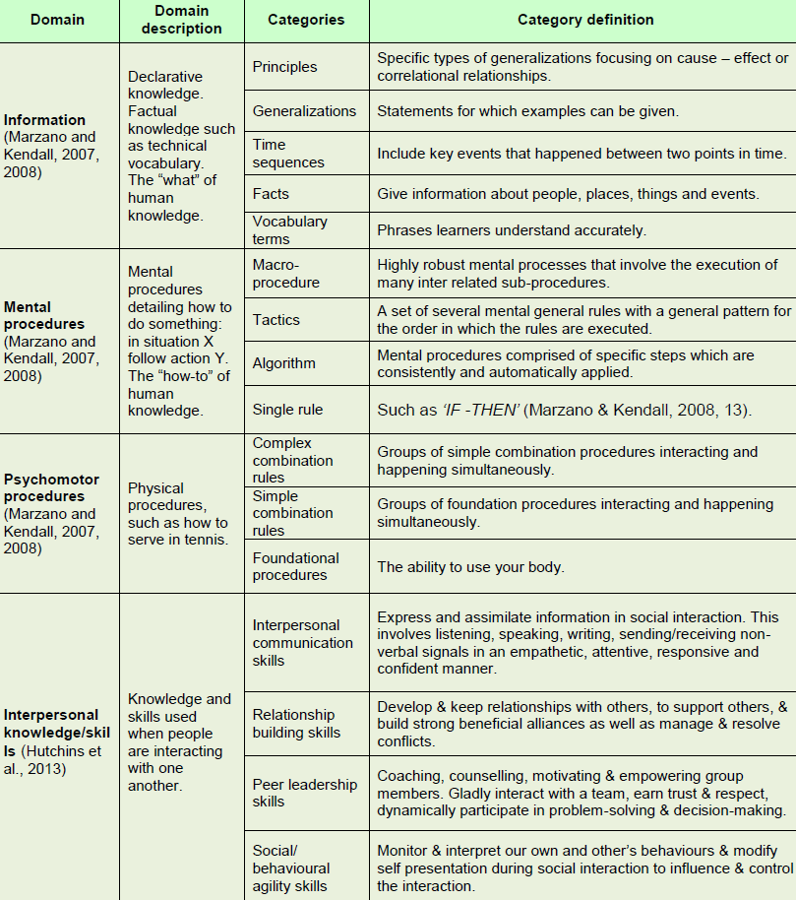
Domains of knowledge
Hierarchy
of demand
Non -Hierarchical

Slide 12
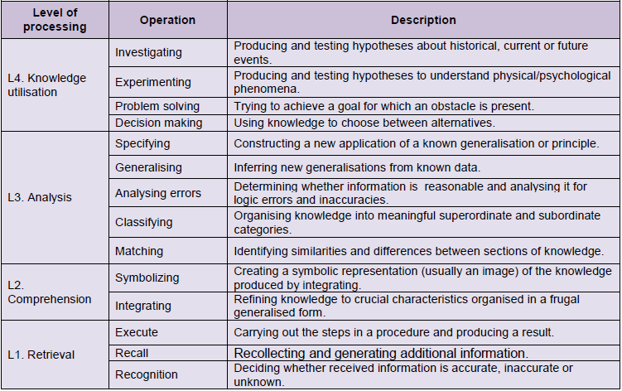
Levels of mental processing (cognitive)
Six levels of mental processing can be used on each type of knowledge (Marzano and Kendall, 2007, 2008).
L4: Knowledge utilisation
Hypothesise about events and phenomena
Hierarchy
of demand
L1: Retrieval
Produce a statement about information from memory

Slide 13
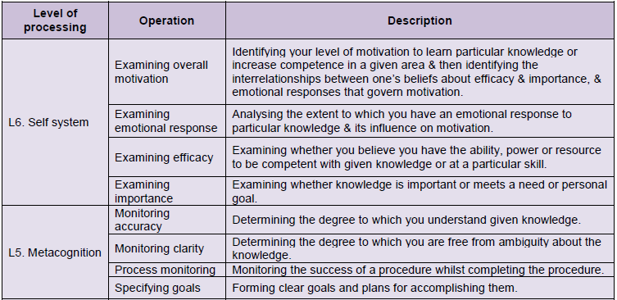
Levels of mental processing (meta-cognition, self-system)
Hierarchical
Non-hierarchical
L5: How students learn about their knowledge
L6: What they know about their attention and motivation to learn

Slide 14
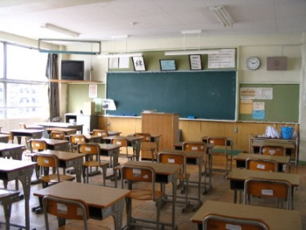
Phase 3: Teacher interviews
Most over the phone
13 teachers
Three from each Cambridge National qualification
One paired interview (Creative iMedia)
All taught Cambridge National and all but one also offered the GCSE
Interview structure:
Section A – Participant information and context
Section B – The decision process in offering qualifications
Section C – Teaching in the school
Section D – Content-specific questions
Section E – Skills that students learn
Section F – Future qualifications

Slide 15
Results

Slide 16
Is Technical Award content different to GCSE content?
Technical Award → GCSE | Units with no overlap | Units with partial overlap | Units with complete overlap
Sport Science → PE | Technology in sport Sport psychology Sports nutrition | Reducing the risk of sports injuries Applying principles of training | Body’s response to physical activity
Sport Studies → PE | Sports leadership Working in the sports industry Developing knowledge and skills in outdoor activities | Sport and the media | Contemporary issues in sport Developing sports skills
Creative iMedia → Media studies |  | All 10 units (planning of productions)
Enterprise → Business |  | Design a business proposal Market and pitch and business proposal | Enterprise and marketing concepts

Slide 17
Is overlapping content actually taught the same?
“I like to think that the teaching is the same for CamNat and GCSE students”
Yes, sometimes
But not always…
Enhanced practical/contextual element in the teaching of Cambridge Nationals than GCSE
Real-world examples (e.g., case studies, Dragon’s Den)
Relating content to jobs (e.g., sport coaching)
Different assessment strategies
“Very very similar to GCSE”
“In the GCSE a more traditional approach, might be quite theoretical. The CamNat taught on basis of application of what it was like for their little business”
“We bring in the careers aspect” (risk of sport injuries unit)
“The kids who put more effort in in the pre-production end of things do come up with the better product”

Slide 18
What do teachers think?
Certain areas of the Cambridge Nationals were:
Highly valued
Provided a key differentiation from the GCSE equivalent
students
outcomes
enjoy
careers
 | Topic/content area
Sport Studies | Leadership Working in the Sports Industry
Business (legacy) | Setting up a business
Creative iMedia | Technical/computer software
“The main one is leadership”
“…can relate their work to the career they want…so it helps them prepare the CV”
“The Nationals worked for Enterprise unit because it got them to use a range of skills”
“Needs…some reality to a qualification….I wanted everybody to have that experience of running a mini-business”
“Overall, the kids doing Creative iMedia probably come out with better software skills”

Slide 19
Different types of knowledge to GCSEs?
Mapping onto taxonomies of knowledge/skills and mental processing
National
GCSE
Both
None
 |  | Sport Science | Sport Studies | Creative iMedia | Business
Information knowledge | Principles
 | Generalizations
 | Time sequences
 | Facts
 | Vocabulary
Mental procedures | Macro-procedure
 | Tactics
 | Algorithm
 | Single rule
Psychomotor procedures | Complex rules
 | Simple rules
 | Foundational
Interpersonal domain | Communication
 | Relationships
 | Peer leadership
 | Social agility

Slide 20
Different types of knowledge to GCSEs?
Mapping onto taxonomies of knowledge/skills and mental processing
National
GCSE
Both
None
 |  | Sport Science | Sport Studies | Creative iMedia | Business
Information knowledge | Principles
 | Generalizations
 | Time sequences
 | Facts
 | Vocabulary
Mental procedures | Macro-procedure
 | Tactics
 | Algorithm
 | Single rule
Psychomotor procedures | Complex rules
 | Simple rules
 | Foundational
Interpersonal domain | Communication
 | Relationships
 | Peer leadership
 | Social agility
Non-exam units

Slide 21
Different levels of processing to GCSEs?
National
GCSE
Both
None
 |  | Sport Science | Sport Studies | Creative iMedia | Business
Level 4: Knowledge utilisation | Investigating
 | Experimenting
 | Problem solving
 | Decision making
Level 3: Analysis | Specifying
 | Generalising
 | Analysing errors
 | Classifying
 | Matching
Level 2: Comprehension | Symbolising
 | Integrating
Level 1: Retrieval | Executing
 | Recalling
 | Recognising
Non-exam units
Non-exam units

Slide 22
Different levels of processing to GCSEs?
National
GCSE
Both
None
 |  | Sport Science | Sport Studies | Creative iMedia | Business
Level 6: Self system | Importance
 | Efficacy
 | Emotions
 | Motivation
Level 5: Metacognition | Goals
 | Process
 | Clarity
 | Accuracy
Non-exam units
More difficult levels to access at qualification level

Slide 23
What key skills are developed in Technical Awards?
Many skills not associated with those in the taxonomies
Time-management
Research skills
Emotional/psychological skills
(e.g., confidence, resilience,
self-esteem, responsibility)
Team work and communication skills
“The biggest skill is managing their workload and time, that's huge and a very important skill for them to learn. Not learned so much in GCSE” (Sport studies/Sport science)
“Coursework element beneficial for those that go onto further education. Learn the importance of referencing their work, reading around subjects, to research things and to give relevant examples” (Sport science)
Non-exams
“‘…a lot of…programs are really fiddly and annoying…huge issue for these type of children, resilience…just getting so frustrated from the stuff” (iMedia)
“Communication skills is a big one because they need to present their idea several times…to each other and then to the senior leadership team…a massive learning curve for the students” (Business)

Slide 24
Conclusions

Slide 25
Conclusions: distinct to GCSEs?
DfE criteria | Criteria met | Evidence source
Not too much content overlap with GCSE | Yes – little content overlap at specification level. Degree of overlap depends on unit options | Phase 1
 | Yes - in how overlapping areas are taught | Phase 3
 | Yes – key content areas not in GCSE (mainly NEA units) | Phase 2 & 3
Acquisition of associated practical or technical skills | Yes – via assessment tasks and pedagogy (e.g. real-world examples) | Phases 2 & 3
Equivalent level of rigour to GCSE | Yes - from desk-based analysis | Phase 2
Practical
Real-world
Content related to jobs
Leadership
Entrepreneur-ship
Software skills
NEA
Interpersonal
Psychomotor

Slide 26
Conclusions and questions: external acceptability
Perceptions of how ‘rigour’ is achieved in qualifications and assessment (Nisbet, 2014).
‘Rigorous and appropriate assessment arrangements, including a significant proportion of the content of a qualification must be subject to external assessment, to offer a comparable level of challenge to GCSEs.’
(DfE, 2016)
Technical Awards
Rigour as Depth of knowledge
Rigour as ‘strictness’
Wide range of destinations
Rigour as external acceptability
Tensions amongst these three concepts of rigour:
Does ‘rigour as strictness’ change the value of qualifications for end-users/employers?
Is anything lost in the transition to external assessment?
What makes a Technical Award level qualification rigorous in your contexts?

Slide 27
Thank you Vitello.S@cambridgeassessment.org.uk Child.S@cambridgeassessment.org.uk

