Slide 1
Working together for young people
How do we prepare young people for a future world of work that we struggle to predict?
Christian Percy – Careers Researcher | Education and Employers
Katy Hampshire – Director Operations and Programmes | Education and Employers
Workshop Session, Education World Forum, Policy Dialogue 24th January 2019
British Council, London
@Edu_Employers

Slide 2
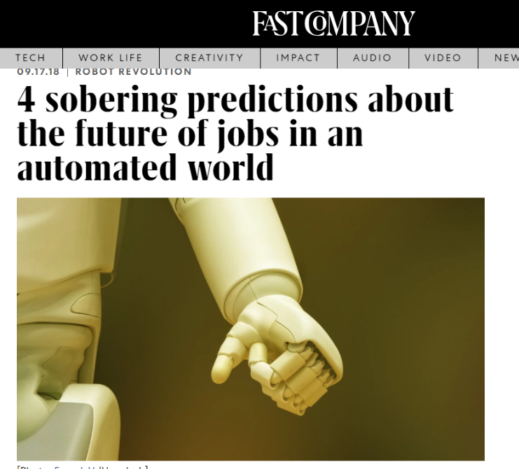
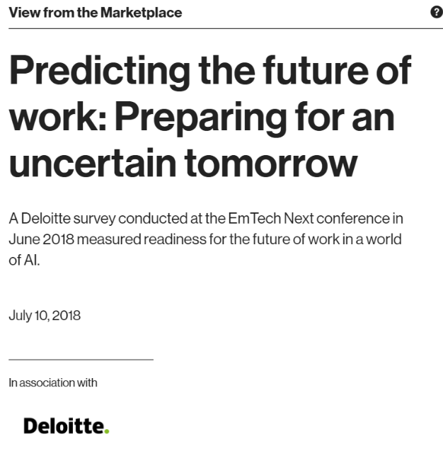
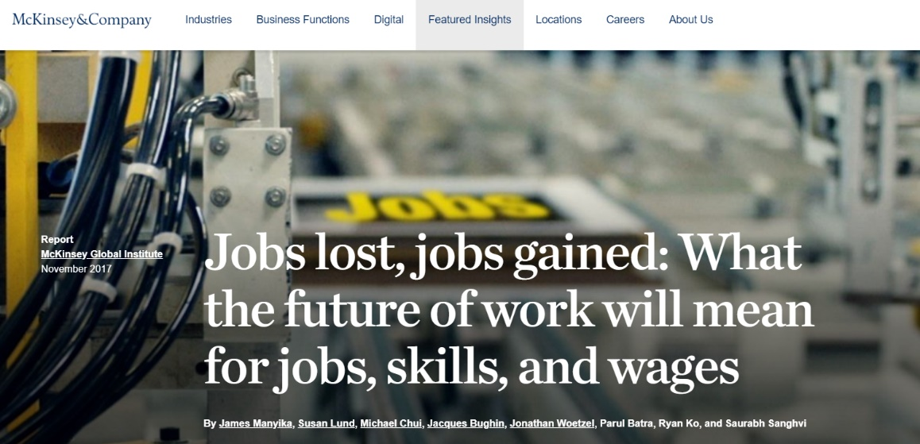
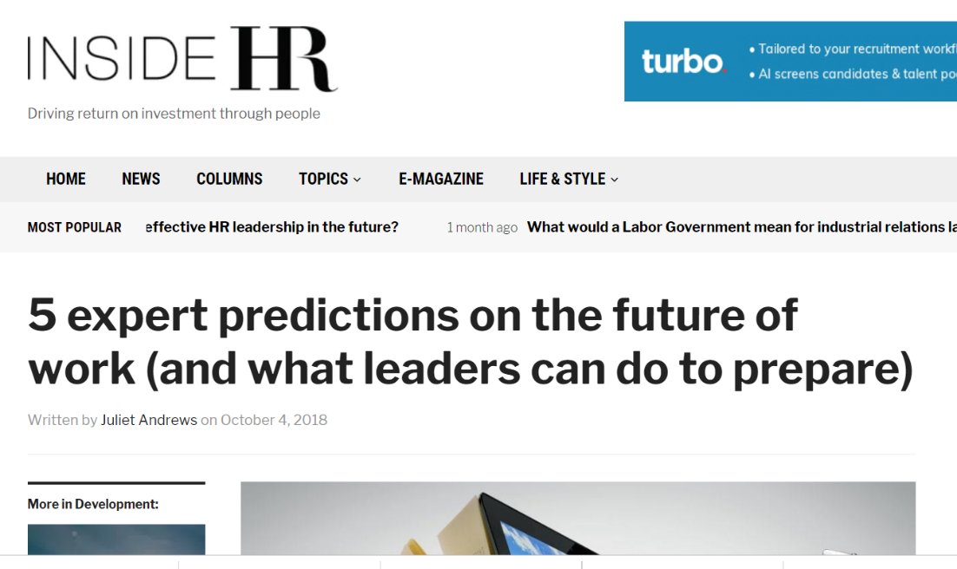
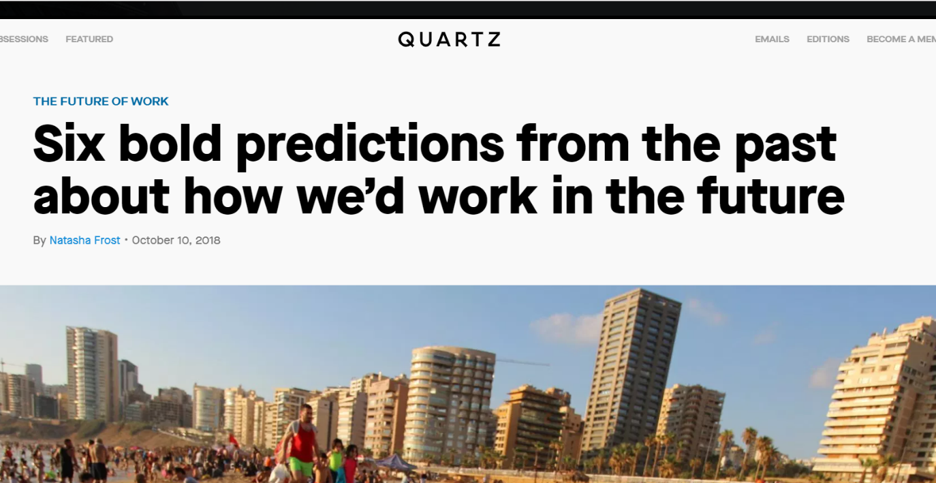
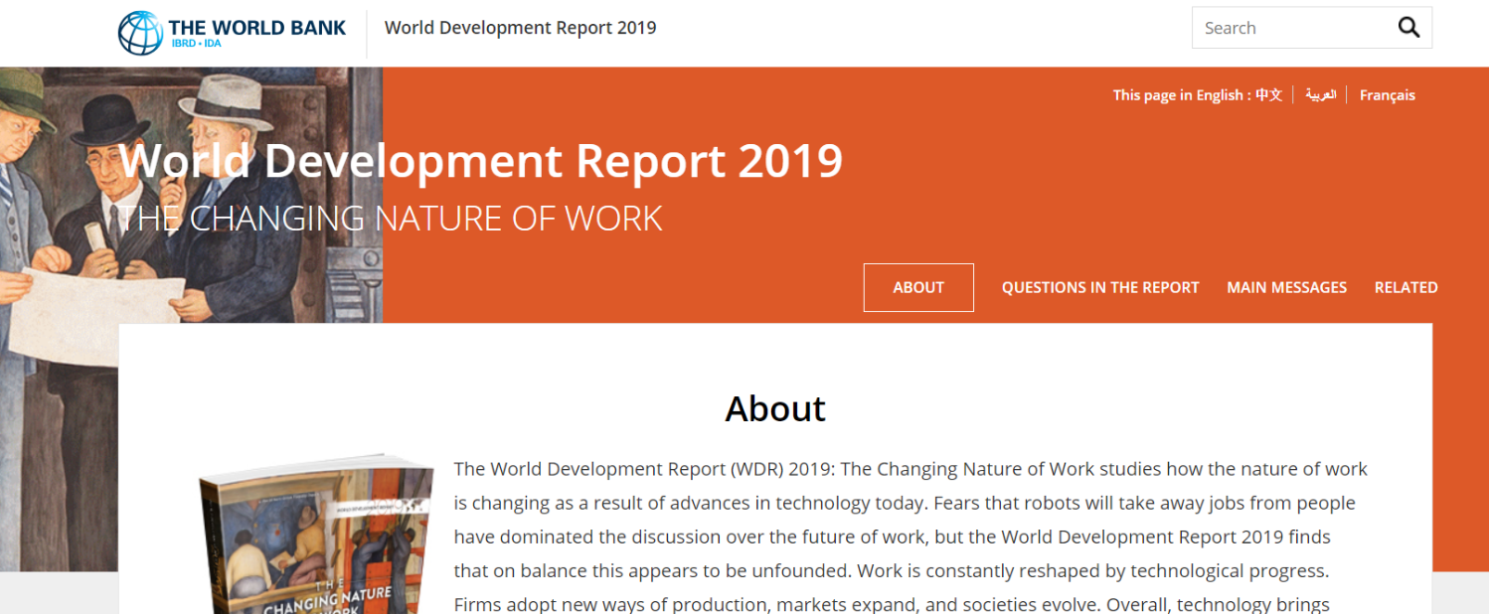
No shortage of predictions about the future

Slide 3
But most past predictions have been weak
“[By 2030 man’s real problem will be] how to occupy the leisure, which science and compound interest will have won for him […] three hours a day is quite enough”
John Maynard Keynes, British Economist, 1930
“[saw mills and stamps will] exclude the labour of thousands of the human race”
Thomas Mortimer, 1772
“The Americans have need of the telephone, but we do not. We have plenty of messenger boys.”
Sir William Preece, British Post Office, 1876
“The invention of aircraft will make war impossible in the future.”
George Gissing, 1903
“By 1982 the graduated income tax will have practically abolished major differences in wealth.”
Irwin Edman, professor of philosophy Columbia University, 1932
“There is no reason anyone would want a computer in their home.”
Ken Olson, Digital Equipment Corp, 1977

Slide 4
And yet: doing the same as before is not good enough
Our kids’ age
4
14
24
34
44
54
64
74
84
2020
2040
2060
2080
2100
Secondary School
First FT job around now?
Major life changes / career changes?
At least 2-3 major recessions / industry disruptions by now?
Retire? New phase of work?
Time from now to their first full-time job is longer than the time since:
Uber/Bitcoin (2009 = 10 years)
iPhone (2007 = 12 years)
Facebook (2004 = 15 years)

Slide 5
Macro trends as more reliable?
Technological progress
?
Localism vs globalism
Longer working lives with multiple career stages
?
Economic growth vs plateau vs decline
Changing world of work (even if specifics unclear)
?
Which industries will thrive, transform or struggle
Pressure on resources / Climate change
?
Impact of regulation on gig economy

Slide 6
Education tends to reform slowly
(despite the noise and the tinkering)
Curriculum changes more slowly than industry
Despite some growth in project-work, examination approach remains as pre-Internet age
Teaching associations emphasise need for stability
Stable system helps to measure students and schools over time
Political pressures lead to tinkering rather than wholesale change
Even if you could predict the future, you would struggle to change education fast enough
→ Important to build “responsiveness” into system as well as ongoing reforms

Slide 7
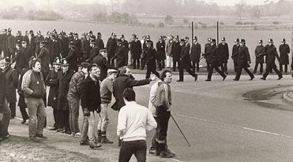
Thought 1: More balanced investment in lifelong learning and training
More investment in general?
Targeted spend in transitions?
US RUST BELT
UK COAL INDUSTRY 1980s
“Human capital tax credits” (R&D model)
Individual lifelong learning wallet
Rebalanced total investment, …
Subsidies for new industries/services in area
Incentives to relocate / transitional benefits
Training schemes, …

Slide 8
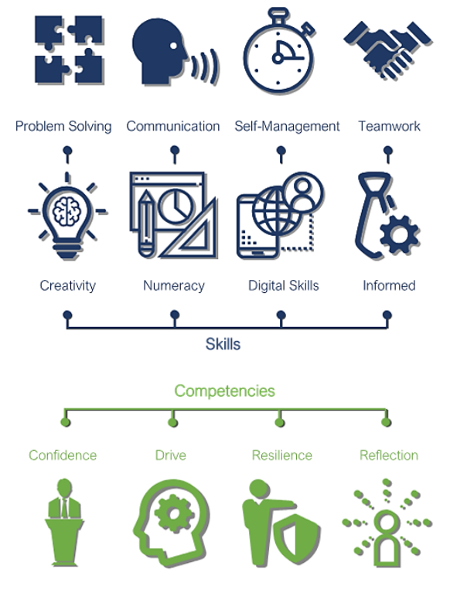
Thought 2: More focus on skills, attitude and preparation, rather than rote learning
Our recent report found seven employability skills and five 'competencies' were most frequently cited as important by employers.
Schools can support young people to develop these both within the classroom and through extra-curricular activities.
The report proposes that we can help young people to continue building these skills by providing them with opportunities for meaningful encounters with the world of the work, and that employers and schools need a joint dialogue.

Slide 9
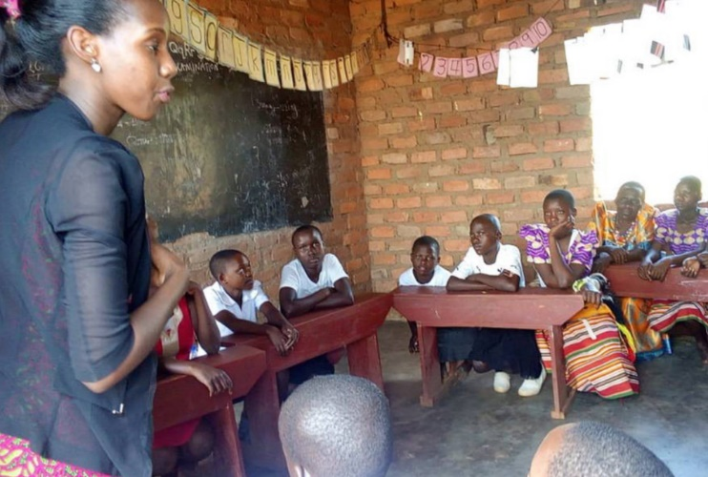
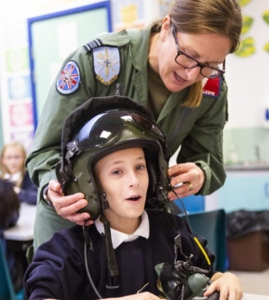
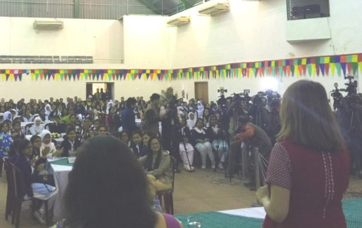
Thought 3: Connect young people directly to world of work – don’t try to micromanage
UGANDA
ENGLAND
BANGLADESH

Slide 10
These connections are powerful: Video
Link: https://youtu.be/6N07G6kCgSc

Slide 11
Career guidance, incl. links with employers, must be part of the answer for many issues
Sector mismatch
Underemployment
Other issues
Low productivity
Disengaged workforce
High (youth) unemployment
Shortage of jobs
Social mobility / inclusion
Stereotyping
School drop-outs
….
~30% in UK have higher qualifications than job needs
~15%-30% of Chinese and Indian graduates unemployed

Slide 12
Meaningful, memorable activities make a difference to young people
Number of employer activities they remember from secondary school aged 14-19
(prompted with work experience, mentoring, enterprise competitions, careers advice, CV, etc.)
Sample size: None=358; One=704; Two=466; Three=182; 4/more=306. The correlation for NEET ratios remains robust when adjusting for background factors, such as demographics, free school meal status, region and so on.

Slide 13
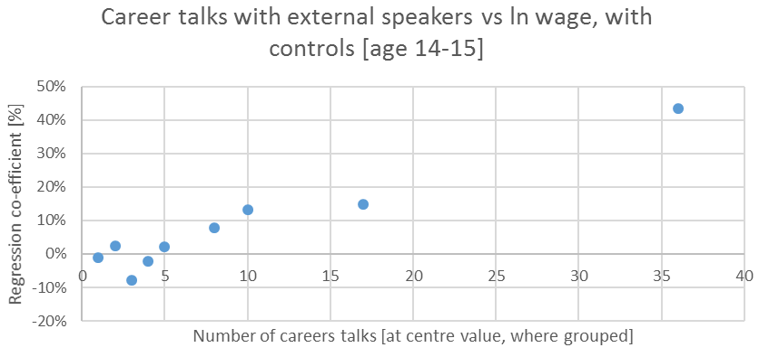
Translating to economic productivity gains
A talk once a fortnight or once a month in secondary school supports 10%-20% higher earnings a decade later
Analysis based on N=826 British adults in full-time employment aged ~26 in 1996, considering the number of careers talks with outside speakers experienced aged in the mid-1980s. A wide range of controls for academic attainment, demographics, local labour market conditions and socio-economic background are included. Less effect in exam years.

Slide 14
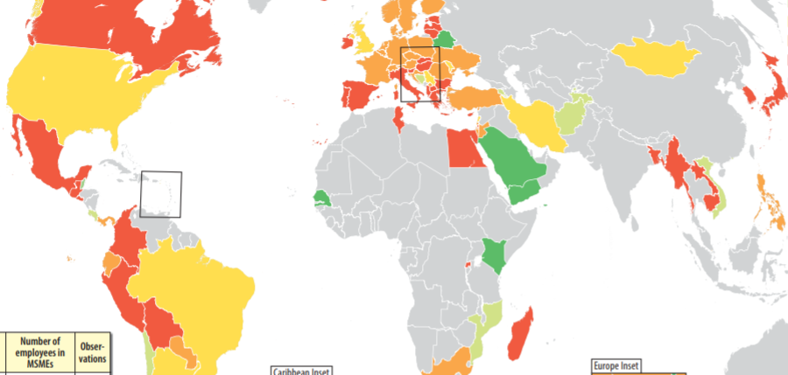
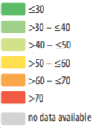
Micro and SME as % of all employment [IFC, 2014]
Key for the major parts of the economy that are hard to influence centrally, e.g. SMEs

Slide 15
Possible Discussion Questions
General: Do young people tend to make good decisions about their future in your country? When they make better decisions, what helps them do so?
Thought 1: What is the right balance between education/training investment prior to entering full-time work and afterwards?
Thought 2: How can education promote skills and attitudes as well as knowledge transfer?
Thought 3: How can you increase the connections between young people and employers in your education system?

Slide 16
Thank you and stay in touch
Working together for young people
www.educationandemployers.org/research-main
@Edu_Employers
katy.hampshire@educationandemployers.org

Slide 17
Sources
Belfield, Crawford and Sibieta. (2018). Long-run comparisons of spending per pupil across different stages of education. London: Institute for Fiscal Studies
Gloster et al from Institute for Employment Studies. (2016). Mapping investment in adult skills: Which individuals, in what learning and with what returns? London: Department for Business, Innovation and Skills
Kashefpakdel, E.T. and Percy, C. (2017). Career education that works: an economic analysis using the British Cohort Study. Journal of Education and Work. Volume 30: 3, 217-234.
Mann, A., Massey, D., Glover, P., Kashefpakdel, E.T., and Dawkins, J. (2013) Nothing in Common: The career aspirations of young Britons mapped against projected labour market demand (2010-2020)
Mann, Kashefpakdel, Rehill and Huddleston. 2017. Contemporary transitions: Young Britons reflect on life after secondary school and college. London: Education and Employers
MSME data from IFC (2014): https://www.smefinanceforum.org/data-sites/msme-country-indicators
Time-related underemployment data from ILO (2017) (aged 15-64; both male and female): https://www.ilo.org/ilostat/faces/oracle/webcenter/portalapp/pagehierarchy/Page3.jspx?MBI_ID=18
Bob Jagendorf credit for US rust belt photo; Labour Party Photograph Library for UK coal strike 1984
Various news articles and reports drawn on throughout; contact the authors for full details.

