Slide 1

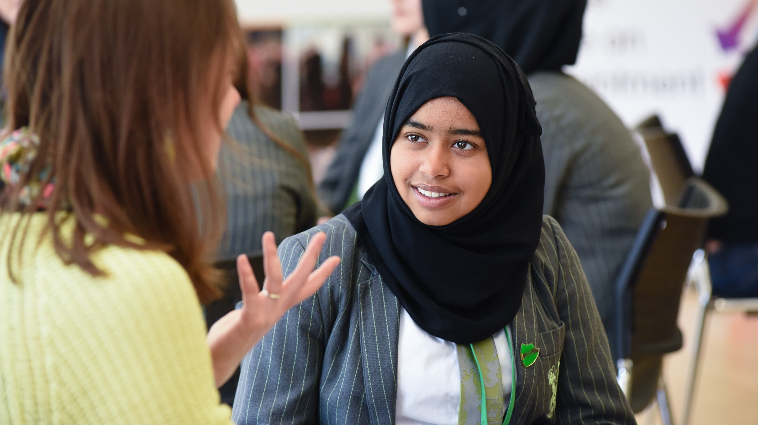

September 2023
brand
toolkit
A guide to getting the most out of brand communications

Slide 2

contents
brand toolkit /September 2023
index
The idea behind the toolkit is to aid use of the brand and its ‘assets’ (logos, typeface, colours etc) to present a strong, consistent brand to our audiences.
And to connect better with them too.
About us 3-6
who we are, what we do, mission, values, key facts
Logos 6-9
Images 12-13
Colour palette 14-15
Typeface 16
Contact 17

Slide 3



who we are /what we do
brand toolkit /September 2023
who we are
what we do
We are an educational charity established in 2009 which enables employers and schools to connect directly so that:
Every young person has the chance to meet people from the world of work who can inspire and motivate, helping them realise their full potential
Employers can engage with their communities both locally and nationally and it is really easy for staff to volunteer in different ways in schools and with young people
Our programmes
A state-of-the-art online matchmaking platform connecting schools and employers across the UK quickly and easily to inspire young people in future careers.
Using the Inspiring the Future platform we connect primary schools and employers to engage and inspire children and challenge ingrained stereotypes.
A video library for schools, parents and young people featuring over 1000 people talking about their careers, with over 1 million views per year.

Slide 4
our mission
brand toolkit /September 2023
our
mission
As a charity, we want to ensure that every young person in our country, wherever they live, whatever their parents or carers’ circumstances, has the opportunity to meet a diverse range of volunteers to hear first-hand about jobs and the world of work
Over the past 14 years our work has had the following impact
Reduced the likelihood of young people becoming NEET (4 or more encounters with employers)
Improved academic attainment and increases young people’s future earning potential
Excited children about subjects, increasing their motivation, confidence, and attitude to learning
Broadened young peoples’ horizons and raises their future aspirations
Challenged gender, race, and social stereotypes – breaking down barriers to certain job role

Slide 5
our values
brand toolkit /September 2023
our
values
As a charity, we are committed to embodying our values in our work with schools, volunteers, employers and staff. We strive to be inspiring, inclusive, innovative and impactful, and to act with integrity in all that we do
Inspiring:
This value stands for what our charity is about, linking the world of work with education, to inspire children from all backgrounds to seek the very best future possible. We will encourage and support our energetic staff, empowering them to do a great job
Inclusive:
We will work collaboratively with employer, volunteer and education partners to champion equality, offering inclusive solutions that meet the diverse needs of all children, particularly those from disadvantaged backgrounds
Innovative:
We will undertake and share our pioneering research, using our Innovative technology to offer creative solutions for the times. We will look to form new partnerships in the interests of children, do things differently and have a ‘can do’ attitude
Impactful:
We will seek to ensure that everything we do makes a real difference on children’s lives. We will ensure we draw on the diversity and talents of all our staff to do this, encouraging and challenging each other to improve ourselves as colleagues and to deliver a better service
Integrity:
We will work with integrity to achieve our aims. This final value underpins all our other values. In everything we do we will be respectful, open, and honest. We will operate with a strong ethical foundation and build trust with stakeholders and between colleagues and the world of work

Slide 6





our logos
brand toolkit /September 2023
our logos
1

Slide 7

our logos
brand toolkit /September 2023
our logos
A selection to allow for maximum flexibility
This is the main /master logo (black lettering on top of blue lettering)
As shown - it is also available with grey or white lettering on top where it might sit on darker images where the master logo is too recessive
Or as an all white version
There is also a mono /black and grey version should there ever be a call for one colour printed items
You should decide what looks best against the image or background you are using
But wherever possible please try to use a version with blue lettering on the base line (the word employers)
2

Slide 8

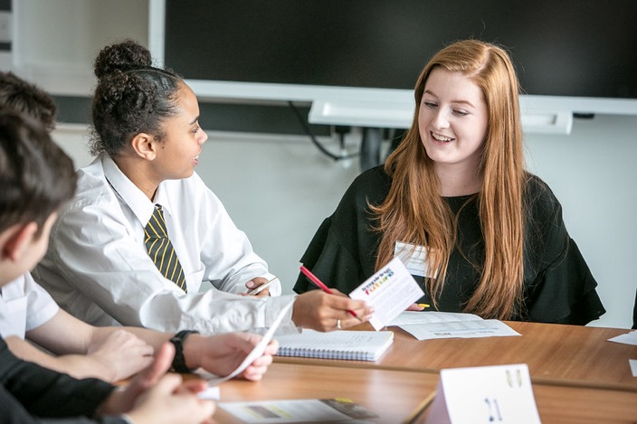




our logos
brand toolkit /September 2023
our logos
3

Slide 9






our logos
brand toolkit /September 2023
our logos
Master logos for our programmes
Versions to sit on darker backgrounds
4

Slide 10


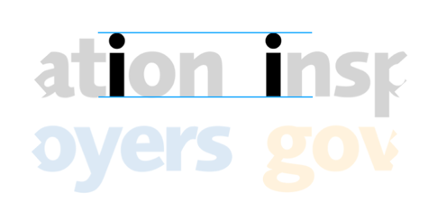

using our logos
brand toolkit /September 2023
using our logos
Each individual logo is ranged left (words sit on top of each other and are stacked to the left)
primary futures doesn’t quite fully range left due to the descender on the ‘p’
When using two or more together they can range left /stack on top of each other but leave room for them to breathe — or they can sit in a line
The rule when using them together is the ‘i’ in each of the names should be the same size height - even though that means some are longer (IG) or shorter (icould)
Please do not adjust the sizing to match on width
1

Slide 11



using our logos
brand toolkit /September 2023
Side by side
A vertical thin rule /line sits equally between the two logos with the master brand logo on the right hand side
using our logos
Education and Employers is in effect the master brand and the programmes are sub-brands
This shows how two of our logos can be ‘locked up’ together or one of our logos with a partners’ logo
There is no emphasising size between the master brand and any sub-brand or partner logo, they are intended to be the same size
(remembering the ‘i’ rule from earlier on in this section when it comes to our logos)
Stacked
A horizontal thin rule /line sits equally between the two logos with the master brand logo on top - centre the logos over each other
Range the logos and line ‘left’
blue line indicating this
2
Stacked /partner logo
Centre the two logos over each other - rather than ranging left as in our own logos

Slide 12
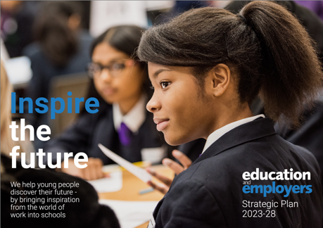
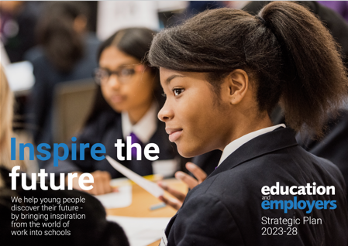
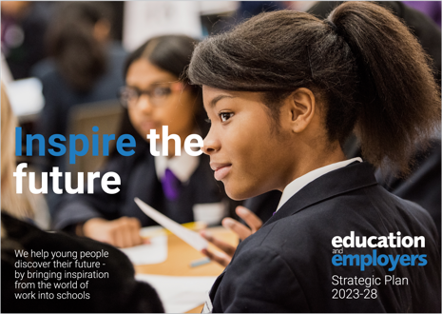
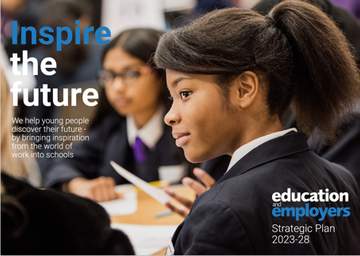
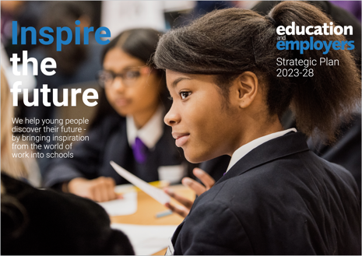
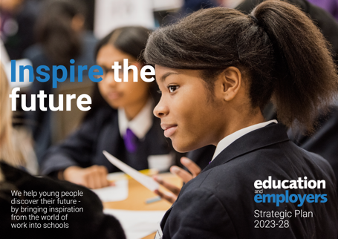
image with copy
brand toolkit /September 2023
The final front cover of the Strategic Report
A two line headline placed here would have worked ok
image
with copy
A two line headline placed here wouldn’t work as it starts to encroach on the main subject /focus
There are some legibility issues coming into play here (the ’t’ of the, the ‘f’ of future) but it feels unbalanced with the main subject /focus
The master logo and report name in the top right detract too much /cover up too much of our main subject
A headline here encroaches too much on the main subject but also takes some focus away from the out of focus /secondary subject - who adds to the overall ‘story’

Slide 13
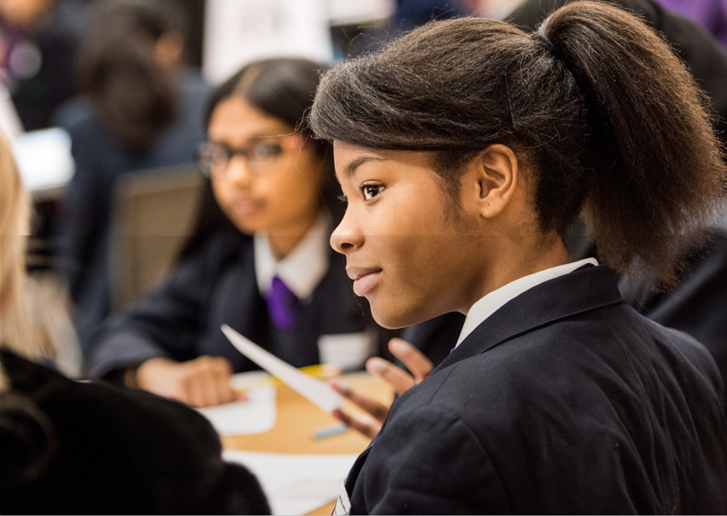

image density
brand toolkit /September 2023
image
density
Sometimes - to help a headline stand out a little better it is worth considering placing a ‘dark screen’ over the image - something that doesn’t detract or distort the image but help legibility
In fact the front cover image on the Strategic Report has a slight dark screen on it - you’ll see the horizontal line half way down the image here
The ‘dark screen’ is easily achieved in Powerpoint - it starts with a 100% black shape and then reducing the opacity to achieve the result you need before it is laid over the image
Top half / original image without screen
Bottom half / with screen
The top half shows the original image before the screen was applied
Here the opacity was 12%

Slide 14
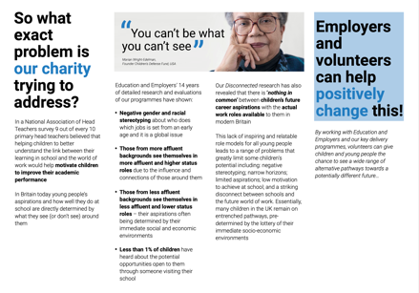
colour palette
brand toolkit /September 2023
colour
palette
primary
supporting /tints
rgb
31 /124 /192
cmyk
78% /40% /1% /1%
hex
#1F7CC0
Pantone /PMS
7689c or medium blue C
These are the main logo colour specifications
Tints can be used to highlight (as a panel) /add variety to a lot of content - as seen here in the Strategic Report
1
75% 50% 25%
RGB
(screen)
CMYK
(4 colour print)
HEX
(web)
Pantone /PMS
(print)
n.b. on PMS matches they will be close but not exact
type of paper, finish will also effect final colour
solid 100% black
rgb
213 /213 /213
cmyk
14% /10% 8% /0%
hex
#D5D5D5
Pantone /PMS
Cool Grey 3U

Slide 15
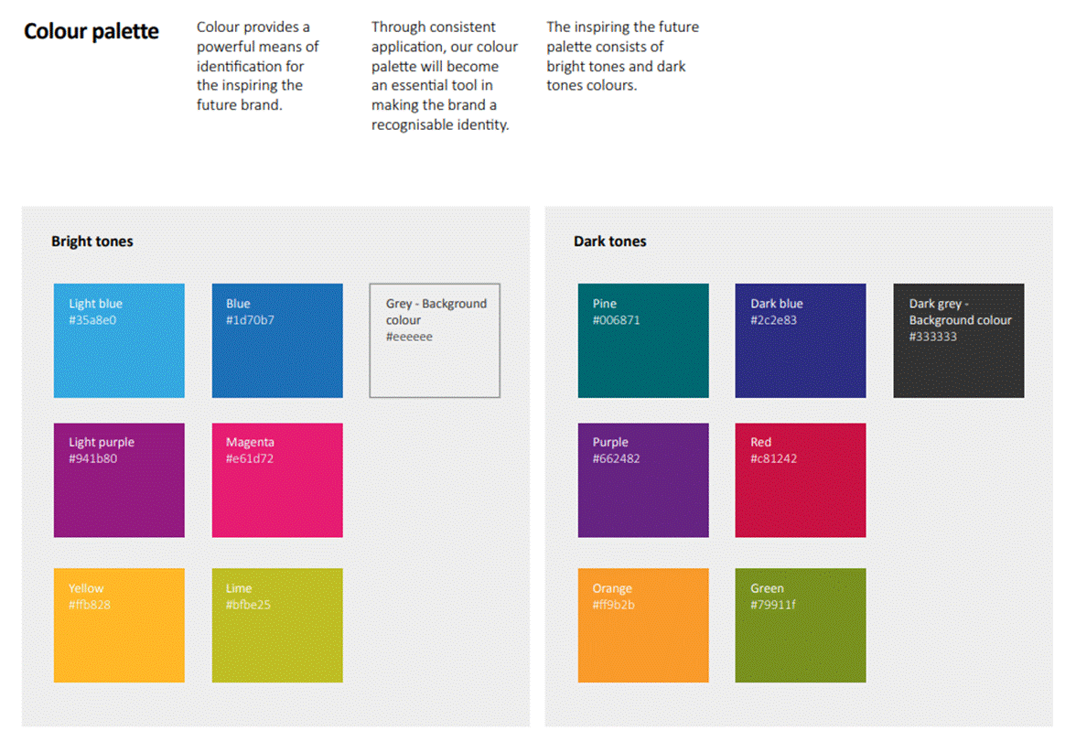
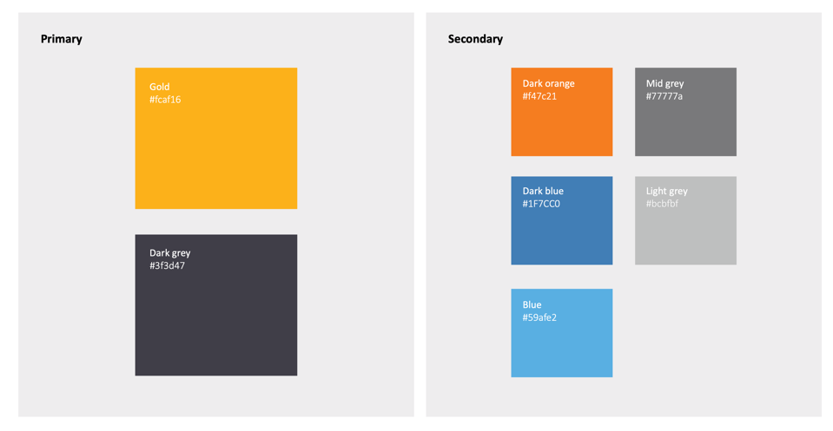
colour palette
brand toolkit /September 2023
Inspiring The Future
colour
palette
Design firm BELL carried out work for us back in 2017
these are the colours (hex code) they specified for our programme brands
(the logos have been updated since - but the colour palette remains the same)
Inspiring Governance

Slide 16
typeface
brand toolkit /September 2023
type
face
We use ROBOTO as our headline and body copy typeface
BOLD for headlines
LIGHT for body copy
However, bold can be used in body copy to accentuate a key fact
Or in some cases italics could be used to accentuate a key fact
Roboto does come in a variety of other weights, REGULAR, MEDIUM, THIN and BLACK - but please keep to BOLD and LIGHT
Line spacing and cap height should be determined by the amount of copy you are using /space available - this paragraph is set in 28pt type size to 0.9pt spacing
This paragraph is set to 1.0 line spacing giving a little more air between the lines
Character spacing here is set to 0%
Try not to mix type size or other spacing across any individual piece - consistency is key
Headlines tend to be written in lower case - to mirror the main logo, but that isn’t a hard and fast rule
As previously seen in the colour palette section, colour can be used to highlight parts of the headline too
This paragraph uses Calibri Regular, perfect for web based work - a ‘safe face’ to use
Also available in Bold to highlight a key point or fact
Or italicised

Slide 17
contact
brand toolkit /September 2023
reach
out
If you need any help - or have an idea on how to make this toolkit more helpful, please contact
Adeline Bibby
Marketing and Communications
Adeline.bibby@educationandemployers.org
Quantum House
22-24 Red Lion Court
Fleet Street
London EC4A 3EB
+44 (0)
A registered charity No: 1130760
A company limited by guarantee No: 6886359

